Slide 2
Alpha Beta Chapter of Sigma Sigma Phi
Alabama College of Osteopathic Medicine
2020

Slide 3
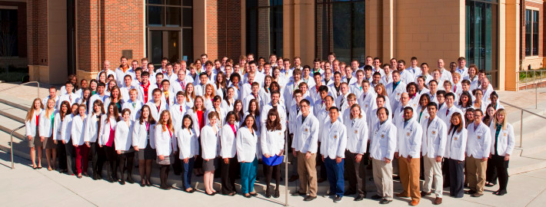
Alabama College of Osteopathic Medicine
ACOM’s Grand opening was on July 29, 2013.
ACOM’s inaugural class began classes on August 5, 2013, and graduated on May 13, 2017.
InSPIRED: Integrity | Service | Passion | Innovation | Respect | Excellence | Diversity
Notes:
We are a relatively new school.
This year marks the school’s 7th class of students. We just graduated our inaugural class in May of 2017.
Our core values include: Integrity, Service, Passion, Innovation, Respect, Excellence, and Diversity

Slide 4
ALPHA BETA CHAPTER REQUIREMENTS
Students must meet:
A minimum of a 3.5 grade point average over the first three semesters at ACOM
At least 20 hours of acceptable service work over the first three semesters at ACOM
Individuals who embody the honor code and mission statement of ACOM

Slide 5
Membership
Students of the class of 2017
Inaugural class
Induction date: July 7th, 2015
Members: 20 students
All members were 3rd year medical students
Students of the class of 2018
Induction date: January 29th, 2016
Members: 26 students
All members were 2nd year medical students
Students of the class of 2019
Induction date: March 18th, 2017
Members: 28 students
All members were 2nd year medical students
Students of the class of 2020
Induction date: January 20th, 2018
Members: 21 students
All members were 2nd year medical students
Students of the class of 2021
Induction date: January 19th, 2019
Members: 32
All members were 2nd year medical students
Students of the class of 2022
Induction date: January 10th, 2020
Members: 29
All members were 2nd year medical students

Slide 6
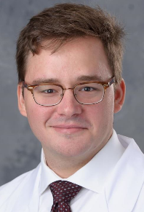
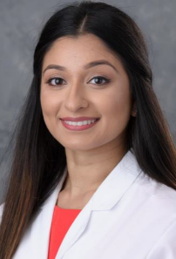
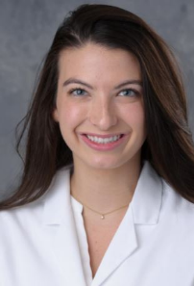
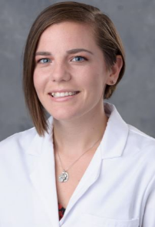
2020-2021 Officers
Elected April of 2020
Zac Mazurek
President
Tuba Mirza
Vice President
Brittanee West
Secretary/Treasurer
Sarah Hicks
Director of Events

Slide 7
Chapter Involvement
Informational session at Osteogenesis 9/7/20
Surveyed SSP members on useful board resources
Completing a “lecture series” on COMLEX 1/Step 1 board prep with the professors from ACOM
First session was 8/16/19

Slide 8
Future Plans
Continue Board Lecture Series
Continue to offer one on one board prep sessions with students
Sigma Sigma Phi Student Survival Guide on Preceptors and Core sites
What preceptors like and don’t like
Pros and cons of the site
Electives available
Things to do in the city
Rotation Core Site volunteer opportunities and useful contacts
School supply drive
Scrub drive
Notes:
.

Slide 9
Our Mission Looking Forward
Continue our commitment to service throughout the community
Help students achieve scholastic excellence through mentorship and lectures
Support the growth and awareness of the Osteopathic Medical Practice
Support events and fundraisers associated with the clubs and organization at ACOM
Establish the Alpha Beta chapter on a local and national level

Slide 10
Thank You

