Slide 1
Sigma Sigma Phi Alpha Psi Chapter

Slide 2
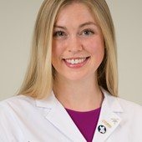
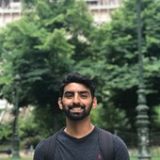
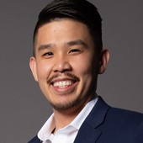
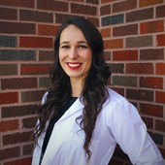
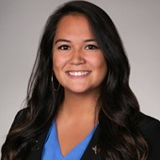
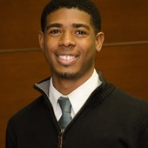
Officers:
Jennifer Gaertner-Otto
President
Rahim Methani
President
Charlie Thai
President Elect
Ashley Lopez
Executive Director
Sioned Kirkpatrick
Secretary
Tevon Hood
Treasurer

Slide 3
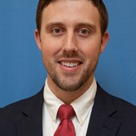
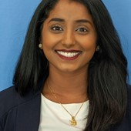
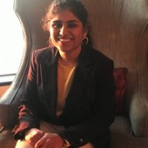
Committee Chairs:
Abeer Chohan
Chair of the Community Service Committee
John Hermann
Chair of the Fundraising Committee
Manojna Kintada
Chair of the Awards Committee
Richa Nathaniel
Chair of the Social Committee

Slide 4
Board of Directors:
Dr. Adam V. Ratner, MD, FACR
Dr. Carol Browne, DO
Dr. Iris Sadowsky, DO, MS
Dr. Marissa Zajac, DO – Faculty Advisor
Dr. Robyn Phillips-Madson, DO, MPH, FACOFP

Slide 5
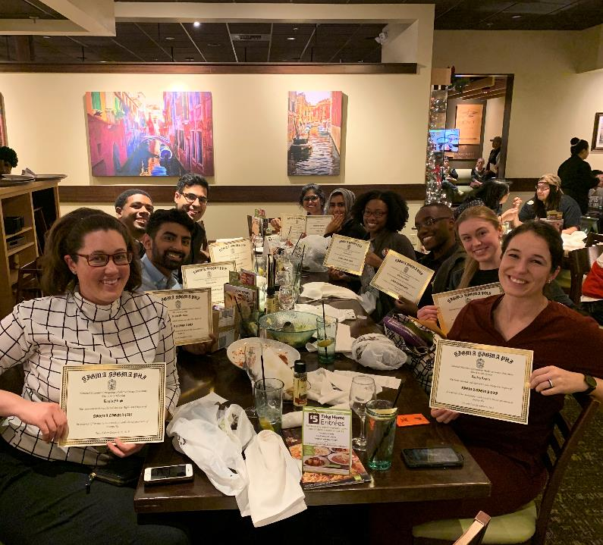
Chapter Meetings
November 1, 2019: 1st general meeting/Induction
Introduction of Alpha Psi Chapter Officer Candidates
Review of SSP mission
Goals for the year
December 6, 2019: Induction Dinner/2nd General Meeting
February 7, 20020: 3rd general meeting
Edits to chapter bylaws proposed and set for vote
Discuss future chapter events
April 17, 2020: 4th General Meeting
Canceled due to COVID-19

Slide 6
Chapter Involvement
Incoming UIWSOM’s OMS-1 Orientation
Holiday Book Drive
Partnered with SA reads and Barnes and Noble for book drive to disadvantaged children around Bexar County
Planned but cancelled due to Covid-19
Hygiene Drive
Food Bank Event
Halfway house adolescences mentoring

Slide 7
Thank You!

