Slide 1
Sigma Sigma Phi Beta Chi Chapter Burrell College of Osteopathic Medicine Las Cruces, NM

Slide 2
Membership Requirements (amended for COVID-19)
Maintain academic standing in top 2 quartiles of the class
No grade below 70% in any course
Participate in 20 (10) hours of community service each academic school year
Organize and host one community service event within first year of membership (suspended requirement)
Membership cannot exceed 25% of student body

Slide 3
Current Officers
Dr. Scott Cyrus - Faculty Advisor
Juliana Young – President
Arianna Dalgleish– Vice President
Janel Harach – Community Service Coordinator
Alondra Sierra – Secretary
Jimmy To - Treasurer

Slide 4
Rush Fall 2020
Designed for the Class of 2024
Aids in selection process and allows students to get to know each other
Upcoming events:
At-home scavenger hunt social

Slide 5
Community Partnerships
City of Las Cruces
Safe Haven Animal Sanctuary
Animal Services of the Mesilla Valley
El Caldito Soup Kitchen
Mesilla Valley Habitat for Humanity
La Casa Inc.

Slide 6
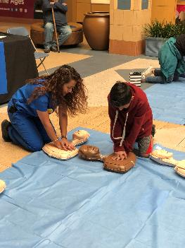
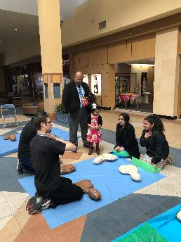
Texas Two Step
Teaching the Community how to do CPR

Slide 7
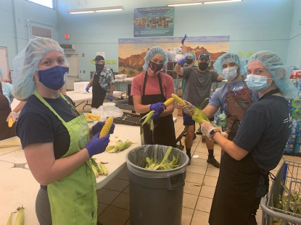
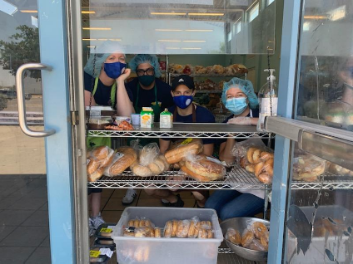
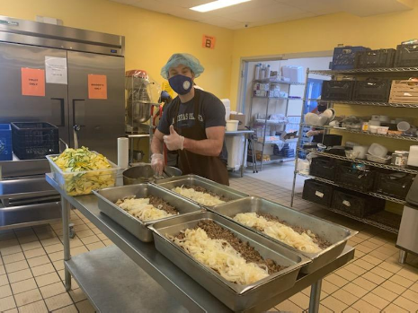
El Caldito Soup Kitchen Preparing and distributing meals

Slide 8
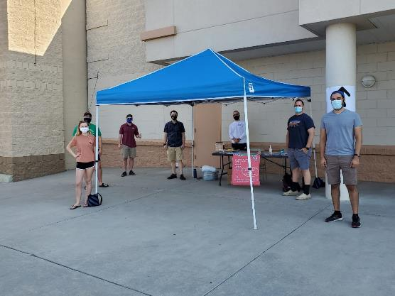
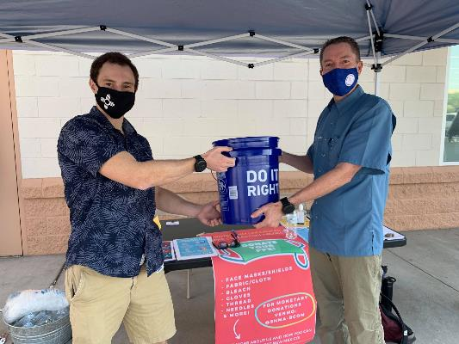
ProtectNM Donation Drive Collecting PPE and monetary donations for distribution to underserved communities

