Slide 1
Midwestern University Chicago College of Osteopathic Medicine
Annie DeVinney
Chapter President, 2020-2021

Slide 2
What is ΣΣΦ
Honorary Osteopathic Service Fraternity
National Objectives:
Further the science of Osteopathic Medicine and its standards of practice
Improve the scholastic standing and promote a higher degree of fellowship among its students
Foster allegiance to the AOA
Epsilon Corollary:
Demonstrate a sincere commitment to serving communities in Chicago as well as within CCOM

Slide 3
Executive Board 2018-2019
President – Annie DeVinney
Vice President – Alexis Borrelli
Treasurer – Amir Siddiqui
Secretary – Jennifer Sheuy

Slide 4
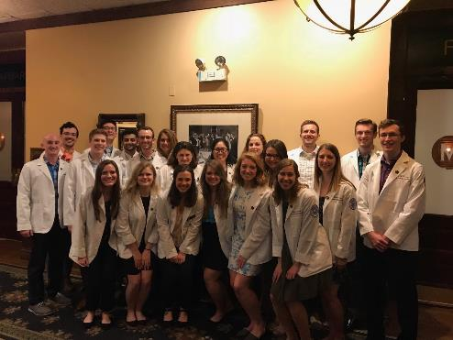
Membership
68 active members
43 OMS-IV
18 OMS-III
8 OMS-II
Faculty Advisors.
Dr. Perry Marshall, D.O.

Slide 5
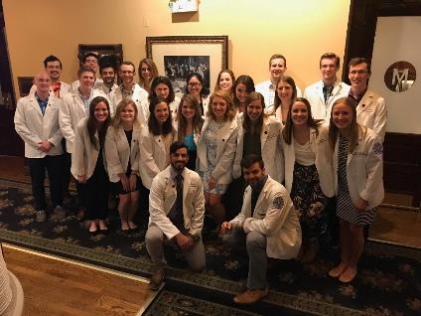
Fall Membership Drive
Began August 13, 2020 with introductory meeting
Written application
Blinded review
Grade check
Interview
Conducted by 2-3 current members who are not classmates
Applications reviewed by selection committee
Criteria for admission
Scholastics (GPA > 3.30)
Community Service
Interest in SSP
Demonstrated leadership

Slide 6
Finances
Current Student Accounts Balance:
$1,859 as of September 8, 2020

Slide 7
Fundraisers
CCOM sweatshirt, t-shirt sales- planning for winter quarter

Slide 8
Projects
Speed rotating event for MS2 students
Student informational panel for MS1 students
Boards study strategy panel for MS2 students
Directory of service opportunities for members
District 99 School Supply Drive

Slide 9
Rotation Speed Dating
Annual event each winter
Third and fourth year students return to campus to share their rotation experiences
Small group format facilitates discussion
Members learn about specialties from peers

Slide 10
Student Informational Panel
Several second year members answer questions from rising second year students
Members offer advice on how to handle the course load as well as how to prepare most efficiently for boards

Slide 11
Boards Study Strategy Panel
Third year members answer questions from second year students and offer suggestions for how to best prepare for boards
Topics include
When to start studying
How much time should be allocated
Most beneficial resources

Slide 12
Service Directory
List of service opportunities and contacts around CCOM and in Chicago
Organized by community served
List will be made available to all members of Epsilon Chapter by the end of this academic year
All members of Epsilon Chapter will be able to edit and maintain the list for future members

Slide 13
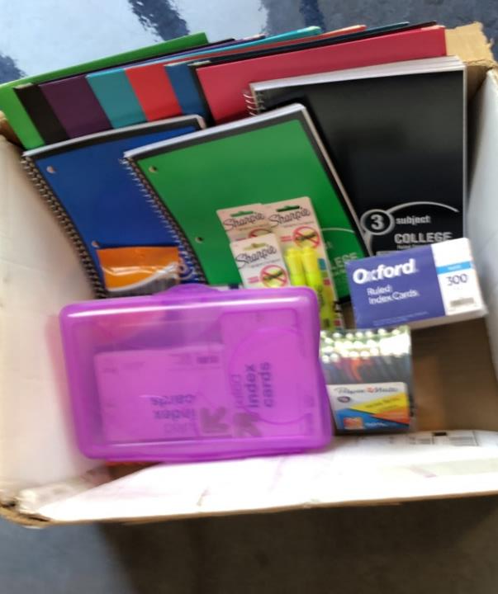
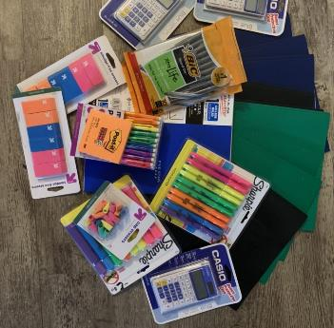
District 99 School Supply Drive
Host a drive for school supplies for a local, underserved school district
Supply drive with simultaneous donation collection to purchase more supplies
Unique service opportunity in light of the COVID-19 Pandemic

Slide 14
Goals
Spread awareness of Sigma Sigma Phi on campus and establish a concrete understanding of the society
Establish an annual Member’s social to increase communication and encourage stronger collaboration in future decision making of Epsilon Chapter
Create a resource for Epsilon Chapter members outlining different service opportunities in the area

Slide 15
Questions
Chapter President, Annie DeVinney
adevinney29@midwestern.edu

