Slide 1
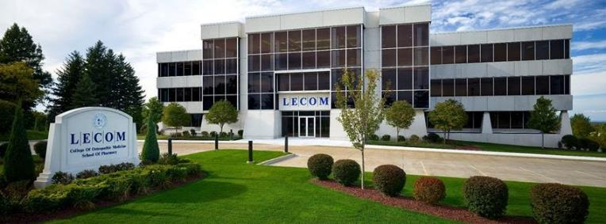
GAMMA CHAPTER OF SIGMA SIGMA PHI

Slide 2
LAKE ERIE COLLEGE OF OSTEOPATHIC MEDICINE
LECOM was established as the 16th college of Osteopathic medicine in December 1992.
The Charter Class Began on August 9, 1993 in Erie, Pennsylvania
LECOM has granted the Doctor of Osteopathic Medicine degree to almost 5,982 graduates as of 2016.

Slide 3
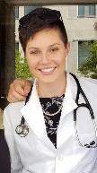
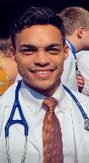
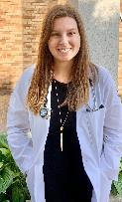
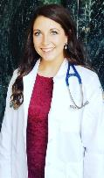
GAMMA CHAPTER EXECUTIVE BOARD
PRESIDENT: Alyson Burchell
VICE PRESIDENT: Joshua Bates
TREASURER: Lindsay Smykowski
SECRETARY: Lindsey Schwanke

Slide 4
GAMMA CHAPTER MISSION STATEMENT
“As an organization founded on scholastic achievement, service, and medicine, we can best serve our community by mentoring the health-underserved populations of Erie, both academically and socially “

Slide 5
GAMMA CHAPTER GOALS
Positively impact the community at large through health-oriented community service projects and outreach programs
Strengthen the presence and awareness of Osteopathy in the local community
Promote fellowship amongst the student body and to continue the scholastic excellence of its members and its colleagues

Slide 6
GAMMA CHAPTER REQUIREMENTS
In order to apply all prospective members must complete the following requirements must:
Demonstrate involvement in school clubs and community service activities
Complete at least 5 community Service hours in the semester prior to the application cycle
Have at least a 3.0 cumulative GPA
In order to maintain active membership status members must:
Maintain a minimum 3.0 cumulative GPA
Participate in 20 community service hours per semester

Slide 7
CURRENT GAMMA CHAPTER MEMBER STATISTICS
Class of 2021 → 47 members
Class of 2022 → 38 members
Class of 2023 → 25 members
Class of 2024 → induction in Spring 2021
Gamma Chapter Total:
110 Total Current Members

Slide 8
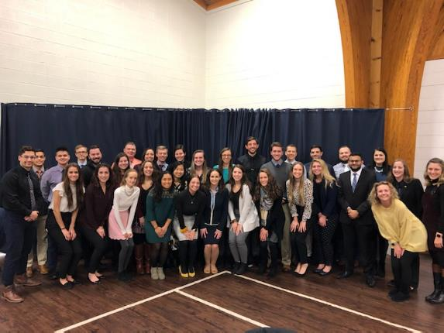
INDUCTION CEREMONY SPRING 2020

Slide 9
GAMMA CHAPTER SERVICE ACTIVITIES

Slide 10
VIRTUAL STUDENT PANEL AND ROTATION REVIEWS
Chapter members serve as ambassadors for LECOM by participating in a virtual student panel for prospective students after their virtual interviews.
Members answer questions related to LECOM, the Erie community and Medical School in general.
3rd and 4th year members maintain a database containing reviews of various rotation sites which are made available to the 2nd year class to aid in their rotation selections.

Slide 11
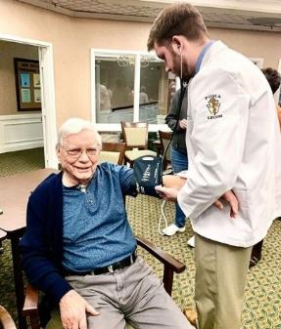
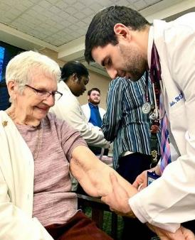
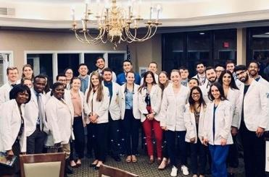
Script Your Future Collaboration
SSP joined the Pharmacy students and provided senior living residents with tips on flu prevention, medication adherence, stress management and did blood pressure screenings.

Slide 12
MS3 and 4 Students Mentoring MS2 Students for Board Preparation
Our MS3 and MS4 students give board prep advice virtually; through zoom, facetime, email and phone to MS2 students. We wanted to make sure that the MS2’s still had a chance to interact with the MS3’s and 4’s in regards to board prep even though they would not being seeing each other in person.

Slide 13
SAFE KIDS ERIE
Safe Kids Erie is a program that is led by LECOM. Member go to schools around Erie and to sponsored events to spread the message of Safe Kids Erie and safety tips.
The mission state of the program states “...Provides dedicated and caring staff, operation support and other resources to assist in achieving our common goal: keeping your kids safe. Based on the needs of the community the coalition implements evidence-based programs, such as car-seat checkups, safety workshops and sports clinics, the help parents and caregivers prevent childhood injury.”

Slide 14
FINAL THOUGHTS
The Gamma Chapter would like to thank the National Grand Chapter for all of its support. We look forward to continuing the fantastic work that our chapter does and to continue our mission of furthering Osteopathic Principles and Values in the communities where we live and serve.

Slide 15
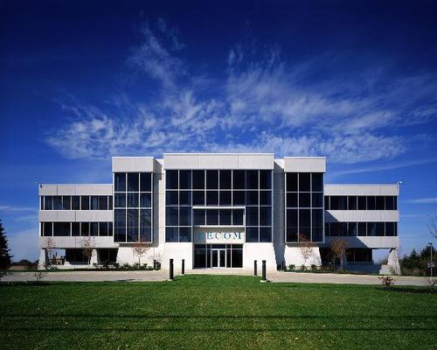
THANK YOU

