Slide 1
Sigma Sigma Phi- Gamma Chapter
NATIONAL HONORARY OSTEOPATHIC SERVICE FRATERNITY
2020

Slide 2
MISSION
Further the philosophy, art, and science of osteopathy and its standards of practice
Improve student’s scholastic standing and promote a higher degree of fellowship among its students
To bring about a closer functional relationship and understanding between student bodies and the officials and members of the faculties of our colleges
To further the welfare of the osteopathic profession, its colleges and other institutions
Foster allegiance to the AOA and to perpetuate high professional standards through the maintenance and development of this organization.

Slide 3
Who we are
LECOM at Seton Hill was establish in 2009
36 students from OMS II-OMS IV belong to the LECOM Seton Hill gamma chapter

Slide 4
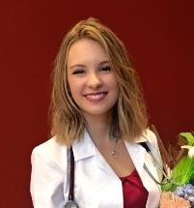
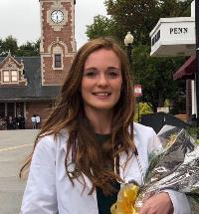
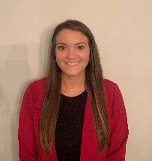
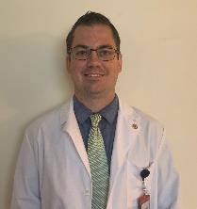
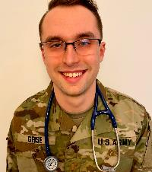
Class of 2023 Eboard
President: Cora Blodgett
Vice President: Emily Converse
Treasurer: Michaela LeDonne
Secretary : Brad Rickabaugh
Historian: Stone Giese

Slide 5
Membership Requirements
Limited to 25% of the student body
Must maintain a 3.0 GPA
OMS I & OMS II
Complete 12 hours of community service each semester
5 hours from SSP events and 5 from non-SSP events
2 additional hours from either category
OMSIII & OMSIV Years
12 hours of any community service per year
COVID19 Policy:
In order to promote public health measures and ensure the safety of our members, we did not require mandatory non-SSP event hours for the Spring or Fall semesters of 2020. We did require participation in at least 1 virtual SSP-sponsored serve event per semester.

Slide 6
What is an SSP event?
Anything that is established as an SSP event by the E board
Must better LECOM and/or the community
If the event is co-sponsored with another club you have the option to record it as either SSP or non-SSP

Slide 7
Inductions
Inductions take place each semester
OMSI application invitations are sent out to everyone meeting our requirements in January and induction occurs in March
OMS2 applications are sent out in August

Slide 8
Spring 2020- Incoming Student Advice Panel
Sponsored by the LECOM admissions team
Members served on a question and answer panel over Zoom for the incoming LECOM Class of 2024 to provide guidance and foster community between LECOM cohorts

Slide 9
Fall 2019 Event- Virtual Game Night for Charity
Hosting a “virtual game night” over Zoom for LECOM students by using online gaming platforms such as Jackbox games
Attendance fee is donated to local organization known as Angel Arms, which provides support services for infants with neonatal abstinence syndrome and their families.

Slide 10
Ongoing Virtual Service Projects for Fall 2020
In light of the COVID19 epidemic, SSP Gamma Chapter will be waiving its normal service requirements until further notice. Instead, members will be required to participate in at least 1 of the following independent virtual service project that will be ongoing for the entirety of the fall semester:
Pen pal with a senior citizen at Paramount Senior Living Community
Utilization of the Charity Miles App to raise money for a charity of choice
Mailing cards and letters of encouragement to hospitalized patients via organizations such as Phil’s Friends, Cards for Hospitalized Kids, Card Care Connection, or Love for the Elderly.

Slide 11
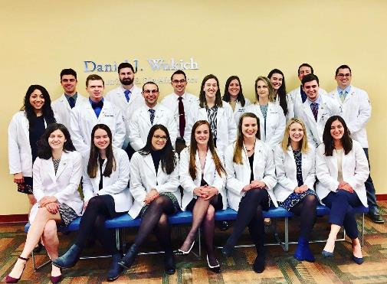
What does membership mean?
ACHEIVEMENT
Taking pride in the hard work you have done to be here, and promote further achievement in ourselves and others
COMMUNITY
Working as a team to promote fellowship within our osteopathic community
SERVICE
Endorsing compassion, empathy, and care for the local community by giving back to those we can!

