Slide 1
SIGMA SIGMA PHI: Lambda Chapter-Cleveland Satellite Annual Report Ohio University Heritage College of Osteopathic Medicine Presented by Danielle Stakes, OMS-II ΣΣΦ Cleveland Satellite-President September 2020

Slide 2
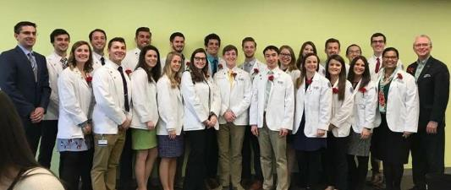
Outline
Membership
Lambda - Cleveland Executive Board
Activities:
Community Service
Academics
Awards

Slide 3
Members
Current Total at Cleveland Satellite: 24
Class of 2021: 12
Class of 2022: 10
Class of 2022: 2
Total OU-HCOM Members: 87
Class of 2021, Class of 2022, Class of 2023
3 Campuses: Athens, Cleveland, Dublin
OU-HCOM Cleveland / SSP Lambda-Cleveland graduated its first class of students in May 2019
Recruitment:
End of Fall term for Class of 2023 and 2024
Emphasis on community service and leadership

Slide 4
Cleveland Executive Board
Newly Chartered in August 2020!
President: Danielle Stakes, OMS-II
ds014714@ohio.edu
Secretary/Treasurer: Sydney Pence, OMS-II
sp883713@ohio.edu
Third Year Representative: Elsie Ikpot, OMS-III
ei149717@ohio.edu

Slide 5
Future Events
Project Linus Service Project – Fall 2020
New Member Application Cycle – December 2020-January 2021
New Member Induction Ceremony – Spring 2021

Slide 6
Community Service
Membership requirement:
1st/2nd years: 12 hrs/semester
3rd/4th years: 4 hrs/semester
*Project Linus*
Members welcome to volunteer in other events/activities

Slide 7
Project Linus
Make fleece tie-blankets to be delivered to sick children at local hospitals
Optional community service project that helps members obtain their Fall semester service requirement
Also services as an informational Q&A session for the Class of 2023 and 2024

Slide 8
Academics
Membership Requirements:
Class of 2023: Pass all semesters without remediation
Class of 2024: Pass all semesters without remediation
OU-HCOM on pass/fail system

Slide 9
Academic Initiatives
Scholar 12 program
Promoting research within the osteopathic community
Certificate program providing foundation in the scientific method
Review Sessions
Providing additional instruction for OMS-Is before exams
Lecture Series
Collaboration with other OU-HCOM organizations
Invite physicians to speak to students about being a physician
Student Panels
Panels of older students speaking about residencies and clinical rotations

Slide 10
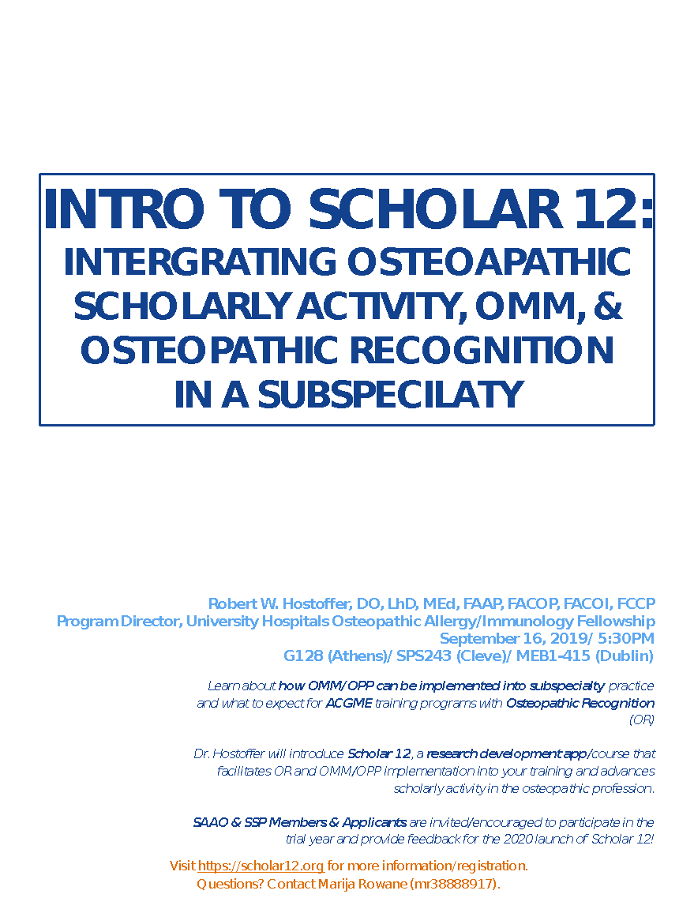

Slide 11
Distinguished Osteopathic Commitment (DOC) Awards
Organized with Student Government Association
Present awards for faculty, staff, and students
Recipients determined by student ballot
Osteopathic Mentor Award
Given to an Ohio Osteopathic Physician who, by his or her example and involvement, excels in mentorship and provides significant influence to students at OU-HCOM

Slide 12
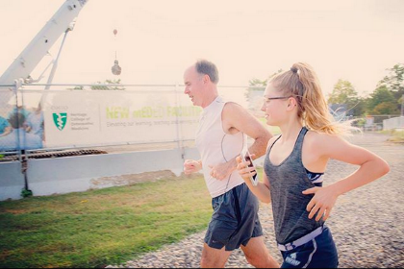
OU-HCOM Activities
Walk with the Dean
Students walk in the park with the Dean as a stress relief event
Therapy dogs, yoga, smoothie day
Initiatives from Student Affairs to promote health and wellness
Learning Community Tutors
Weekly virtualreview sessions for OMS-Is
OMM Honors TAs
Weekly virtual instruction on OMS-Is in OMM lab

Slide 13
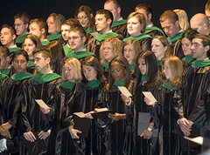
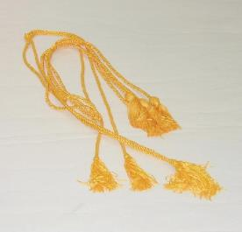
Honor Cords
Presented by second year class to Sigma Sigma Phi members of the graduating class.

Slide 14
Thank You!
Danielle Stakes, OMS-II
ds014714@ohio.edu

