Slide 1
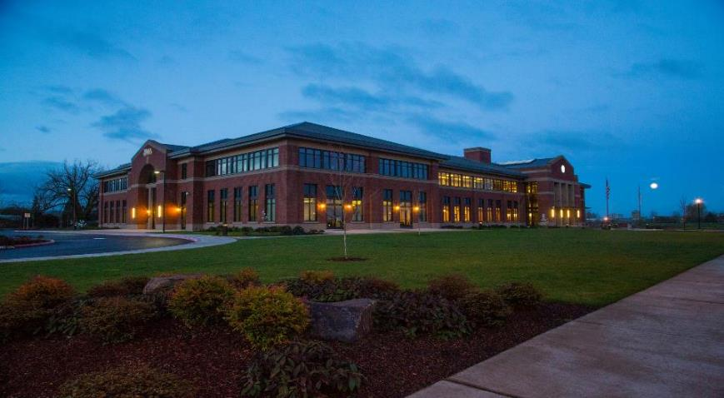
Sigma Sigma Phi – Mu Chapter
National Osteopathic Honors Society
Western University of Health Sciences
COMP – Northwest, Lebanon, OR
Notes:
This is the 2020 Mu Chapter Report

Slide 2
CURRENT LEADERSHIP (2020-2021)
SSP Officers:
President: Blake Dickenson, OMS II
Vice President: Jonathan Holland, OMS II
Treasurer: Kellie Gaura, OMS II
Secretary: Veronica Polyakova, OMS II
Service Coordinator: L.J. McKenzie, OMS II
SSP Faculty Advisor:
Dr. Robyn Dreibelbis, D.O.

Slide 3
CHAPTER GOALS
To further the Science of Osteopathic Medicine and its standards of Practice
To preserve the meaning of and encourage scholastic excellence and community service
To continue a high degree of fellowship among its students
To cultivate relationships and understanding between the student bodies and officials, such as Faculty members of our Colleges
To foster allegiance to the American Osteopathic Association
To perpetuate Sigma Sigma Phi by preserving the principles and objectives of the organization

Slide 4
MEMBERSHIP
Lebanon
2016: 13
2017: 26
2018: 26
2019: 23
2020: 26
2021: 27
2022: 20
2023: 9

Slide 5
APPLICATION REQUIREMENTS
According to the Sigma Sigma Phi Constitution of Mu Chapter:
Candidate must have completed at least one semester of school
Candidate must have a GPA above 3.0 (>85%) to be considered for membership
Membership is limited to 20% of the class
Notes:
NOTE:
National Chapter states 25% of class, but our chapter is a bit stricter

Slide 6
APPLICATION PROCESS
Application process takes place only during the fall semester on the final week before winter break
Students are notified via email outlining what Sigma Sigma Phi represents, the membership criteria, and the application process
SSP membership committee meets and decisions are made regarding admission/rejection to SSP based on preset criteria; this review process is “blinded” to the entire committee and is rubric-driven to make it as objective as possible
Notices of acceptance/rejection are sent out via individual email no later than 14 days after the application due date

Slide 7
INDUCTION CEREMONY
The Induction Ceremony is a formal event that typically occurs for all new SSP members during the spring semester of the academic year of becoming a member of SSP. This event has been postponed in 2020 until a safe return to campus policy has been established for a responsible response to COVID-19. A dual induction ceremony with 2023 and 2024 classes Spring 2021 is most likely at this time
Current members in good standing are also invited and encouraged to attend
All new members must pay a one-time, non-refundable membership fee of $100 prior to the date of the Induction Ceremony; this fee covers the cost of the Induction Ceremony as well as the national per-member fee

Slide 8
MEMBERSHIP REQUIREMENTS
Service hours:
All SSP members (1st, 2nd, 3rd, and 4th year students) are required to participate in 20 hours of community service activities per academic year with the exception for rising 4th years to submit 40 hours total prior to graduation for their upperclassmen years (3rd and 4th) to ease their hour requirement timeline in response to COVID-19
Members can record 15 “obligated” hours for events in which they are obligated to attend (e.g. being an officer of another club) and 5 “non-obligated” hours per academic year
Students granted membership in their 2nd year must participate in a total of 40 hours of service by the end of the academic year, with no more than 20 hours from the 1st year and no more than than 30 “obligated” hours

Slide 9
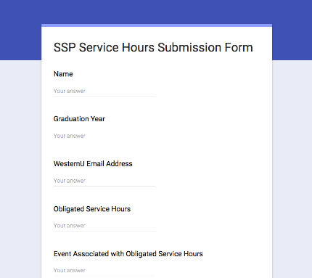
SERVICE HOUR LOGS
Service hour submission automated with Google forms
Service hours are submitted by SSP members and then approved by the secretary to be logged in the official spreadsheet
Hour log spreadsheet collates data into each class and whether they have met required amount of hours for membership

Slide 10
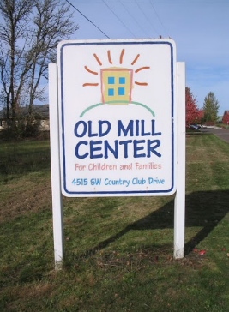
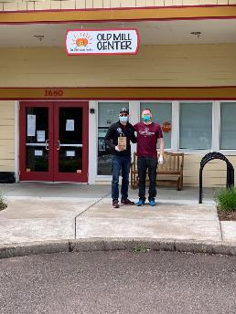
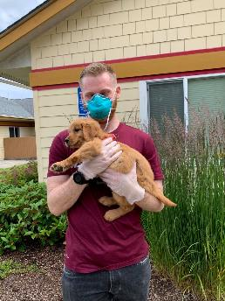
EVENTS and VOLUNTEERING
Old Mill Auction - Corvallis
Notes:
Old Mill Center for Children and Families is a full-service provider of preschool, mental health, early intervention and parent support for children from birth to 18 and their families.
Their services address the educational, social, emotional, and family needs of a diverse population of children.
Our SSP members help in the weeks leading up to the auction to prepare and set up for this major fundraising event.
We also have students that volunteer year round with the center

Slide 11
EVENTS and VOLUNTEERING
“BUGS and DRUGS” Lecture Series
Notes:
Board review series aimed at the 2nd year students runs from November-April.
This was started in 2014 as a joint effort between the Lebanon and Pomona SSP members.
PowerPoints were created and shared between the campuses and posted for everyone’s use.
The PowerPoints are updated and added to each year.
Presentations are done separately on each campus but often from the same PowerPoint.

Slide 12
EVENTS and VOLUNTEERING
“BUGS and DRUGS” Lecture Series
Notes:
Board review series aimed at the 2nd year students runs from November-April, run by 2nd year students
This was started in 2014 as a joint effort between the Lebanon and Pomona SSP members.
PowerPoints were created and shared between the campuses and posted for everyone’s use.
The PowerPoints are updated and added to each year.
Presentations are done separately on each campus but often from the same PowerPoint.

Slide 13
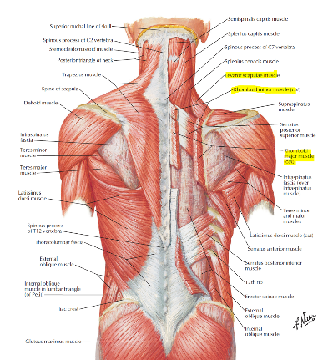
EVENTS and VOLUNTEERING
“ANATOMY BOARD REVIEW” Lecture Series
Notes:
Board review series aimed at both 1st and 2nd year students, runs throughout the year to coincide with the 1st year students’ curriculum
This was started in 2016 on the Lebanon campus by SSP members.
PowerPoints were created and shared between the campuses and posted for everyone’s use.
The PowerPoints are updated and added to each year.
Presentations are done separately on each campus but often from the same PowerPoint.

Slide 14
EXPULSION PROCESS
Active/honorary members may be expelled from SSP and have all rights revoked by the local chapter governing body if any of the following occur:
Failure to comply with rules as stated in the Constitution & By-laws of the fraternity
Conspiracy against another member
Conduct unbecoming of a physician or member
Violation of Code of Ethics of AOA
Failure (<70%) of ANY required course in the curriculum WITHOUT evidence against personal fault (i.e. death in the family, debilitating health crisis, etc.)

Slide 15
THANK YOU!
SSPclubLebanon@westernu.edu

