Slide 1
Mu Chapter Western University-College of Osteopathic Medicine of the Pacific Pomona, CA
Sigma sigma phi national meeting
2020

Slide 2
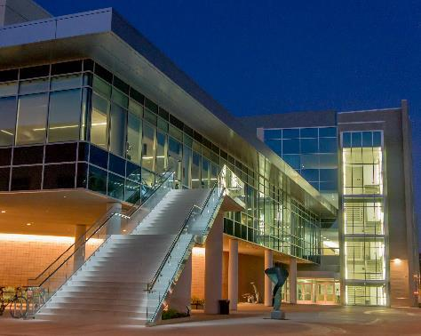
Western University of Health Sciences

Slide 3
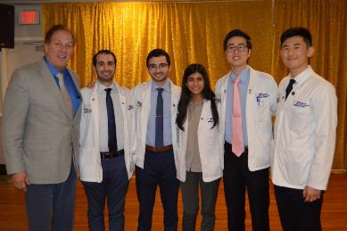
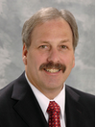
Current Officers and Faculty Advisors
President – William Whang
Vice President – Sangkyu (Steven) Noh
Treasurer – Saad Sidiq
Secretary – Bisma Khwaja
Service Coordinator- Zade Zahlan
Faculty Advisor:
Dr. David A. Connett, D.O., FACOFP
Administrative Assistant:
Roxanne Gonzalez

Slide 4
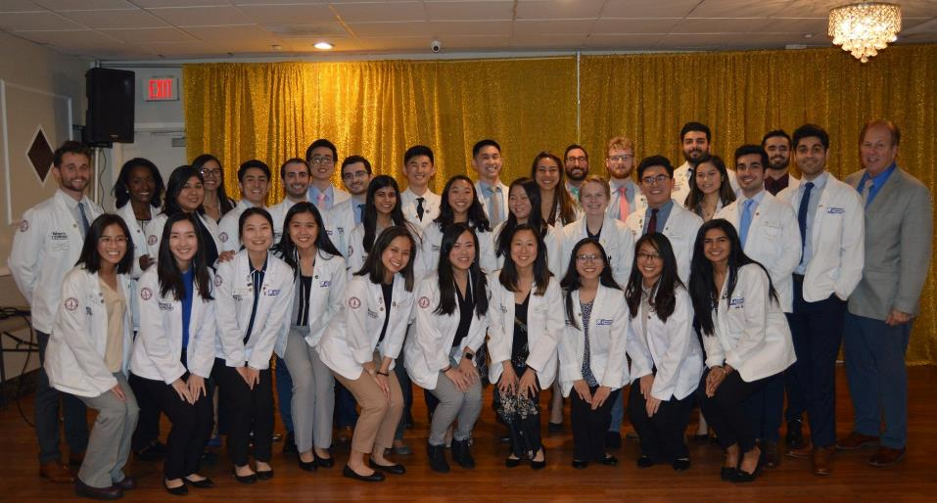
Membership
2014: 47
2015: 52
2016: 59
2017: 53
2018: 50
2019: 54
2020: 37
2021: 50
2022: 44
2023: 32

Slide 5
Chapter Goals
To further the science of osteopathic medicine and its standards of practice
To preserve the meaning of and encourage scholastic excellence and community service
To continue a high degree of fellowship among its students
To cultivate relationships and understanding between the student bodies and officials, such as Faculty members of our Colleges
To foster allegiance to the American Osteopathic Association
To perpetuate Sigma Sigma Phi by preserving the principles and objectives of the organization
To meet the needs of underserved populations in Pomona, California and the Greater Los Angeles area

Slide 6
Application Requirements
According to the National Sigma Sigma Phi Constitution:
Candidate must have completed at least one semester of school.
Candidate must have a GPA above 3.0 (>85%) to be considered for membership.
Membership is limited to 20% of the class.

Slide 7
Membership Requirements
OMS-I and OMS-II students are required to participate in at least 20 hours of community service activities per school year.
Members must record at least 15 “obligated” hours per school year for events in which they are obligated to attend (e.g. service learning).
Members must record at least 5 “non-obligated” hours per school year for events hosted by Mu Chapter (e.g. SSP free clinic).
For 2019-2020, this requirement was waived due to COVID-19, but the majority of our members exceeded this requirement regardless
Students granted membership in their second year must participate in a total of 40 hours of service by the end of the year, with no more than 20 hours from the first year and no more than 30 “obligated” hours.
Subject to change as a result of COVID-19

Slide 8
Application Process
Application process takes place only during the fall semester on the final week before winter break.
SSP admission committee will meet and decisions regarding admission/rejection will be made in no later than 14 days.
Notices of acceptance or rejections will be sent out via email in January.

Slide 9
Appeals & Induction
Applicants who are not accepted by the admission committee based on the primary application have 5 days after receiving the notice to appeal.
Induction will occur during the spring semester
All accepted applicants must pay a $90 membership fee prior to induction.

Slide 10
Expulsion
Active/honorary members may be expelled from SSP and have all rights revoked by the local chapter governing body if any of the following occur:
Failure to comply with rules as laid down by the Constitution & By-laws of the fraternity
Conspiracy against another member
Conduct unbecoming of a physician or member
Violation of Code of Ethics of AOA
Failure (<70%) of ANY required course in the curriculum WITHOUT evidence against personal fault.
(ex. Death in the family, debilitating health crisis)

Slide 11
Major Events
Philanthropy
Academic
God’s Pantry- Ongoing
Santa’s Workshop- December
Care Harbor LA- April
Impacted due to COVID-19
Annual CME Silent Auction- June
Impacted due to COVID-19
Lecture Series (Ongoing)
Professional Development
Health & Public Policy
Via Zoom

Slide 12
God’s Pantry
Local food bank in Pomona Valley
Goal is community outreach and serving the under-served areas around our campus

Slide 13
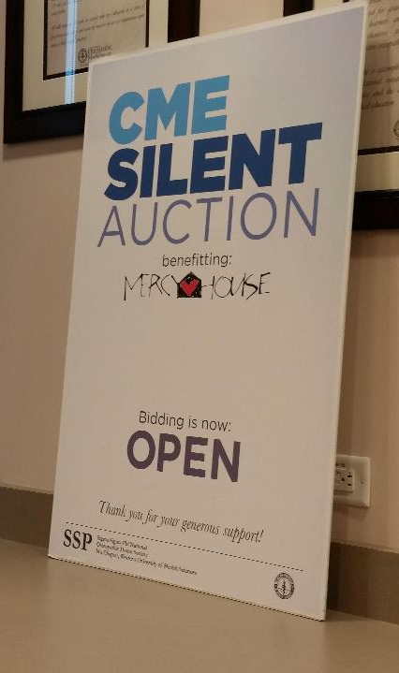
Annual CME Silent Auction
Held at WesternU
All proceeds go to MERCY HOUSE
Member Requirements:
Donate 1 item $25 min.
Solicit donations if possible.
Assist in running the auction.

