Slide 1
Sigma Sigma Phi Phi Chapter

Slide 2
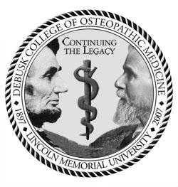
Introduction
The Phi Chapter of Sigma Sigma Phi at Lincoln Memorial University-DeBusk College of Osteopathic Medicine is in its twelfth year of existence. The members of this chapter are actively involved with both campus and community activities. We are committed to growing both this chapter and the National Organization.

Slide 3
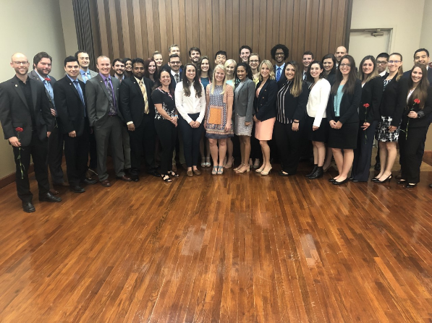
Phi Chapter Membership
Class of 2012: 46
Class of 2013: 45
Class of 2014: 43
Class of 2015: 35
Class of 2016: 26
Class of 2017: 27
Class of 2018: 11
Class of 2019: 34
Class of 2020: 32
Class of 2021: 16
Class of 2022: 17
Class of 2023: 21
353 Total Members
Executive Board:
President-Anthony Carbone
Vice President-Jeannie Nguyen-Cuu
Secretary-Megan Thompson
Treasurer-Amy Rousselot
Faculty Advisor-Michael Weiting, DO

Slide 4
Selections & By-laws
Students who have achieved a 3.2 GPA and have demonstrated exceptional dedication to community service are eligible for selection into the Sigma Sigma Phi, Phi Chapter.
Applicants are awarded points for completing campus activities, community service, GPA, leadership, and conference attendance.
Applicants are assigned a blind ranking by the number of points they accumulate.
Those candidates with the highest rankings are accepted for induction into the Phi Chapter.
There are two induction committees to assist in the candidate selection process.

Slide 5
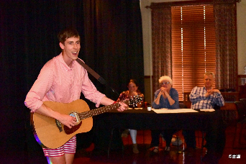
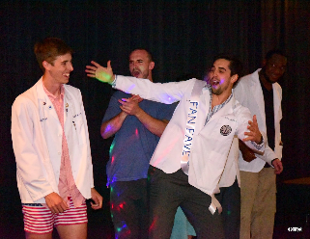
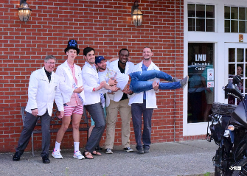
Phi Chapter sponsored Service & Events
Mr. DCOM Pageant
The Phi Chapter hosts an annual comedy night and pageant.
Pageant categories include: talent, school spirit, formal-wear, and an interview.. Always with a funny twist!
In 2012, we raised $1000 for the Tennessee Special Olympics.
In 2013, we raised $1300 for the Tennessee Special Olympics.
In 2014, we raised $1000 for the Tennessee Special Olympics.
In 2016, we raised $600 for the Tennessee Special Olympics.
In 2019, we raised $662 for the Tennessee Special Olympics.
Our goal for this upcoming year is $1000 for the Tennessee Special Olympics! – If Covid allows!

Slide 6
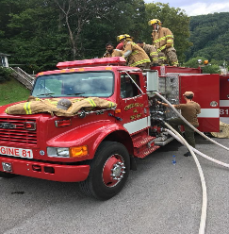
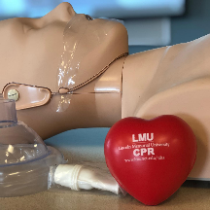
In addition to these sponsored events, members of the Phi Chapter also:
Are members of Cumberland Gap Volunteer Fire Department, a fire department run completely by medical students.
Provide free medical and dental care to patients at Remote Area Medicine (RAM) Clinics
Provide Math and Science tutoring services for local middle schoolers through a program called Math DOcs
Go to local elementary schools to teach children about medicine with our “What’s in a doctor’s bag?” program
Serve as CPR instructors for the AHA “BLS for Healthcare Providers course”

Slide 7
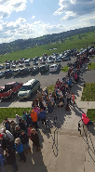
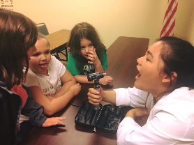
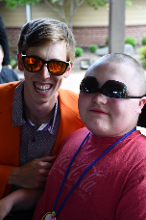
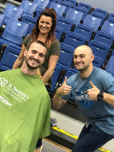
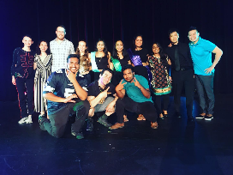
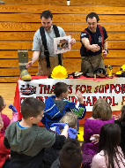
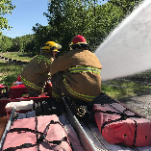
And much more:

Slide 8
Plans for the future:
Implementation of a Mentor System within the Phi Chapter of Sigma Sigma Phi.
Partner with other clubs to host Covid appropriate events
Would allow medical students to be able to communicate with established physicians, residents and recent graduates, giving insight into all aspects of post medical school life

Slide 9
All of these activities are supported by members of Sigma Sigma Phi, Phi Chapter. Participants include members of the classes of 2020, 2021, 2022, and 2023, as well as Grand Chapter faculty members here at Lincoln Memorial University DeBusk College of Osteopathic Medicine. We pride ourselves on being a strong, positive presence in both the campus and the community. Our members are committed to service, fraternity, and furthering the Osteopathic presence in the community.

Slide 10
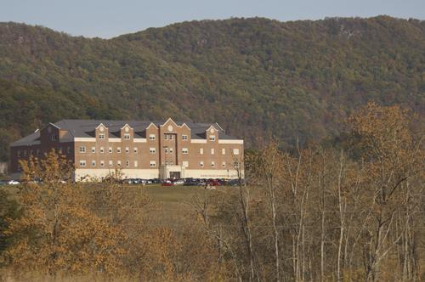
Thank You!
This report is respectfully submitted on behalf of the Executive Board and the general membership of the Phi Chapter of Sigma Sigma Phi
by Anthony Carbone, Sigma Sigma Phi, Phi Chapter President
Contact: anthony.carbone@lmunet.edu

