Slide 1
Alpha Beta Chapter of Sigma Sigma Phi
Alabama College of Osteopathic Medicine 2021

Slide 2
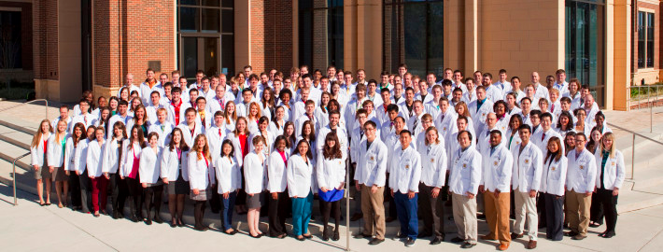
ACOM’s Grand opening was on July 29, 2013.
We are located in Dothan, Alabama!
Our Core Values are InSPIRED
Integrity | Service | Passion | Innovation | Respect | Excellence | Diversity

Slide 3
Alpha Beta Member Requirements
Students must meet:
A minimum of a 3.5 grade point average over the first three semesters at ACOM
At least 20 hours of acceptable service work over the first three semesters at ACOM
Individuals who embody the honor code and mission statement of ACOM

Slide 4
Membership
Students of the class of 2017
Inaugural class
Induction date: July 7th, 2015
Members: 20 students
All members were 3rd year medical students
Students of the class of 2018
Induction date: January 29th, 2016
Members: 26 students
All members were 2nd year medical students
Students of the class of 2019
Induction date: March 18th, 2017
Members: 28 students
Students of the class of 2020
Induction date: January 20th, 2018
Members: 21 students
Students of the class of 2021
Induction date: January 19th, 2019
Members: 32
Students of the class of 2022
Induction date: January 18th, 2020
Members: 28
Students of the class of 2023
Induction date: Sunday March 14th, 2021
Members: 34

Slide 5
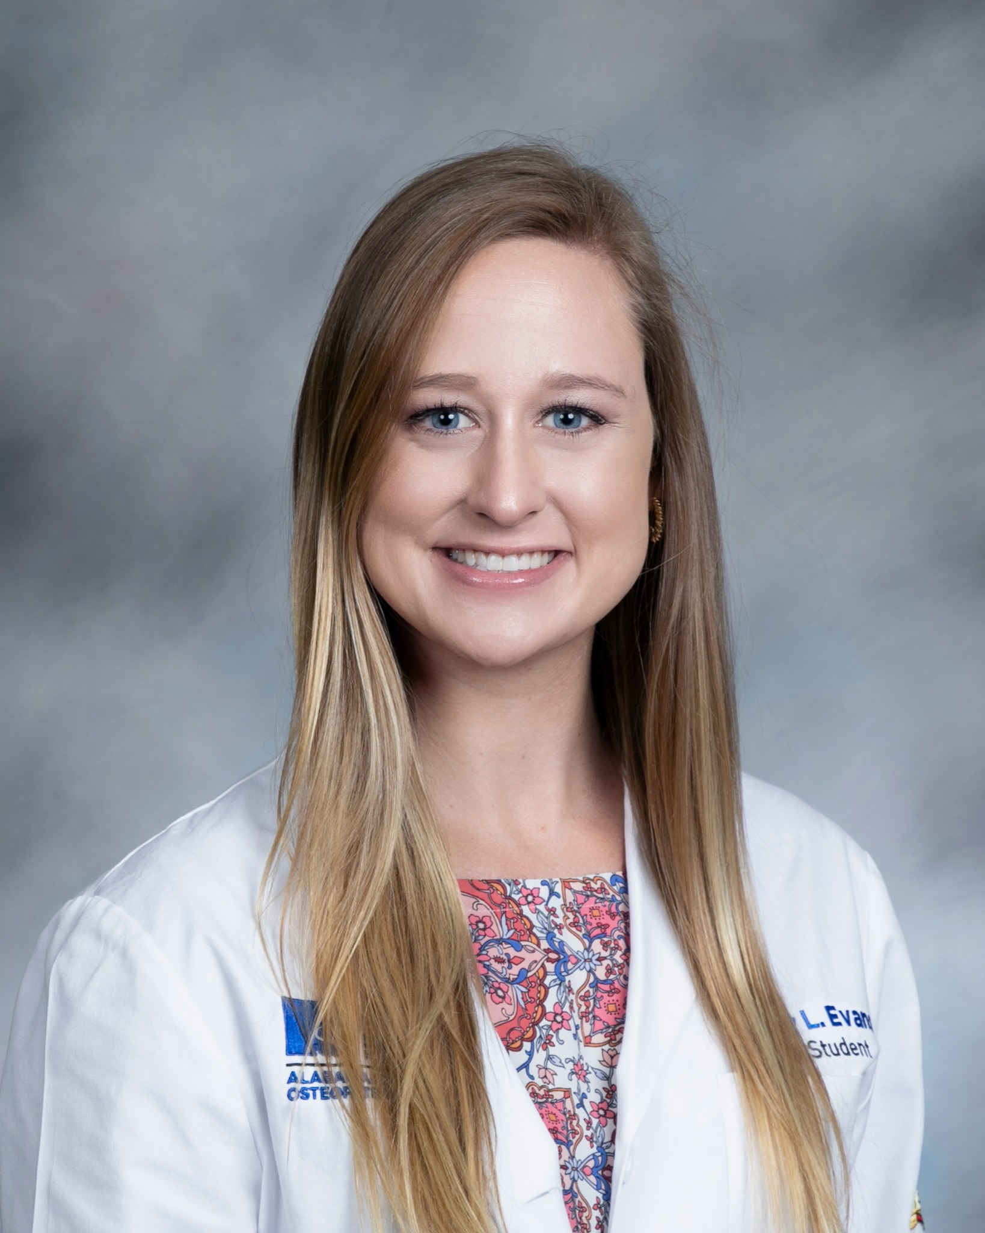
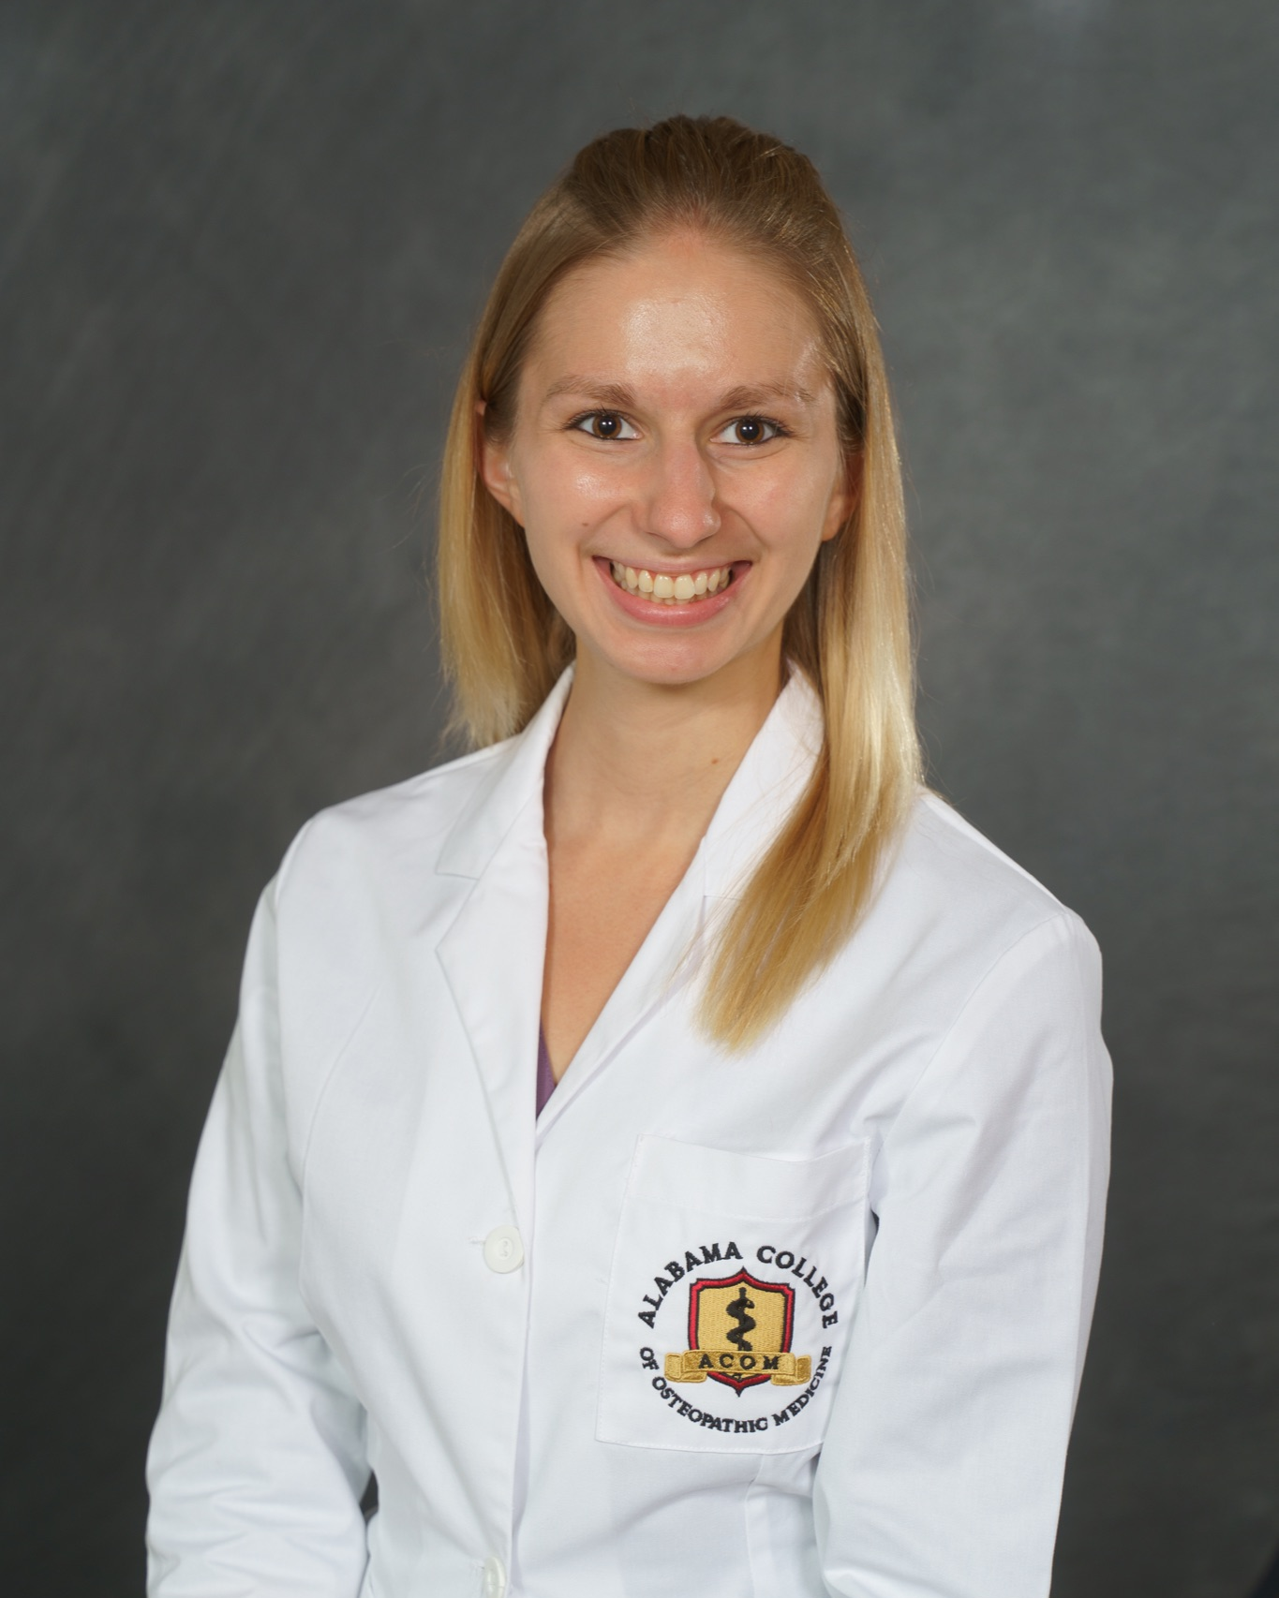
Elected Officers 2021-2022
Courtney Evans
President
Bridget Bundy
Vice President

Slide 6
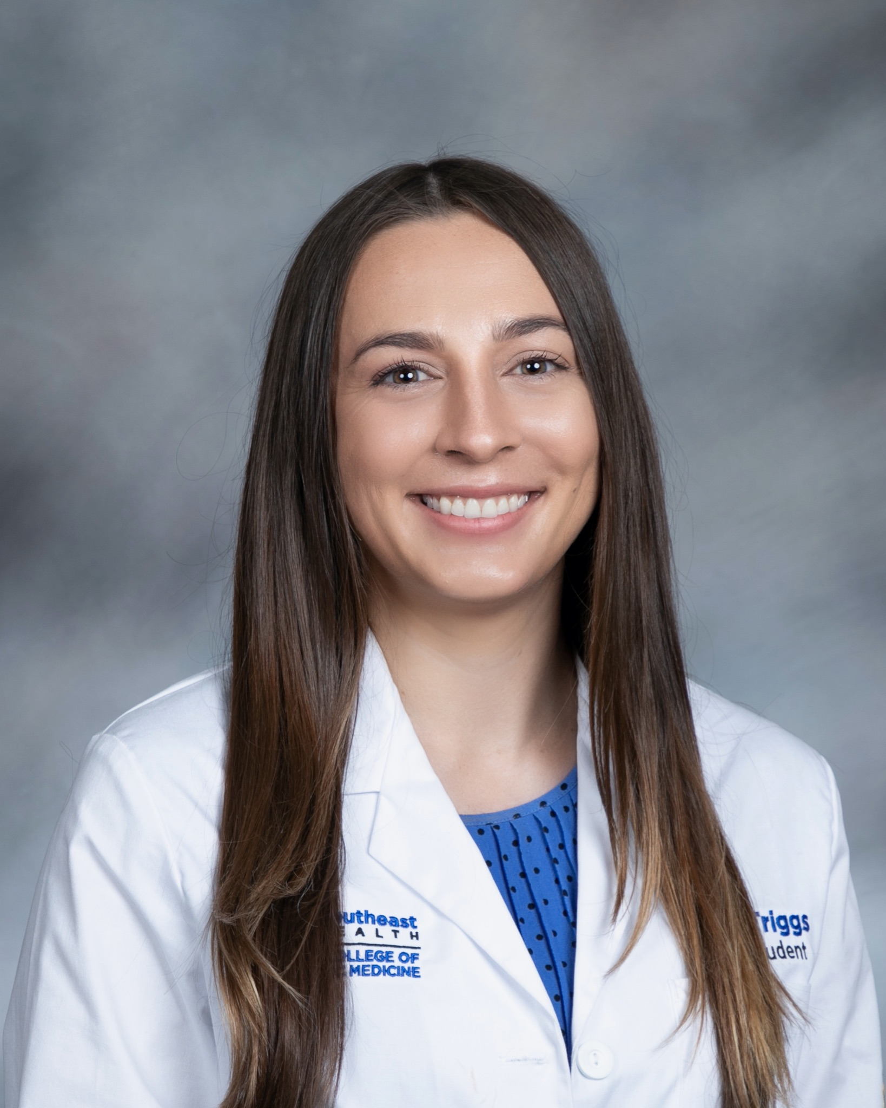
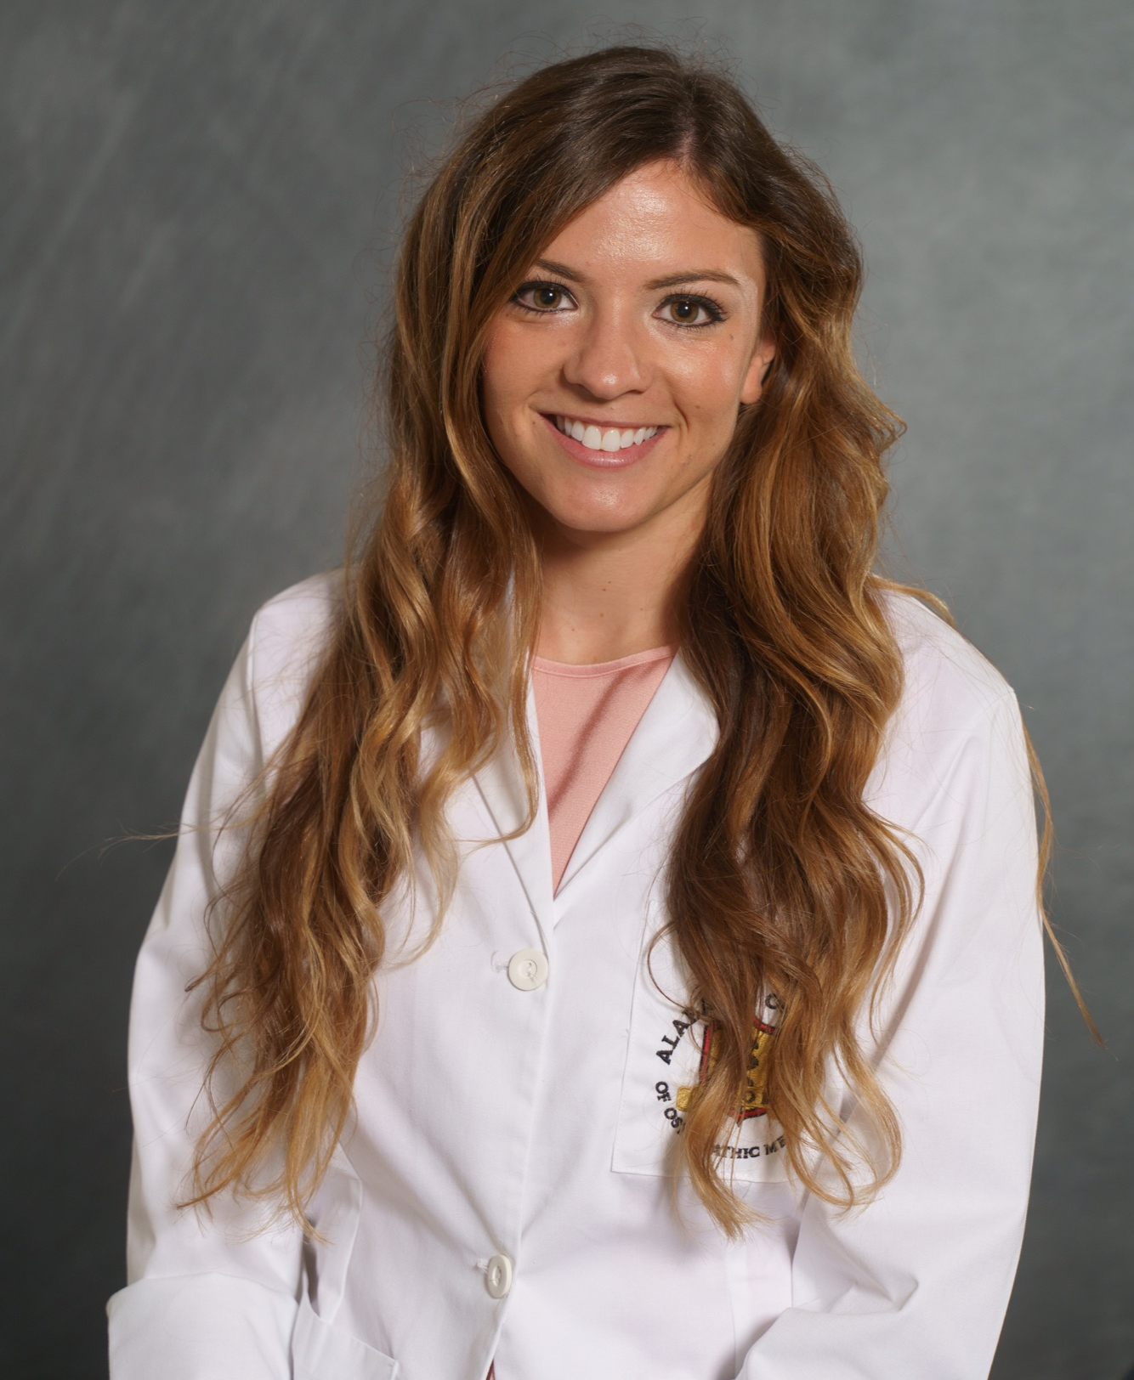
Elected Officers 2021-2022
Molly Triggs
Treasurer/Secretary
Shelbie Cole
Director of Events

Slide 7
Chapter Involvement
Informational Session at Osteogenesis 2021
Sigma Sigma Phi Survival Guide for starting Rotations
Residency focused fireside chats with Alumni and faculty
Reintroduce “Lecture Series” focused on studying for USMLE Step I/Comlex Level I

Slide 8
Future Plans
Continue our commitment to service throughout the community
Help students achieve scholastic excellence through mentorship and lectures
Support the growth and awareness of the Osteopathic Medical Practice
Support events and fundraisers associated with the clubs and organization at ACOM
Establish the Alpha Beta chapter on a local and national level

Slide 9
Thank you!

