Slide 1
Sigma Sigma Phi Beta Chi Chapter Burrell College of Osteopathic Medicine Las Cruces, NM

Slide 2
Membership Requirements (amended for COVID-19)
Pass all courses
No grade below 70% in any course
Participate in 20 (10) hours of community service each academic school year
Organize and host one community service event within first year of membership (suspended requirement)
Membership cannot exceed 25% of student body

Slide 3
Current Officers
Dr. Scott Cyrus - Faculty Advisor
Kevin Watson – President
Cristina Lee – Vice President
Analekha Chesnick – Community Service Coordinator
Mery Yanez – Community Service Coordinator
Tina Wong – Secretary
Emily Barr – Treasurer

Slide 4
Rush Fall 2021
Designed for the Class of 2025
Aids in selection process and allows students to get to know each other
Upcoming events:
At-home scavenger hunt social

Slide 5
Community Partnerships
City of Las Cruces
Animal Services Center of the Mesilla Valley (ASCMV)
El Caldito Soup Kitchen
Southern New Mexico Diabetes Outreach (SNMDO)
Safe Haven Animal Sanctuary
Mesilla Valley Habitat for Humanity
La Casa Inc.
Children’s Reading Alliance of Las Cruces
Protect New Mexico

Slide 6
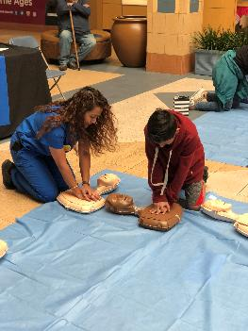
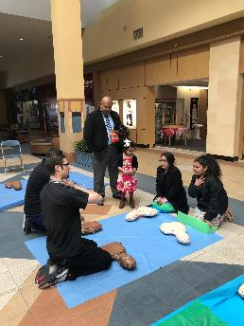
Texas Two Step
Teaching the Community how to do CPR

Slide 7
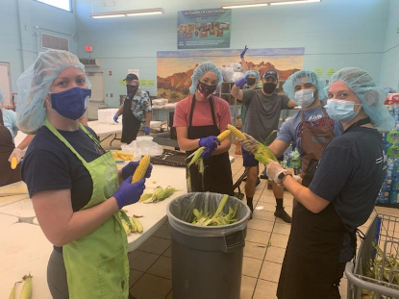
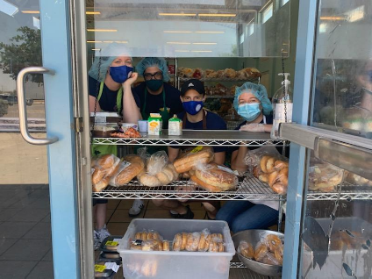
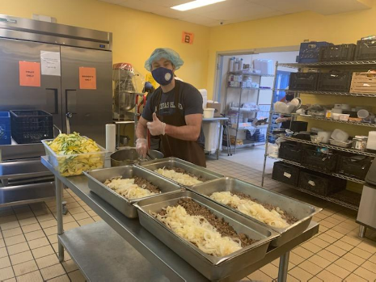
El Caldito Soup Kitchen Preparing and distributing meals

Slide 8
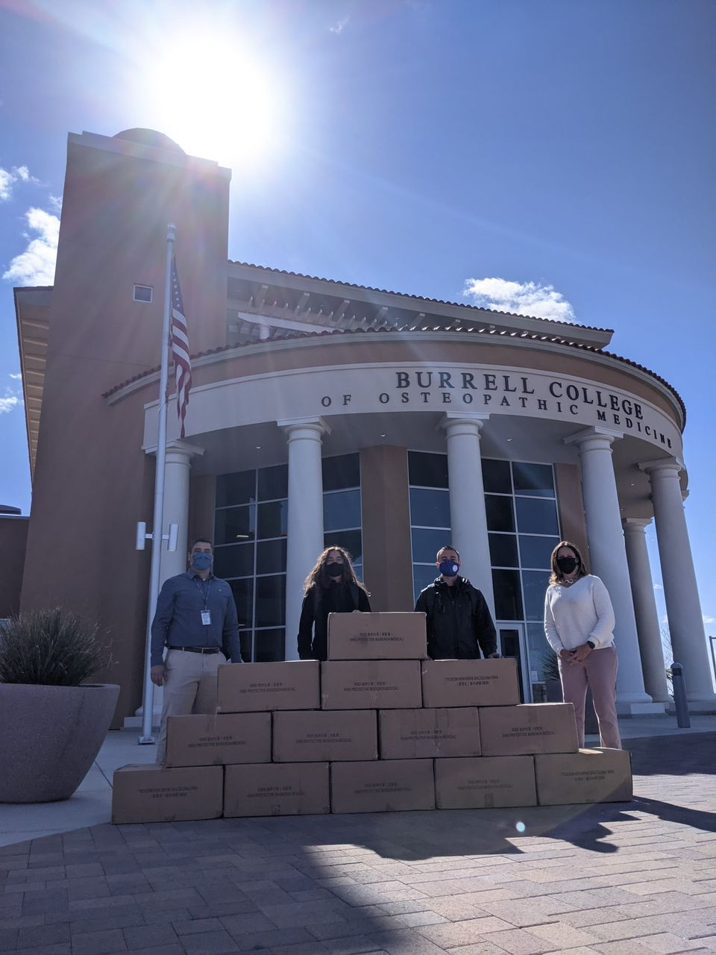
ProtectNM Donation Drive Collecting PPE and monetary donations for distribution to underserved communities

Slide 9
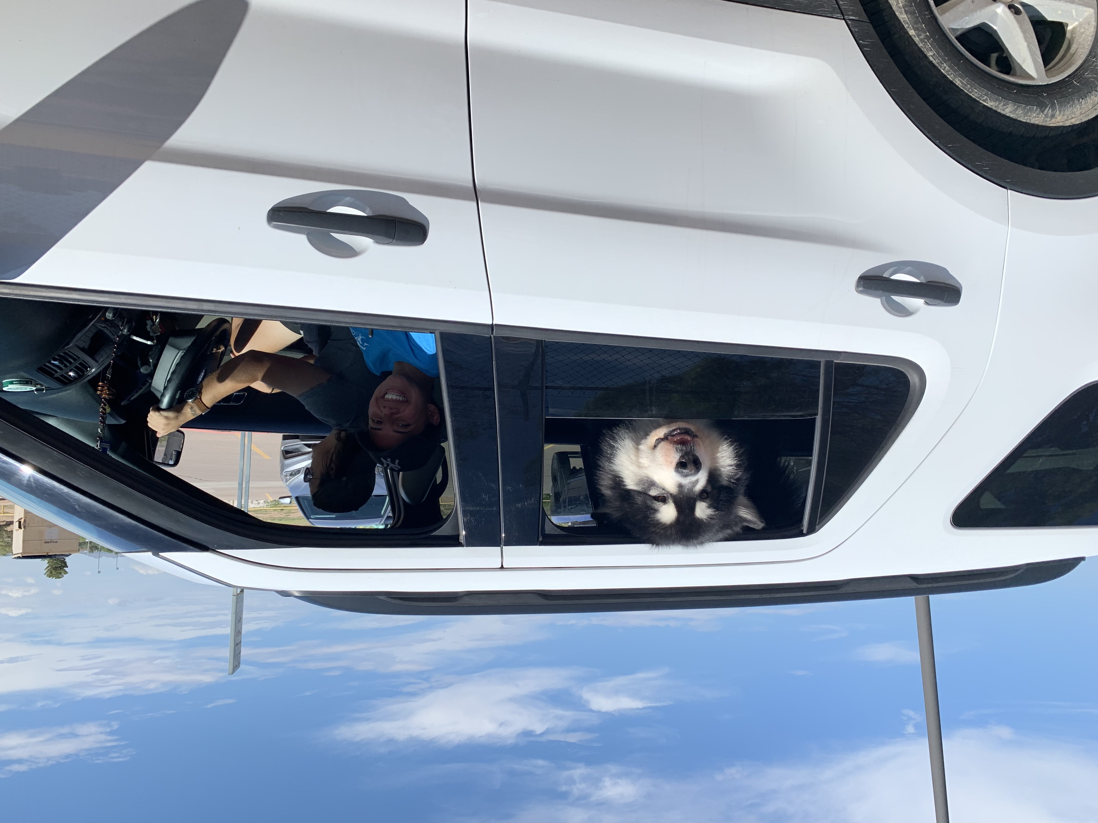
Animal Service Center of the Mesilla Valley Event: Clear the Shelters

