Slide 1
Edward Via College of Osteopathic Medicine
Auburn Campus
2021 Annual Report

Slide 2
Chi - Auburn Chapter
Mission Statement:
Sigma Sigma Phi is an Honorary Osteopathic Service Fraternity. Its objectives and purposes are to further the science of osteopathic medicine and its standards of practice, to improve the scholastic standing and promote a higher degree of fellowship among its students, to bring about a closer relationship and understanding between the student bodies and the officials and members of the faculties of our colleges, and to foster allegiance to the American Osteopathic Association and to perpetuate these principles and the teachings through the maintenance and development of this organization.
The key symbols (skull, spine, & femur) adorn the fraternity emblem. The emblem itself is shaped in the likeness of a sternum, due to it's key role in hematopoiesis, and thus, the origin of our life source & vitality.

Slide 3
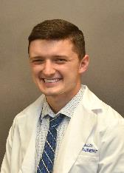
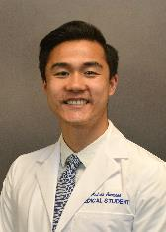
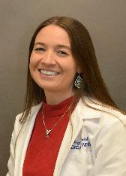
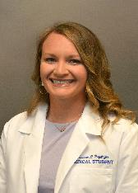
Officers: Fall 2021 - Spring 2022
James Pollock, OMS II
President
Andrew Sunwood, OMS II
Vice President
Megan Rogers Axford, OMS II
Secretary/Treasurer
Madison Heydinger, OMS II
Membership Chair

Slide 4
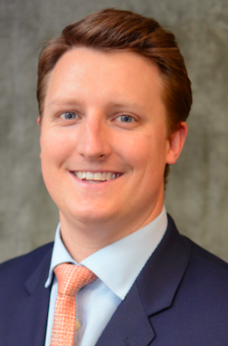
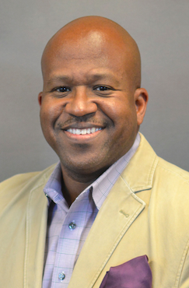
Faculty Advisors
Jake Williamson, PhD
David J. Stephen, DO
Associate Dean for Student Affairs
Discipline Chair for Pathology and Histology

Slide 5
Membership Criteria
Our criteria for invitation are currently:
Must have a 3.8 GPA or higher at VCOM at end of first year or second year
Must have no current or pending academic deficiencies
Must be considered in good standing with VCOM
e.g., no current or pending behavioral infractions, no academic probation, etc.
Must be willing to provide advice or counsel to other medical students or potential medical students on the values and benefits of being an osteopathic physician

Slide 6
Requirements to Maintain Membership
Maintain GPA – 3.65
Students with a GPA below 3.65 after induction will go under probation and review
Service Hours
2nd years – 20 hours/year (10 hours/semester)
3rd and 4th years – 10 hours/year (5 hours/semester)
Must attend SSP events and member meetings

Slide 7
Chapter Involvement: On Campus
VCOM’s “Student and Faculty of the Block” Award for Excellence in Scholarship and Teaching
This award recognizes students who go above and beyond in promoting academic excellence to their classmates, and faculty members who demonstrate commitment to educating and mentoring their students
Board Prep Jeopardy
Bug and Drug of the Week
Information about a specific infection/condition and the medication used to treat it
Board Questions of the Week
Questions and answers are put on projector screens in lecture halls prior before and after classes
VCOM – Auburn Rescue Race scenario sponsor

Slide 8
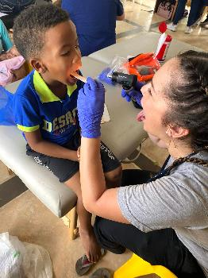
Chapter Involvement: Service
Medical Mission Trips
Honduras
Dominican Republic
El Salvador
Peer Tutoring and Mentoring
White Coat & Graduation Ambassadors
Community Partners:
Unity Wellness Center- HIV/Aids center

Slide 9
Thank you!

