Slide 1
Midwestern University Chicago College of Osteopathic Medicine
Sean Callahan
Chapter President, 2020-2021

Slide 2
What is ΣΣΦ
Honorary Osteopathic Service Fraternity
National Objectives:
Further the science of Osteopathic Medicine and its standards of practice
Improve the scholastic standing and promote a higher degree of fellowship among its students
Foster allegiance to the AOA
Epsilon Corollary:
Demonstrate a sincere commitment to serving communities in Chicago as well as within CCOM

Slide 3
Executive Board 2021-2022
President – Sean Callahan
Vice President – To be filled
Treasurer – Florian Walter
Secretary – To be filled

Slide 4
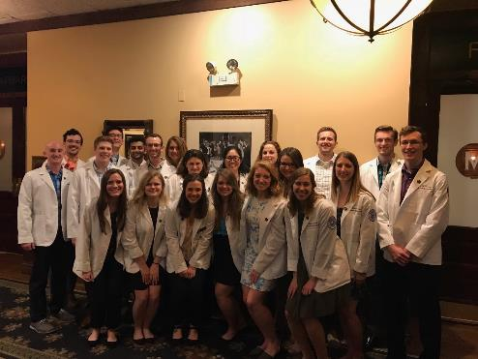
Membership
52 active members
24 OMS-IV
18 OMS-III
10 OMS-II
Faculty Advisors.
Dr. Perry Marshall, D.O.

Slide 5
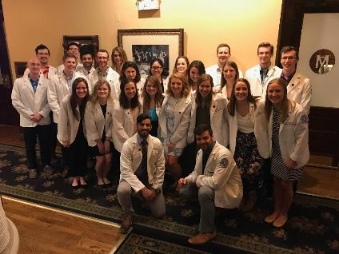
Fall Membership Drive
Began Aug. 18, 2021 with introductory meeting
Written application (application cycle currently ongoing until Sept. 15th
Blinded review
Grade check
Interview
Conducted by 2-3 current members who are not classmates
Applications reviewed by selection committee
Criteria for admission
Scholastics (GPA > 3.30)
Community Service
Interest in SSP
Demonstrated leadership

Slide 6
Finances
Current Student Accounts Balance:
$2,900 as of September 8, 2021

Slide 7
Fundraisers
CCOM sweatshirt, t-shirt sales- planning for winter quarter

Slide 8
Projects
Speed rotating event for MS2 students
Student informational panel for MS1 students
Boards study strategy panel for MS2 students
Directory of service opportunities for members
Collaboration with the Mini Med Campaign

Slide 9
Rotation Speed Dating
Annual event each winter
Third and fourth year students return to campus to share their rotation experiences
Small group format facilitates discussion
Members learn about specialties from peers

Slide 10
Student Informational Panel
Several second year members answer questions from rising second year students
Members offer advice on how to handle the course load as well as how to prepare most efficiently for boards

Slide 11
Boards Study Strategy Panel
Third year members answer questions from second year students and offer suggestions for how to best prepare for boards
Topics include
When to start studying
How much time should be allocated
Most beneficial resources

Slide 12
Service Directory
List of service opportunities and contacts around CCOM and in Chicago
Organized by community served
List will be made available to all members of Epsilon Chapter by the end of this academic year
All members of Epsilon Chapter will be able to edit and maintain the list for future members

Slide 13
Mini Med Campaign
This is a virtual event hosted by the Student Government Association’s Social Equity Committee
Goal is educating high school students from ethnicities that are underrepresented at the RN, PA, and physician level on the pathway to different medical professions
SSP Members will have the opportunity to help run virtual education sessions in February

Slide 14
Goals
Spread awareness of Sigma Sigma Phi on campus and establish a concrete understanding of the society
Establish an annual Member’s social to increase communication and encourage stronger collaboration in future decision making of Epsilon Chapter
Create a resource for Epsilon Chapter members outlining different service opportunities in the area

Slide 15
Questions
Chapter President, Sean Callahan
Sean.callahan@midwestern.edu

