Slide 1
SIGMA SIGMA PHI: Lambda Chapter-Cleveland Satellite Annual Report Ohio University Heritage College of Osteopathic Medicine Nidha Khan, OMS-II ΣΣΦ Cleveland Satellite-President September 2021

Slide 2
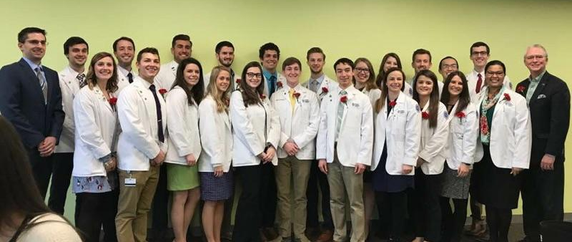
Outline
Membership overview
Lambda - Cleveland Executive Board
Activities:
Community Service
Academics
Awards

Slide 3
Members
Current Total at Cleveland Satellite: 17
Class of 2022: 10
Class of 2023: 2
Class of 2024: 5
Total OU-HCOM Members: 88
Class of 2022, Class of 2023, Class of 2024
3 Campuses: Athens, Cleveland, Dublin
OU-HCOM Cleveland / SSP Lambda-Cleveland graduated its first class of students in May 2019
Recruitment:
End of Fall term for Class of 2024 and 2025
Emphasis on community service and leadership

Slide 4
Cleveland Executive Board
President: Nidha Khan, OMS-II
nk769420@ohio.edu
Vice President: Amelia El-Mahdy, OMS-II
ae307920@ohio.edu
Secretary/Treasurer: Troy Williams, OMS-II
tw560316@ohio.edu

Slide 5
Future Events
Fall 2021
Project Linus Service Project
Giving Tree
New Member Application Cycle: December 2021-January 2022
Spring 2022
New Member Induction Ceremony
Valentine’s Project
SSP Day of Service

Slide 6
Community Service
Membership requirement:
OMS-I & OMS-II: 12 hrs/semester
OMS-III & OMS-VI: 4 hrs/semester
All members are presented with SSP-hosted opportunities to help fulfill membership requirements:
Project Linus
Giving Tree
SSP-Cleveland Day of Service
Members welcome to volunteer in other events & activities

Slide 7
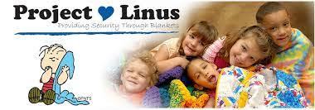
Project Linus
Make fleece tie-blankets to be delivered to sick children at local hospitals
Optional community service project that helps members obtain their Fall semester service requirement
Also services as an informational Q&A session for the Class of 2024 and 2025

Slide 8
Giving Tree
Make or purchase donations for local children and families in need in the Greater Cleveland Area
Last year’s focus was on providing access to clean masks

Slide 9
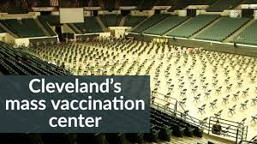
SSP-Cleveland Day of Service
SSP members collectively decide on a service project they want to do together
Some ideas being considered for 2022:
Greater Cleveland Foodbank
COVID-vaccine efforts
Akron Foodbank
Habitat for Humanity

Slide 10
Academics
Membership Requirements:
Class of 2024: Pass all semesters without remediation
Class of 2025: Pass all semesters without remediation
OU-HCOM on pass/fail system

Slide 11
Academic Initiatives
Review Sessions
Providing additional instruction for OMS-Is before exams
Lecture Series
Collaboration with other OU-HCOM organizations
Invite physicians to speak to students about being a physician
Student Panels
Panels of older students speaking about residencies and clinical rotations

Slide 12
Distinguished Osteopathic Commitment (DOC) Awards
Organized with Student Government Association
Present awards for faculty, staff, and students
Recipients determined by student ballot
Osteopathic Mentor Award
Given to an Ohio Osteopathic Physician who, by his or her example and involvement, excels in mentorship and provides significant influence to students at OU-HCOM

Slide 13
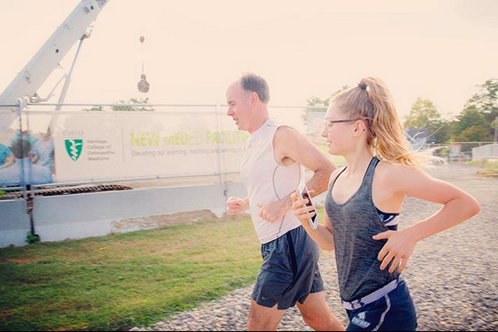
OU-HCOM Activities
Walk with the Dean
Students walk in the park with the Dean as a stress relief event
Therapy dogs, yoga, smoothie day
Initiatives from Student Affairs to promote health and wellness
Learning Community Tutors
Weekly virtual review sessions for OMS-I students
OMM Honors TAs
Weekly virtual instruction on OMS-Is in OMM lab

Slide 14
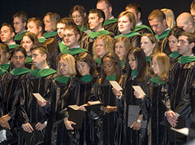
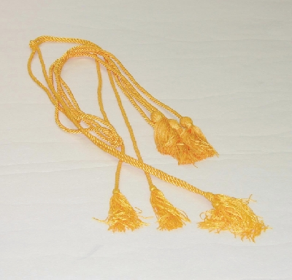
Honor Cords
Presented by second year class to Sigma Sigma Phi members of the graduating class.

Slide 15
Thank You!
Nidha Khan, OMS-II
nk769420@ohio.edu

