Slide 1
Sigma Sigma Phi Phi Chapter

Slide 2
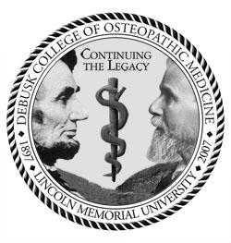
Introduction
The Phi Chapter of Sigma Sigma Phi at Lincoln Memorial University-DeBusk College of Osteopathic Medicine is in its thirteenth year of existence. The members of this chapter are actively involved with both campus and community activities. We are committed to growing both this chapter and the National Organization.

Slide 3
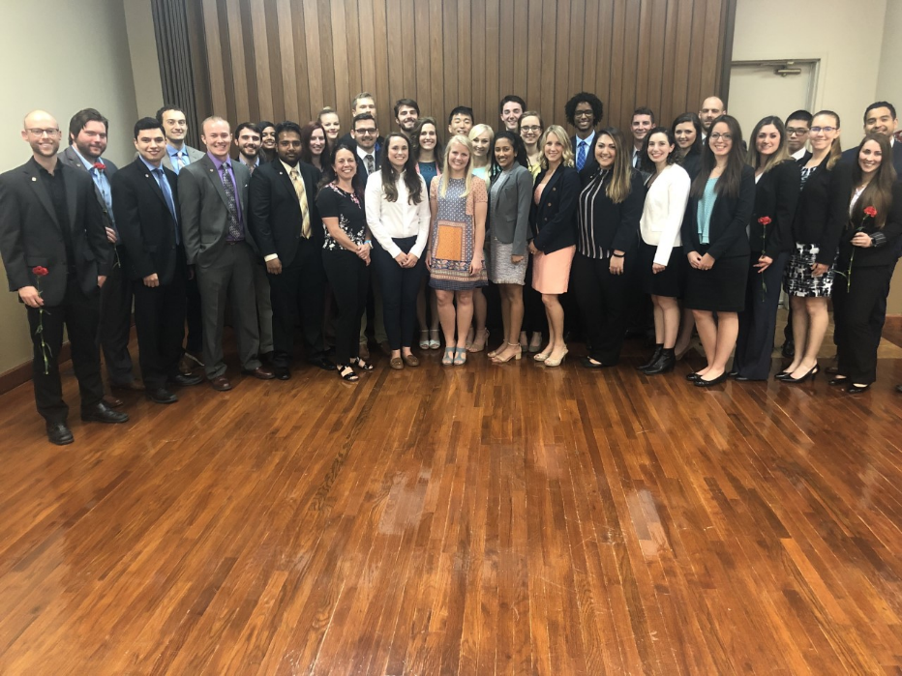
Phi Chapter Membership
Class of 2012: 46
Class of 2013: 45
Class of 2014: 43
Class of 2015: 35
Class of 2016: 26
Class of 2017: 27
Class of 2018: 11
Class of 2019: 34
Class of 2020: 32
Class of 2021: 16
Class of 2022: 17
Class of 2023: 21
Class of 2024: 17
370 Total Members
Executive Board:
President-Ashley Sundin
Vice President-Christopher Loiselle
Secretary-Anna Devin Taylor
Treasurer-Carrie Wild
Faculty Advisor-Michael Weiting, DO

Slide 4
Selections & By-laws
Students who have achieved a 3.2 GPA and have demonstrated exceptional dedication to community service are eligible for selection into the Sigma Sigma Phi, Phi Chapter.
Applicants are awarded points for completing campus activities, community service, GPA, leadership, and conference attendance.
Applicants are assigned a blind ranking by the number of points they accumulate.
Those candidates with the highest rankings are accepted for induction into the Phi Chapter.
There are two induction committees to assist in the candidate selection process.

Slide 5
Phi Chapter sponsored Service & Events
The Angel Tree Program
Every year, the Phi Chapter teams up with the Angel Tree Program to donate Christmas gifts to needy children in the local community. Last year, the Phi Chapter donated gifts to 200 children in need!
This year our goal is 300!
ROHO Charitable Trust
Students fundraise for this local non-profit and their annual christmas event to help children in need.

Slide 6
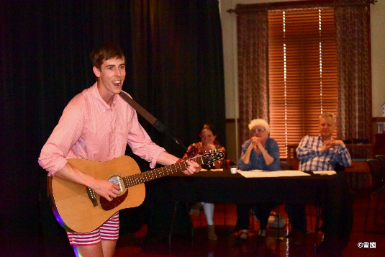
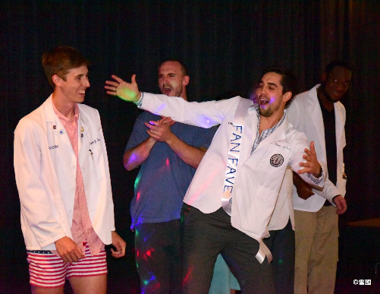
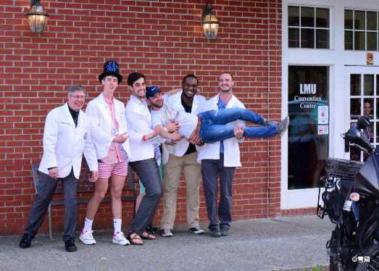
Phi Chapter sponsored Service & Events
Mr. DCOM Pageant
The Phi Chapter hosts an annual comedy night and pageant.
Pageant categories include: talent, school spirit, formal-wear, and an interview.. Always with a funny twist!
In 2012, we raised $1000 for the Tennessee Special Olympics.
In 2013, we raised $1300 for the Tennessee Special Olympics.
In 2014, we raised $1000 for the Tennessee Special Olympics.
In 2016, we raised $600 for the Tennessee Special Olympics.
In 2019, we raised $662 for the Tennessee Special Olympics.
Our goal for this upcoming year is $1000 for the Tennessee Special Olympics!

Slide 7
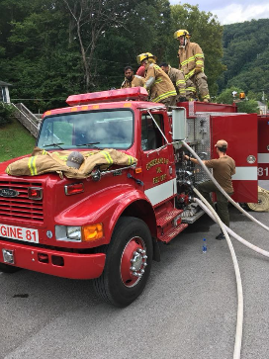
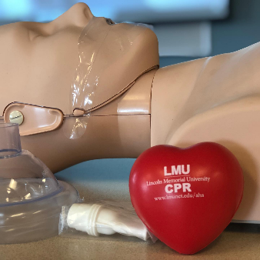
In addition to these sponsored events, members of the Phi Chapter also:
Are members of Cumberland Gap Volunteer Fire Department, a fire department run completely by medical students.
Provide free medical and dental care to patients at Remote Area Medicine (RAM) Clinics
Provide Math and Science tutoring services for local middle schoolers through a program called Math DOcs
Go to local elementary schools to teach children about medicine with our “What’s in a doctor’s bag?” program
Serve as CPR instructors for the AHA “BLS for Healthcare Providers course”
Participate and fundraise for ROHO, a local charity for children in need.

Slide 8
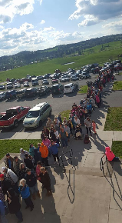
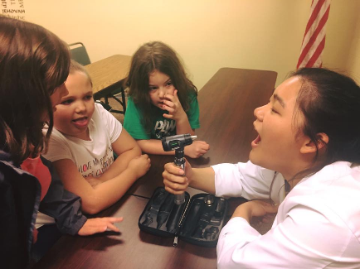
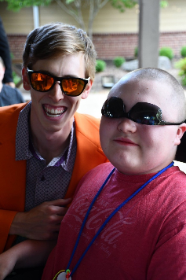
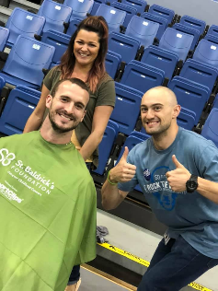
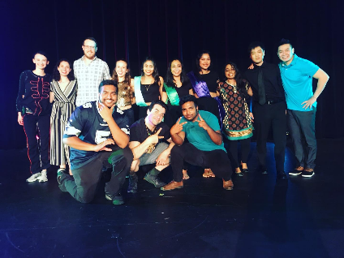
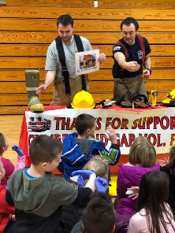
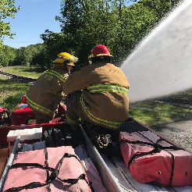
And much more:

Slide 9
Plans for the future:
Implementation of a Mentor System within the Phi Chapter of Sigma Sigma Phi.
Partner with other clubs to host Covid appropriate events
Would allow medical students to be able to communicate with established physicians, residents and recent graduates, giving insight into all aspects of post medical school life

Slide 10
All of these activities are supported by members of Sigma Sigma Phi, Phi Chapter. Participants include members of the classes of 2021, 2022, 2023, and 2024, as well as Grand Chapter faculty members here at Lincoln Memorial University DeBusk College of Osteopathic Medicine. We pride ourselves on being a strong, positive presence in both the campus and the community. Our members are committed to service, fraternity, and furthering the Osteopathic presence in the community.

Slide 11
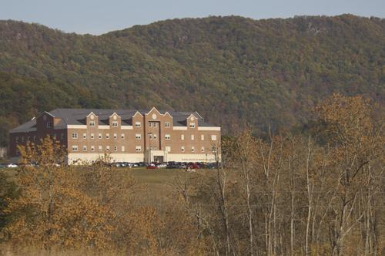
Thank You!
This report is respectfully submitted on behalf of the Executive Board and the general membership of the Phi Chapter of Sigma Sigma Phi
by Ashley Sundin, Sigma Sigma Phi, Phi Chapter President
Contact: ashley.sundin@lmunet.edu

