Slide 1
Touro College of Osteopathic Medicine Middletown, NY
Sigma Sigma Phi
Psi Chapter - Additional Site
Annual Chapter Report - 2021

Slide 2
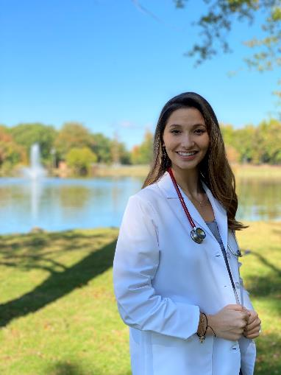
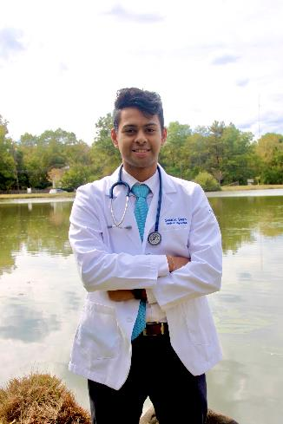
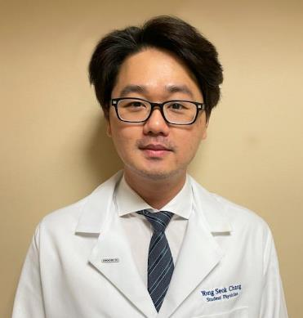
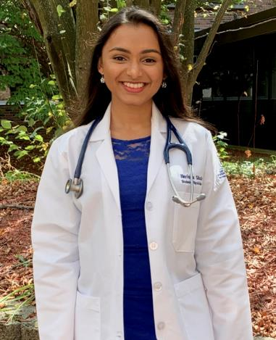
2021-2022 Executive Board
Secretary:
Yong Seok Chang
Vice President:
Herisha Shah
President:
Brittany Galuppo
Treasurer:
Sachin Shah
Faculty Advisor: Dr. Kenneth Steier, DO

Slide 3
Application process
Have at least a 3.0 cumulative GPA to apply
Submit an application for membership in spring of 1st year or fall of 2nd year of medical school
Application is reviewed blindly and scored
Points are given for commitment to service, honors, leadership, activities, work experience, academic performance, and essay
Membership is offered to top-scoring applicants, not to exceed more than 25% of the class (60% of seats available given in spring and 40% given in fall)

Slide 4
Membership requirements
Maintain a minimum 3.0 cumulative and semester GPA
Attend all general member meetings
Complete 10 hours of community service outside of SSP per semester
Serve on one SSP service committee and dedicate 10 hours per semester toward event planning
Attend 1 national conference or 3 grand rounds meetings per academic year
Not incur any honor code violations and maintain good standing with the school

Slide 5
Current membership
Class of 2022: 35
Class of 2023: 34
Class of 2024: 34
Class of 2025 Anticipated:
20 in Spring 2022
14 in Fall 2022

Slide 6
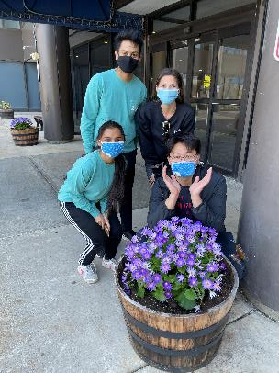
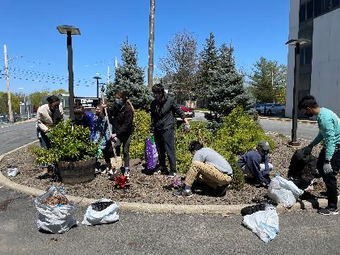
Events held during 2020-2021 academic year
Virtual Kid’s Klothing Drive for local daycare
Letters to Santa – Make-A-Wish Foundation
Hygiene Kits for local Warming Station
MedAchieve Presentation – “Med School Myth Busting”
Earth Day Celebration
MedBee with MedAchieve
Business of Medicine Talk
**Due to the COVID-19 pandemic, many of these events had to be done online on Zoom. Please see speaker notes for a description of each event.
Notes:
Virtual Kid’s Klothing Drive: Our chapter hosted a virtual clothing drive where donations were collected for purchasing clothing for a local daycare.
Letters to Santa: Students wrote letters to critically ill children through the Make-A-Wish Foundation, and for every letter written, Macy’s donated $1 to Make-A-Wish.
Hygiene Kits: Small hygiene kits were prepared for donation to the Warming Station, the local homeless shelter Touro gives a lot of support to. Approximately 36 kits were prepared, and they consisted of socks, undershirts, boxers, masks, and hand sanitizers.
MedAcheive Presentation: MedAchieve is volunteer mentoring program at Touro in which medical students mentor local high school students that are interested in pursuing science and medicine. Each week, a two-hour meeting is held where mentors and mentees get together to listen to presentations and participate in hands-on activities. SSP had a presentation titled “Med School Myth Busting” on Zoom for one meeting.
Earth Day Celebration: Our chapter hosted an Earth Day event where students planted flowers on Touro’s campus and cleaned up the campus grounds and surrounding community by picking up trash.
MedBee with MedAchieve: See description of MedAchieve above. A medical spelling bee was held by our chapter for the high school students on Zoom.
Business of Medicine Talk: A Zoom talk was organized by our chapter in which we had Dr. Sanjay Bakshi, a pain medicine specialist and investor in early-stage medical companies, presented on his experience with balancing private practice medicine and being an investor as well as an author.

Slide 7
Goals for psi chapter – additional site
Encourage members to volunteer in the community through our chapter-led events or others
Host new service and education events, adding to some of our recurring annual events
Promote academic excellence
Emphasize importance of professionalism in both academic and work settings
Continue to foster strong relationships with local organizations
Strengthen the relationship and understanding between student body and faculty and administration

