Slide 1
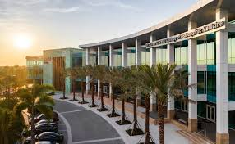
Sigma Sigma Phi
Xi Chapter

Slide 2
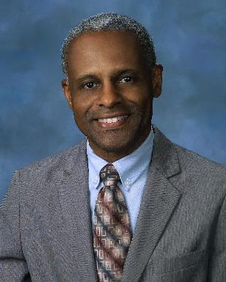
Our Advisor
Dr. Cyril Blavo

Slide 3
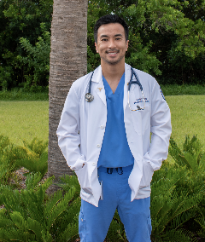
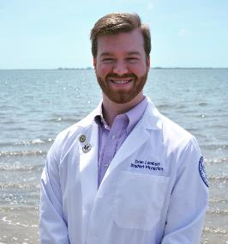
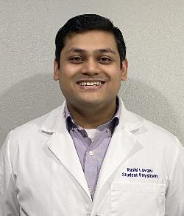
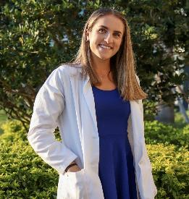
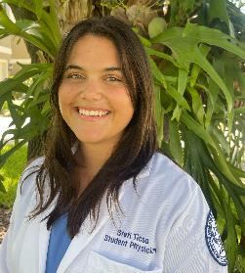
Our Executive Board
Joseph Phan
President
Evan Lambert
Vice President
Rushi Lavani
Secretary
Rachel Pray
Treasurer
Maria ‘Stefi’ Ticsa
Historian

Slide 4
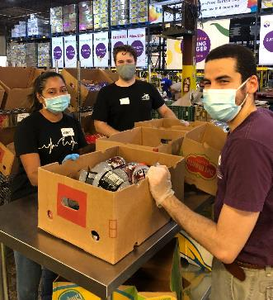
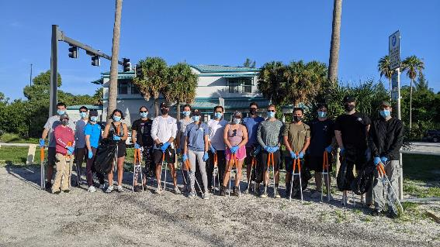
Leadership Positions
Bridge Park & Sailing Center Clean Up: Joseph Phan
Feeding Tampa Bay: Evan Lambert
PathFinder Program: Joseph Phan
OneBlood Drive: Rushni Lavani
Help Out HEP (Homeless Empowerment Program): Rachel Pray
Inspire Equine Therapy: Rushni Lavani
Shopping Angels: Maria ‘Stefi’ Ticsa
Athletic EKG Screenings: Elise Quartucio
Waverly’s Way Tutoring: Thao Tran
Who We Play for: Elise Quartucio

Slide 5
Academic Events
Rotations Dinner
Board Preparation Talk Series
Essays

Slide 6
Membership Process
Membership for only 25% of each class
Three application cycles each year:
Fall cycle: M2s only
Winter cycle: M1s and M2s
Application focuses on dedication to the community, academics, research experience, extracurriculars, and essays
In order to qualify to apply, applicants must attend at least 1 SSP event and show a dedication to their community

Slide 7
Volunteer Events
Despite the difficulties that the COVID pandemic has inflicted on volunteer opportunities, SSP continues to be dedicated to their local community in a multitude of areas including:
Food insecurity
Homelessness
Children
Environment
High school students
Elderly
Veterans

Slide 8
Future Plans
Expanding to different volunteering events
Providing more volunteer events while keeping volunteers and others safe
Maintaining the current events and relationships with local community leaders

