Slide 1

SSP ALPHA PSI CHAPTER 2022-2023
Notes:
Call to Order Introductory SSP Alpha Psi Chapter Meeting 2022-2023 Year

Slide 2

What is Sigma Sigma Phi- Alpha Psi Chapter?
  Sigma Sigma Phi is an Honorary Osteopathic Service Fraternity
  Objectives and purposes:
    Further the science of osteopathic medicine and its standards of practice
    Improve the scholastic standing and promote a higher degree of fellowship among its students
    Bring about a closer relationship and understanding between the student bodies and the officials and members of the faculties of our colleges
    Foster allegiance to the American Osteopathic Association
    Perpetuate these principles and the teachings through the maintenance and development of this organization

Slide 3
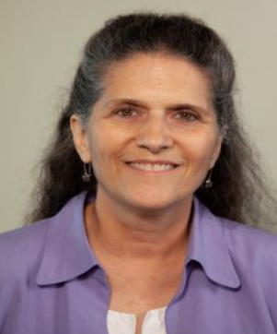
Faculty Advisor: Dr. Iris Sadowsky, DO, MS
Medical Degree from University of New England College of Osteopathic Medicine
Established private practice in Arizona, practiced family medicine for 13 yrs
  Integrative Medicine
  Osteopathic Medicine
  Preventive care and Women’s Health
Joined faculty of UIWSOM August 2019
Fellow of American Board of Family Medicine and American Academy of Family Practice

Slide 4
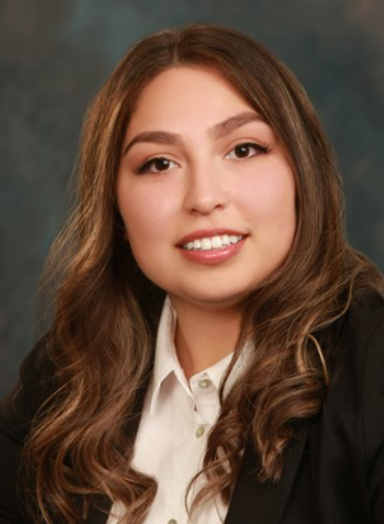
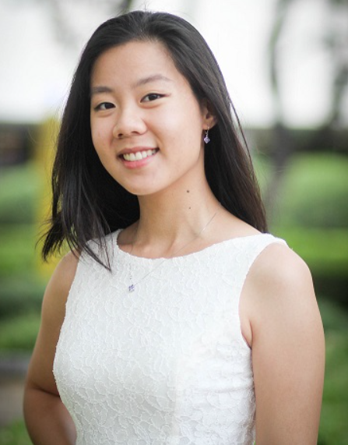
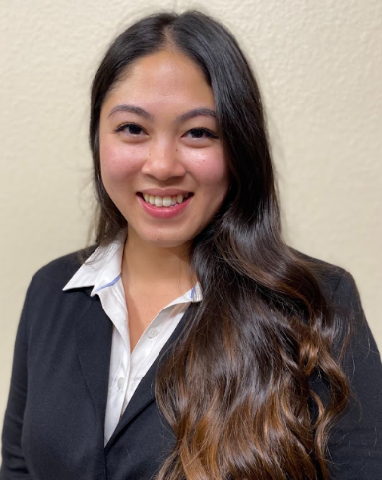
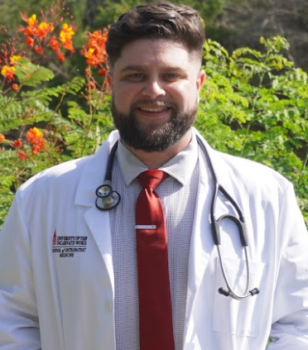
Officers:
President: Richa Patel
Vice President: Nancy Kha
Treasurer & Secretary: Rita Tran
Community Service Officer: Michael Shaffer
Fundraising Officer: Celina Salcido

Slide 5
Past Events:

Slide 6
Past Events:

Slide 7
Activities for 2022-2023
3rd year Boards Panel for Level 1/Step 1 Preparation
4th year Boards Panel for Level 2/Step 2 Preparation
Graduate Panel for Residency Preparation
Guest Speakers based on member choice
Monthly Boards Prep Meetings
OMM Booklet Lamination as Academic Contribution to UIWSOM
Volunteer opportunity through CUB and San Antonio Food Bank

Slide 8
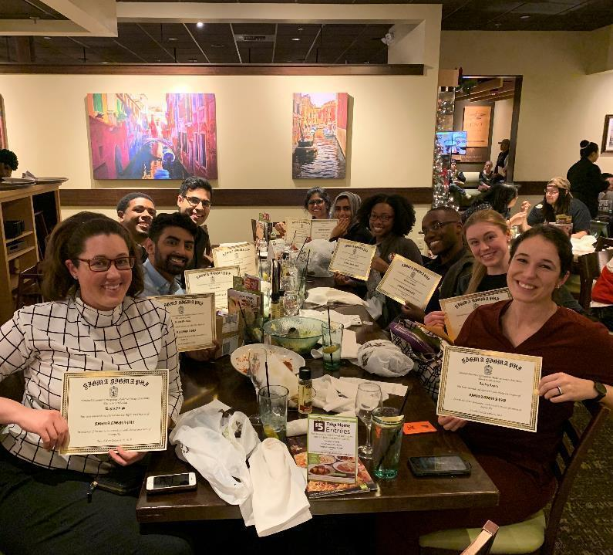
Chapter Meetings
September 2, 2022: 1st general meeting/Induction
  New Member Induction
  Introduction of Alpha Psi Chapter Officer Candidates
  Review of SSP Mission
  Goal for the year
November 2022: 2nd general meeting
  Discuss future chapter events
January 2023: 3rd general meeting
  New Member Induction
  Propose edits to chapter bylaws
March 2023: 4th general meeting
  New Officer Elections
SSP Member Induction 2019

Slide 9



UIWSOM SSP in the San Antonio Community
San Antonio Food Bank
  UIWSOM SSP volunteers with SA Food Bank year round
  During the pandemic, our members assisted with warehouse sorting and packing along food distribution to the underserved southwest Texas area.
  With the onset of the pandemic, most of the assembled meal packages went to families in need, especially to those with children who were not able to obtain school lunches due to school closures.
Church Under the Bridge
  CUB serves as San Antonio’s church for the homeless community.
  SSP members participated in prepping dinners and serving the homeless population in the downtown area.
  Food and clothing drives were also organized with CUB.

