Slide 1
Sigma Sigma Phi Beta Chi Chapter Burrell College of Osteopathic Medicine Las Cruces, NM

Slide 2
Membership Requirements
Maintain a Pass score in all courses
Community Service
Members in their first and second year of medical school are required to participate in 20 hours of community service each academic school year and attend at least 2 community service events organized by the fraternity
Members in their third and fourth year of medical school are required to participate in 5 hours of community service each academic school year
Organize and host one community service event before the end of their second year of medical school
Membership cannot exceed 25% of student body
Current Membership
Class of 2020 (19 members)
Class of 2021 (34 members)
Class of 2022 (34 members)

Slide 3
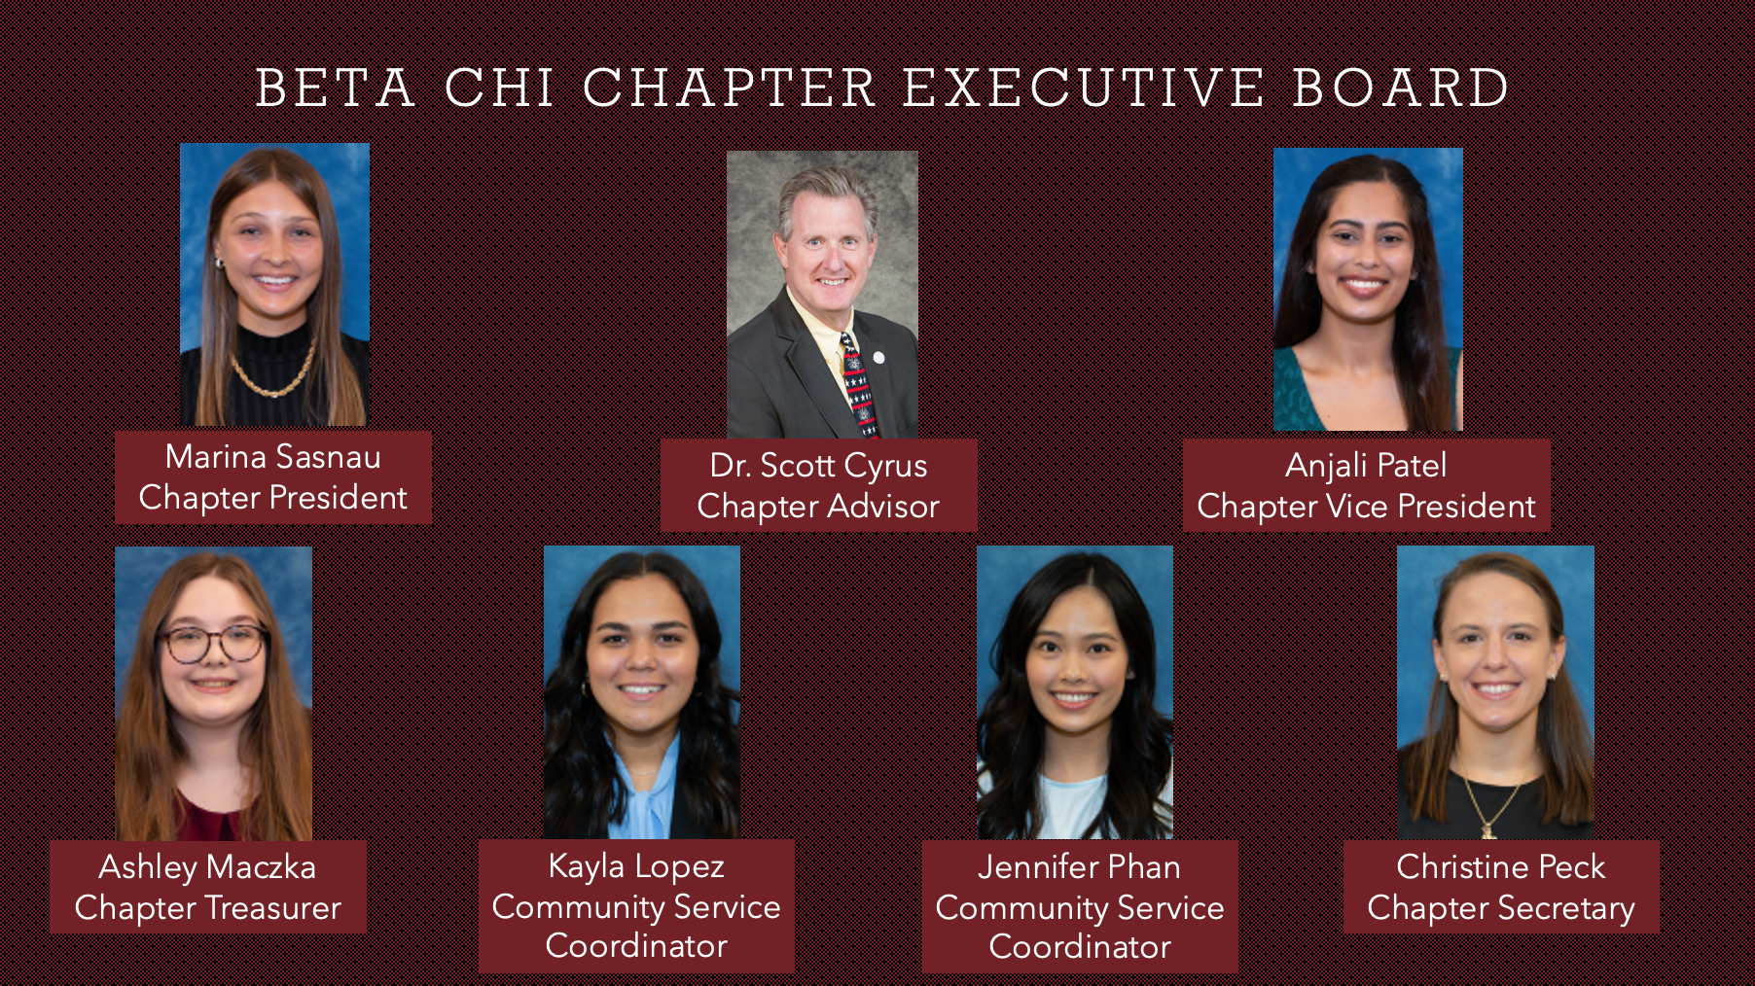
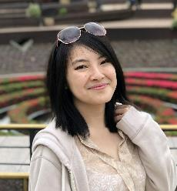
Beta Chi Chapter Executive Board

Slide 4
Rush Fall 2022
Designed for the Class of 2026
Aids in selection process and allows students to get to know each other
Upcoming events
At-home scavenger hunt social
Hot chocolate at Beck’s social

Slide 5
Community Partnerships
Animal Services Center of the Mesilla Valley
Las Cruces Asylum Seeker Shelter
City of Las Cruces
Children’s Reading Alliance of Las Cruces
El Caldito Soup Kitchen
La Casa Inc.
Mesilla Valley Habitat for Humanity
Southern New Mexico Diabetes Outreach
2021-2022 849.75 community service hours from SSP members

Slide 6
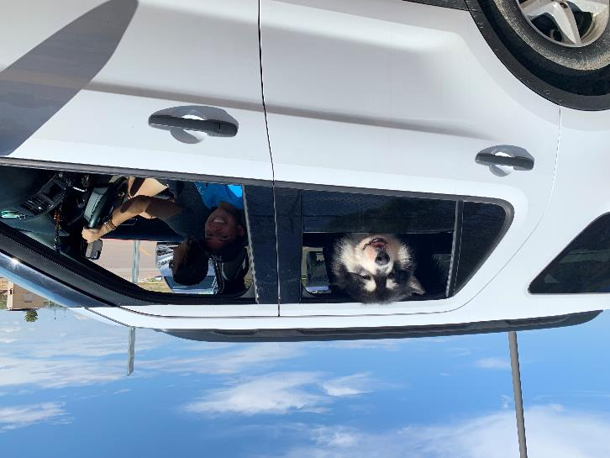
Animal Service Center of the Mesilla Valley Event: Clear the Shelter Pet adoption drive that helps find loving homes for animals in need

Slide 7
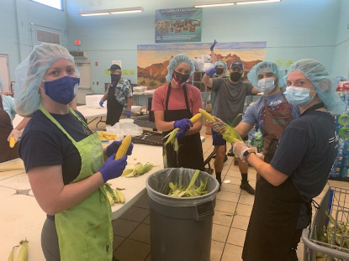
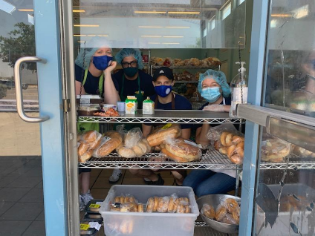
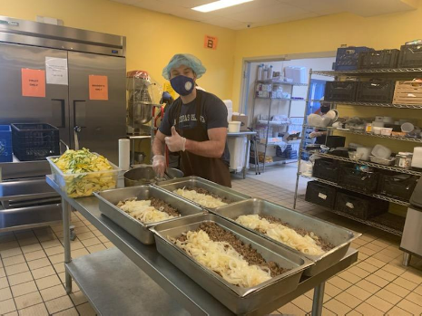
El Caldito Soup Kitchen Prepare and distribute meals to Dona Ana county residents experiencing homelessness and food insecurity

