Slide 1
Edward Via College of Osteopathic Medicine
Auburn Campus
2022 Annual Report

Slide 2
Chi - Auburn Chapter
Mission Statement:
Sigma Sigma Phi is an Honorary Osteopathic Service Fraternity. Its objectives and purposes are to further the science of osteopathic medicine and its standards of practice, to improve the scholastic standing and promote a higher degree of fellowship among its students, to bring about a closer relationship and understanding between the student bodies and the officials and members of the faculties of our colleges, and to foster allegiance to the American Osteopathic Association and to perpetuate these principles and the teachings through the maintenance and development of this organization.
The key symbols (skull, spine, & femur) adorn the fraternity emblem. The emblem itself is shaped in the likeness of a sternum, due to it's key role in hematopoiesis, and thus, the origin of our life source & vitality.

Slide 3
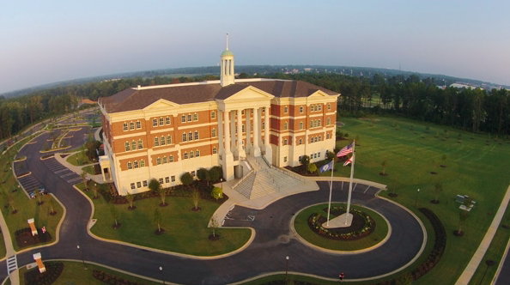
VCOM Auburn
Auburn, AL, “The Loveliest Village on the Plains”

Slide 4
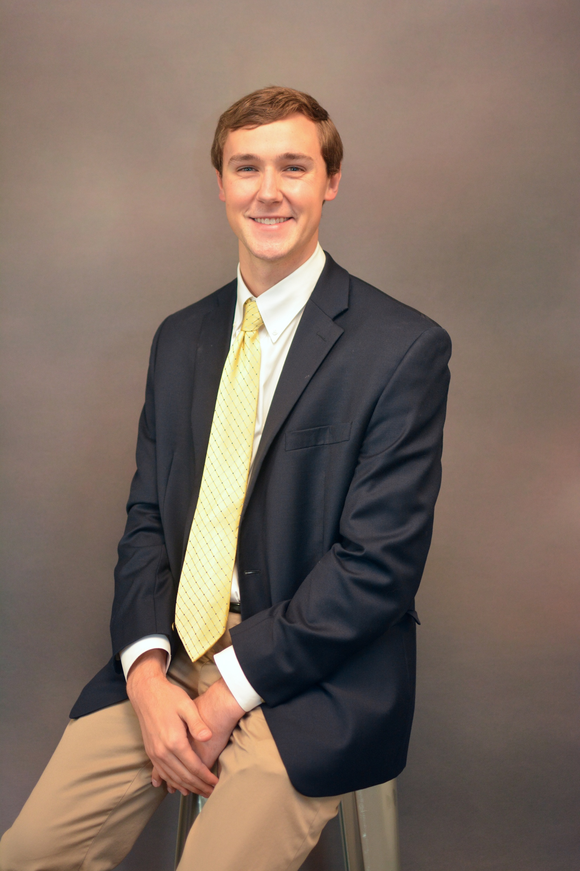
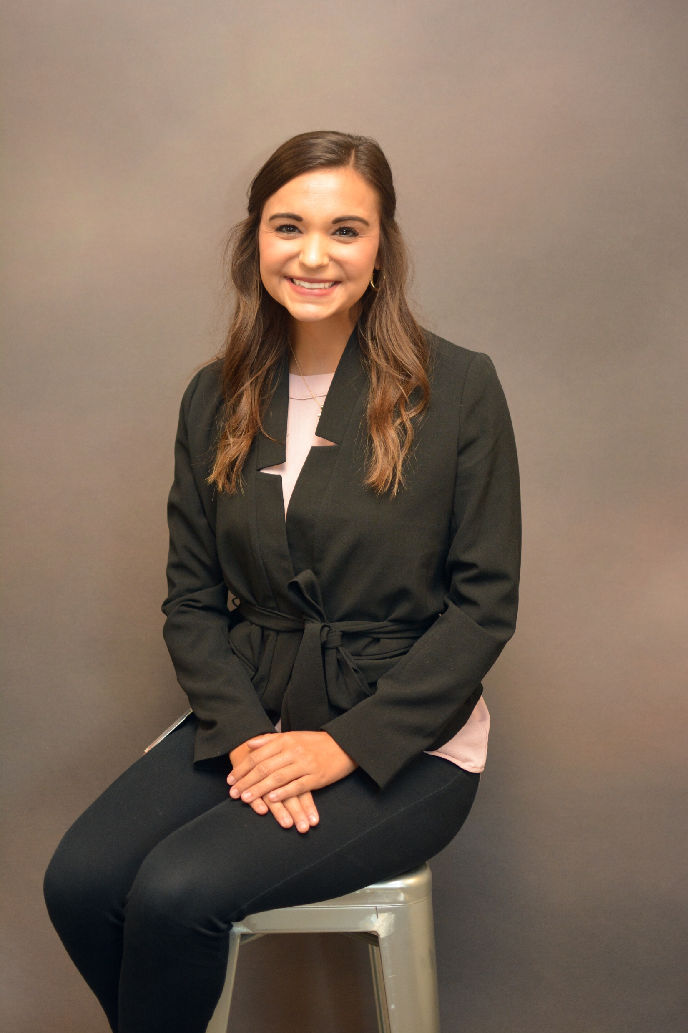
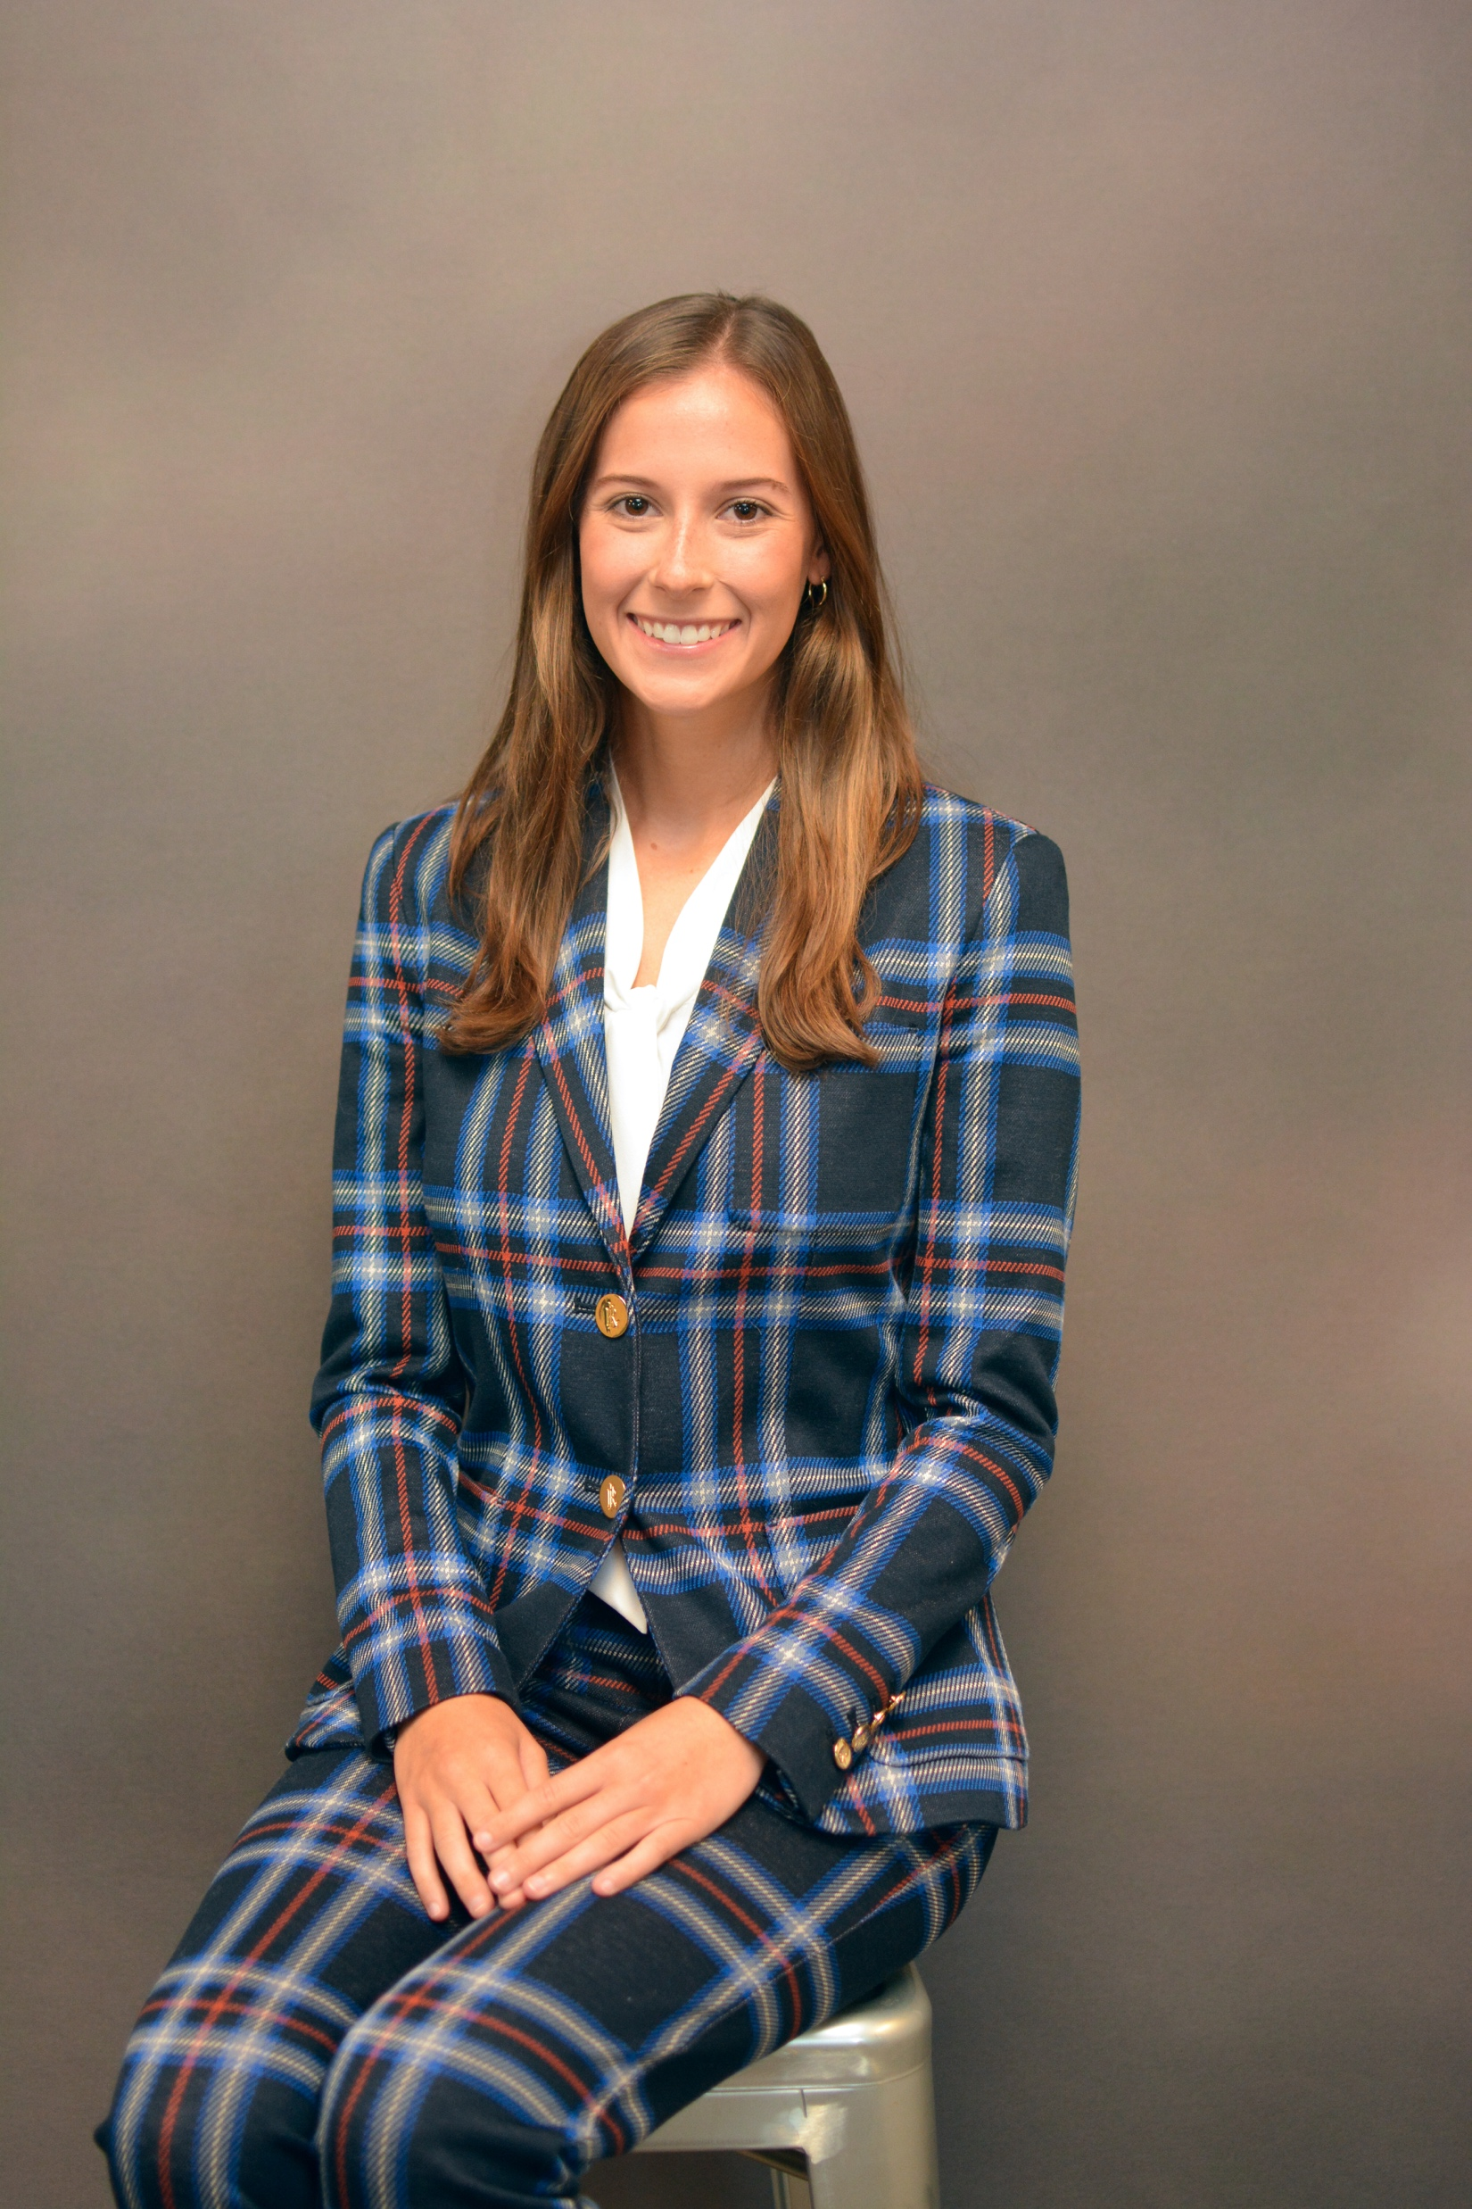
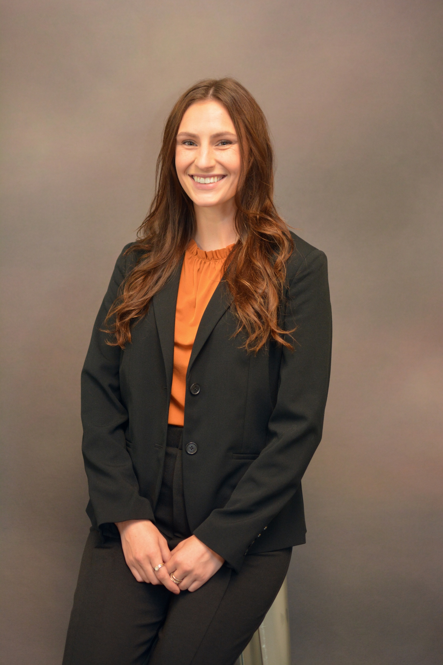
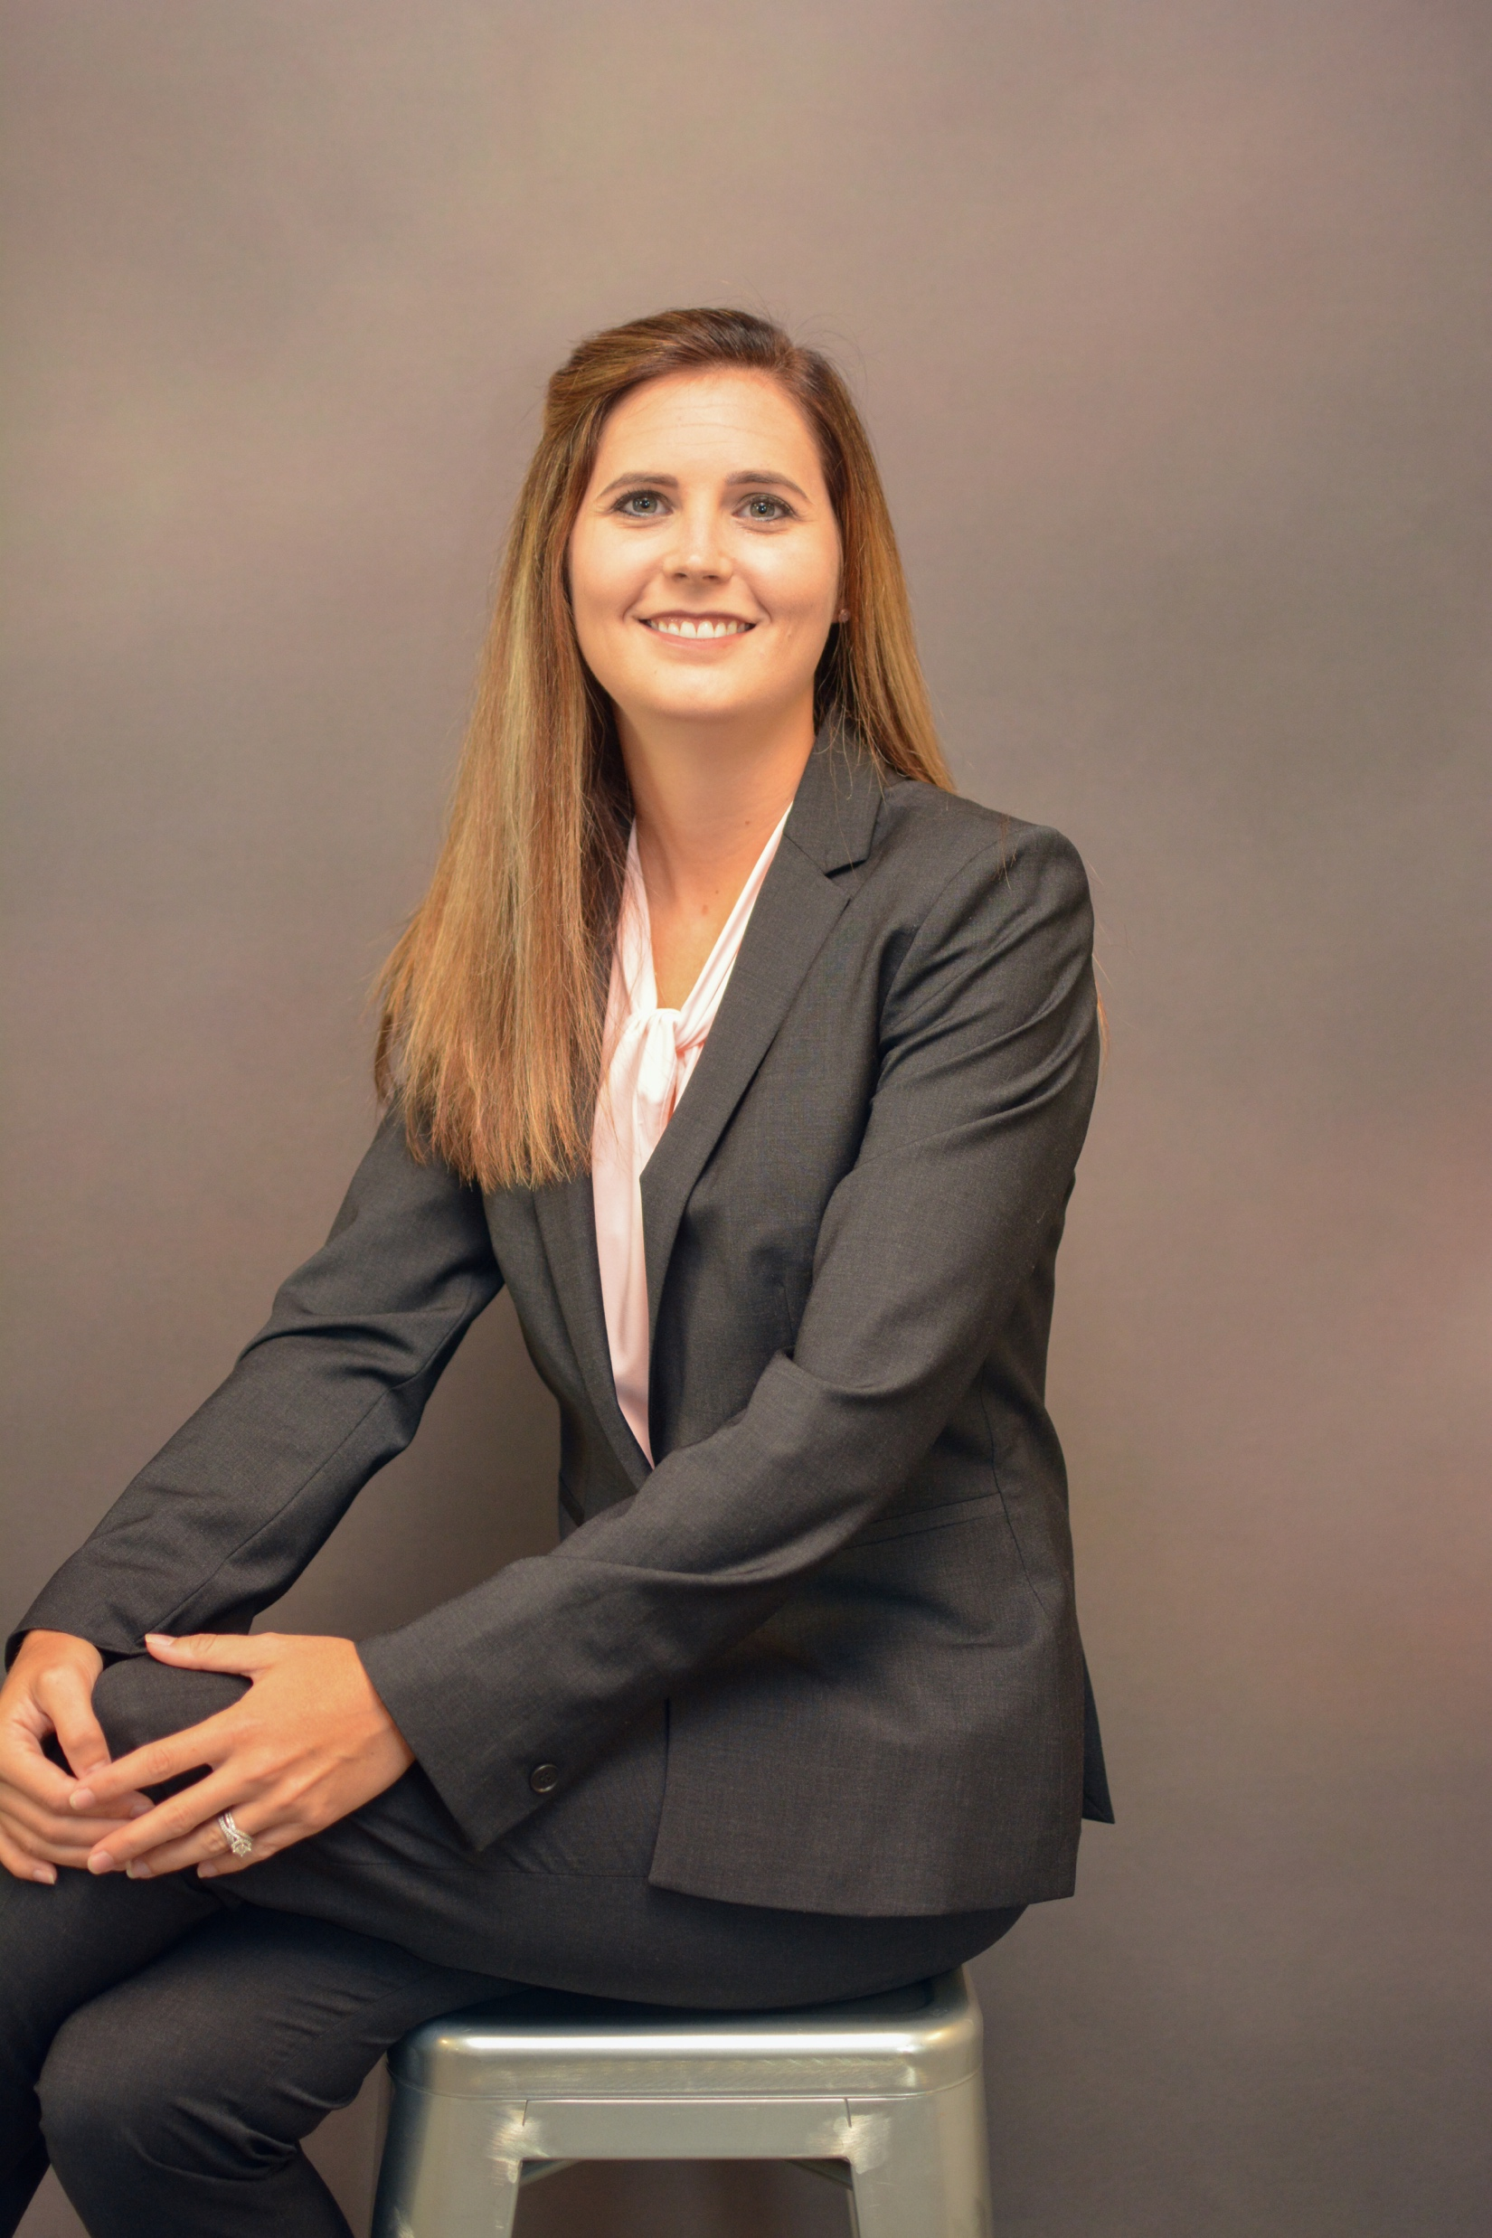
Officers Fall 2022- Spring 2023
Cody Jones, OMS II
President
Claudia Reid, OMS II
Vice President
Kaylee Burlingame, OMS II
Secretary
Lindsay Slemmons, OMS II
Treasurer
Devan Barnett, OMS II
Membership Chair

Slide 5
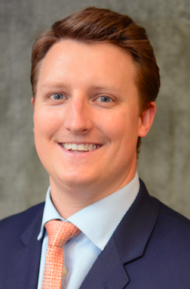
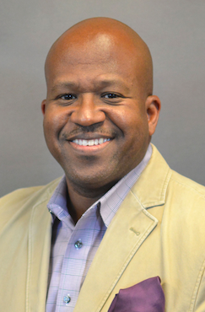
Faculty Advisors
Jake Williamson, PhD
David J. Stephen, DO
Associate Dean for
Student Affairs
Associate Dean for OMS 4th Year and Graduate Medical Education & Discipline Chair for Pathology and Histology

Slide 6
Membership Criteria:
Our criteria for invitation are currently:
Must have a 3.8 GPA or higher at VCOM at end of first year or second year
Must have no current or pending academic deficiencies
Must be considered in good standing with VCOM
e.g., no current or pending behavioral infractions, no academic probation, etc.
Must be willing to provide advice or counsel to other medical students or potential medical students on the values and benefits of being an osteopathic physician

Slide 7
Requirements to Maintain Membership:
Maintain GPA – 3.65
Students with a GPA below 3.65 after induction will go under probation and review
Recommended Service Hours
2nd years – 20 hours/year (10 hours/semester)
3rd and 4th years – 10 hours/year (5 hours/semester)
Must attend SSP events and member meetings

Slide 8
Chapter Involvement:
On Campus
VCOM’s “Golden Apple” Award for Excellence in Teaching Practices
The purpose of this award is to recognize faculty members who are dedicated to educating, mentoring and inspiring the students of VCOM
Future Plans:
VCOM After Dark Boards Trivia Night
Merchandise Fair
Bugs and Drugs
Weekly board facts
Rescue Race- scenario sponsor
Auburn Undergraduate Outreach
New Member Induction Ceremony

Slide 9
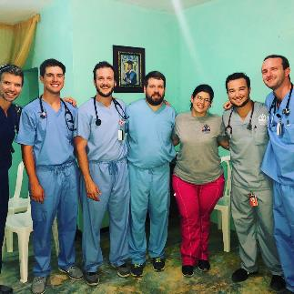
Chapter Involvement:
Service
Medical Mission Trips
Locations:
Honduras
Dominican Republic
El Salvador
Peer Tutoring/Mentoring
White coat fitting
Hosted for first years
White Coat Ceremony Attendants
Board Prep Jeopardy
Graduation Ceremony Attendant

Slide 10
Thank you!

