Slide 1
Edward Via College of Osteopathic Medicine
Louisiana Campus
2022 Annual Report

Slide 2
Chi Chapter- Monroe Branch
Mission Statement:
Sigma Sigma Phi is an Honorary Osteopathic Service Fraternity. Its objectives and purposes are to further the science of osteopathic medicine and its standards of practice, to improve the scholastic standing and promote a higher degree of fellowship among its students, to bring about a closer relationship and understanding between the student bodies and the officials and members of the faculties of our colleges, and to foster allegiance to the American Osteopathic Association and to perpetuate these principles and the teachings through the maintenance and development of this organization.
The key symbols (skull, spine, & femur) adorn the fraternity emblem. The emblem itself is shaped in the likeness of a sternum, due to its key role in hematopoiesis, and thus, the origin of our life source & vitality.

Slide 3
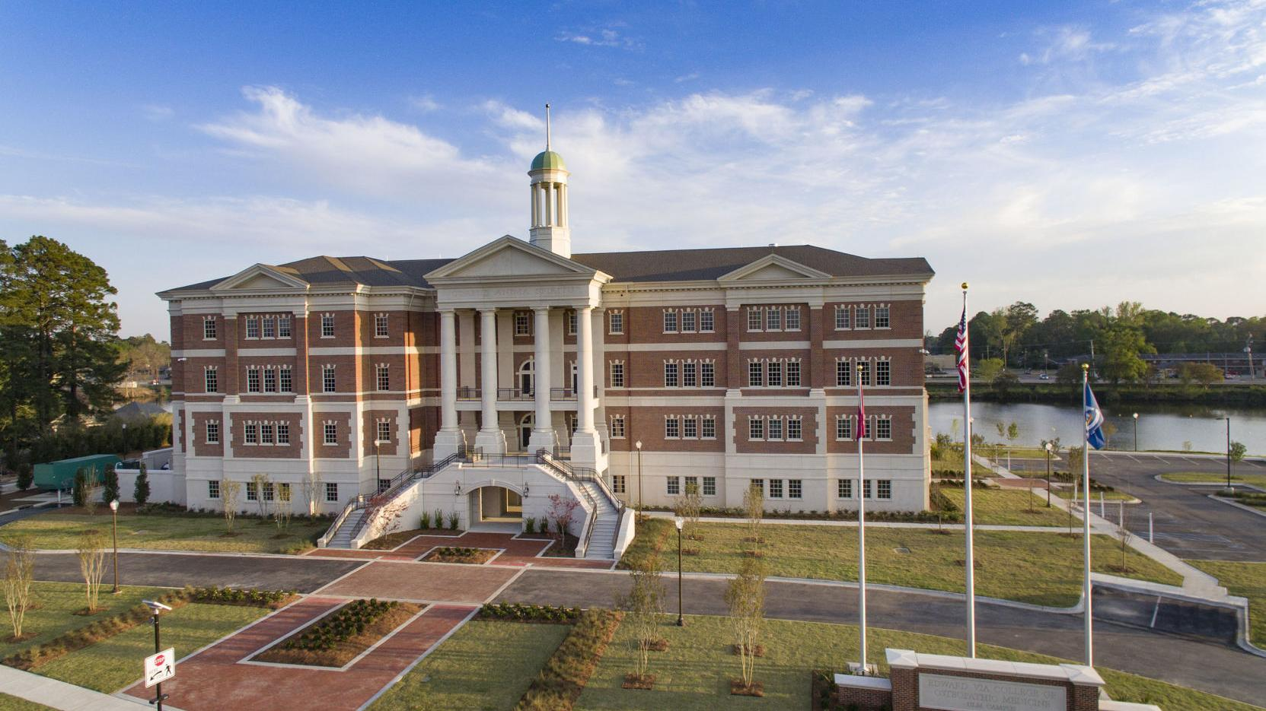
VCOM-Louisiana
Monroe, LA

Slide 4
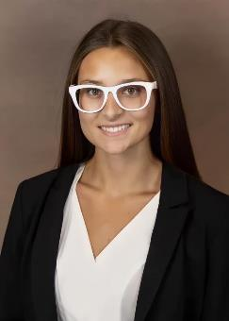
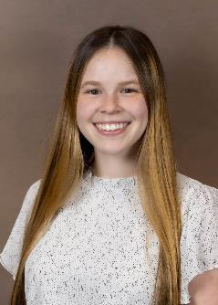
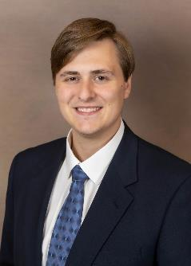
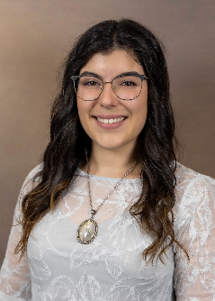
Officers
Fall 2022-Spring 2023
Samantha Jacobson, OMS II
President
Macey Tycoliz, OSM II
Vice President
Chris Yacobucci, OMS II
Secretary/Treasurer
Madison Lambert, OMS III
OMS-3 Advisor

Slide 5
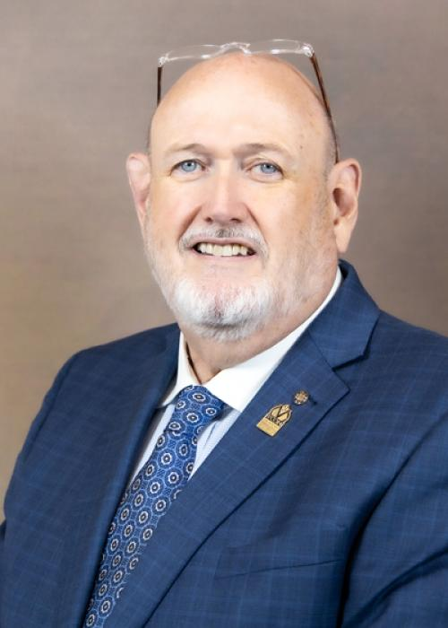
Faculty Advisor
Ray Morrison, DO
Associate Vice President for College Development and Advancement in the Louisiana Region
Dean Emeritus

Slide 6
Membership Criteria:
Our criteria for invitation are currently:
Must have a 3.8 GPA or higher at VCOM at end of the 3rd or 7th blocks
Must have no current or pending academic deficiencies
Must be considered in good standing with VCOM
e.g., no current or pending behavioral infractions, no academic probation, etc.
Must be willing to provide advice or counsel to other medical students or potential medical students on the values and benefits of being an osteopathic physician

Slide 7
Requirements to Maintain Membership:
Maintain GPA – 3.8
Required Service Hours
10 hours/year
Must attend SSP events and member meetings

Slide 8
Chapter Involvement: On Campus
VCOM’s “Golden Apple” Award for Excellence in Teaching Practices
The purpose of this award is to recognize faculty members who are dedicated to educating, mentoring and inspiring the students of VCOM
New Member Induction Ceremony
Future Plans:
Merchandise Fair
Bugs and Drugs
CV workshop

Slide 9
Chapter Involvement: Service
White Coat Ceremony
Future Plans:
Peer Tutoring/Mentoring
Tutoring local students of community
White coat fitting
Board Prep Jeopardy / Trivia
Graduation Ceremony Attendant

Slide 10
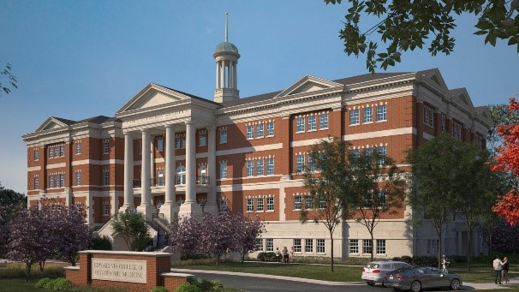
Thank you!

