Slide 1
Sigma Sigma Phi
Delta Chapter - Joplin Report
OCTOBER 30, 2022

Slide 2
Meet Our Executive Board
President: Chloe Maye
Vice President: Michelle Mathew
Treasurer: Avina Mahroke
Secretary: Shelby Mertz
Community Service Chair: Tabitha Joyner
Selection Committee Chairs: Nagib Manzur & Michelle Mathew
Advisor: Dr. Kenneth Stewart, DO, FACEP, FAAEM

Slide 3
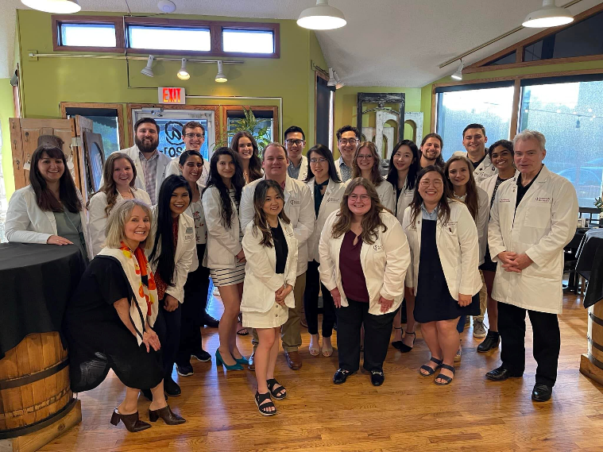
Spring 2022 Induction Ceremony
On May 13, 2022, 28 students were inducted into Delta Chapter - Joplin.
Class of 2024: 5 new members
Class of 2025: 23 new members

Slide 4
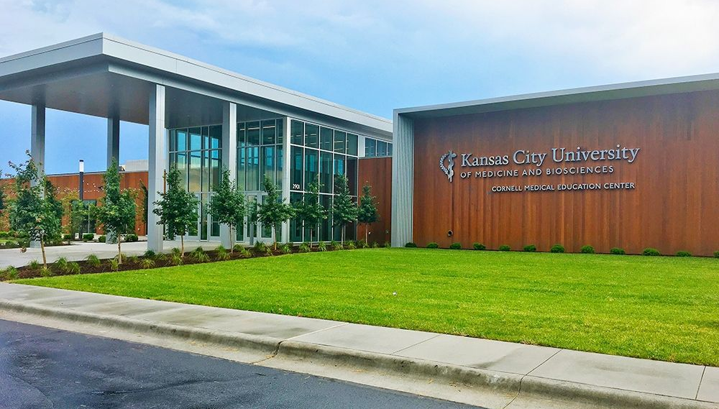
Total Membership
Class of 2021: 28
Class of 2022: 25
Class of 2023: 22
Class of 2024: 43
Class of 2025: 23

Slide 5
Requirements for Acceptance
Requirements to Maintain Membership
Must have completed the first semester of OMS-I courses with ≥80% in each course.
Must have submitted an application detailing relevant scholastic accomplishments and community involvement.
Applications are reviewed and potential members are voted on by the Selection Committee.
Delta Chapter - Joplin membership shall not exceed 25% of the total number of students enrolled at the Joplin campus.
Members must maintain ≥80% in each course.
Members cannot have a rotation failure during their 3rd or 4th year.
Members must complete at least 4 Sigma Sigma Phi-affiliated hours of community service per academic year.

Slide 6
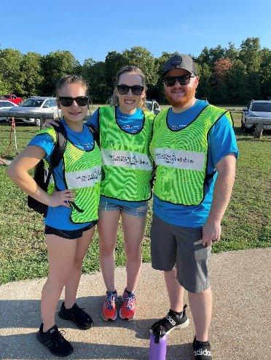
Fall 2022 Events
August 3rd: First Meeting/Chapter Social
August 13th: Shoal Creek Water Festival
August 22nd: OMS-I Tips and Tricks
September 17th: Doggy’s Day Out with the Joplin Humane Society
October 21st-22nd: Ghostly Glades with the Wildcat Glades Friends Group
November 3rd: Board Prep Panel with KCU-Joplin’s Boards and Beyond Student Interest Group
Delta Chapter - Joplin members taking a picture after a long morning of directing traffic at the Shoal Creek Water Festival!

Slide 7
Future Projects
Establishing a mentorship program with Missouri Southern State University’s Caduceus Club.
Working with the Delta Chapter in Kansas City to host cross-campus Board prep workshops in the Spring semester.
Continuing our community partnerships with the Wildcat Glades Friends Group and Joplin Humane Society.

Slide 8
Questions?
Feel free to reach out!
Email: Chloe.Maye@kansascity.edu

