Slide 1
Midwestern University Chicago College of Osteopathic Medicine
Monica Misch
Chapter President, 2022-2023

Slide 2
What is ΣΣΦ?
Honorary Osteopathic Service Fraternity
National Objectives:
Further the science of Osteopathic Medicine and its standards of practice
Improve the scholastic standing and promote a higher degree of fellowship among its students
Foster allegiance to the AOA
Epsilon Corollary:
Demonstrate a sincere commitment to serving communities in Chicago as well as within CCOM

Slide 3
Executive Board 2022-2023
President – Monica Misch
Vice President – Bryce Young
Treasurer – Andrea St. Laurent
Secretary – To be recruited

Slide 4
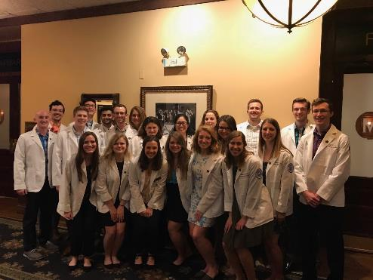
Membership
46 active members
9 OMS-IV
19 OMS-III
18 OMS-II
Faculty Advisors.
Dr. Perry Marshall, D.O.

Slide 5
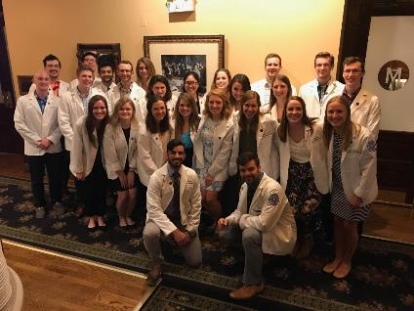
Fall Membership Drive
Executive board meeting with former president as early as June 24 to set clear expectations for the year
Written applications closed on August 29th
Applicants are currently undergoing a grade check
Will be randomized before distribution to a blind peer review
Conducted by 2-3 current members who are not classmates
Applications reviewed by selection committee by the goal of Sep. 16th
Criteria for admission
Scholastics (GPA > 3.30)
Community Service
Interest in SSP
Demonstrated leadership

Slide 6
Sample Essay Prompts
Hippocrates is credited with coining the aphorism “Wherever the art of medicine is loved, there is also a love of Humanity”. According to this quote, how is Sigma Sigma Phi’s commitment to service imperative to the art of medicine?
In your opinion, what is the most valuable aspect of an Osteopathic education?
How do you believe academic integrity relates to a future in medicine? How will this value influence your career as an Osteopathic physician?

Slide 7
Finances
Current Student Accounts Balance:
$4,000 as of August 30, 2021

Slide 8
Fundraisers
CCOM Apparel Sale
Half Zip Sweatshirts and T-shirts
Sale goes live in Winter Quarter

Slide 9
Projects
Speed rotating event for MS2 students
Student informational panel for MS1 students
Boards study strategy panel for MS2 students
Bi-monthly service opportunity newsletter
Collaboration with local food pantries
West Suburban Community Pantry, monthly visits
People’s Resource Center, self sign-up
Making Strides Against Breast Cancer Walk

Slide 10
Rotation "Speed Dating"
Annual event to take place Winter Quarter
Third and fourth year students return to campus to share their rotation experiences
Small group format facilitates discussion
Chance for members to compare and contrast specialty interests

Slide 11
Student Information Panel
Several second-year members answer questions from current first year students
Members offer advice on managing course load and how to make the most out of the M1 summer

Slide 12
Boards Study Strategy Panel
Third year members answer questions from second year students and offer suggestions for how to best prepare for boards
Topics include
When to start studying
How much time should be allocated
Most beneficial resources

Slide 13
Service Opportunity Newsletter
List of service opportunities near the CCOM campus
Makes search seem less daunting, more approachable
Encourages active participation
Convenient perk for members
List will be made available to all members of Epsilon Chapter on a bi-monthly basis

Slide 14
Goals
Create a precedent for academic success that is centered around an encouraging, positive outlook
Host a celebratory induction ceremony following the Spring application cycle
Actively search for group service opportunities so members can develop meaningful friendships
Advocate for Sigma Sigma Phi on campus and increase chapter size

Slide 15
Contact
Chapter President, Monica Misch
monica.misch@midwestern.edu
Thank you!

