Slide 1
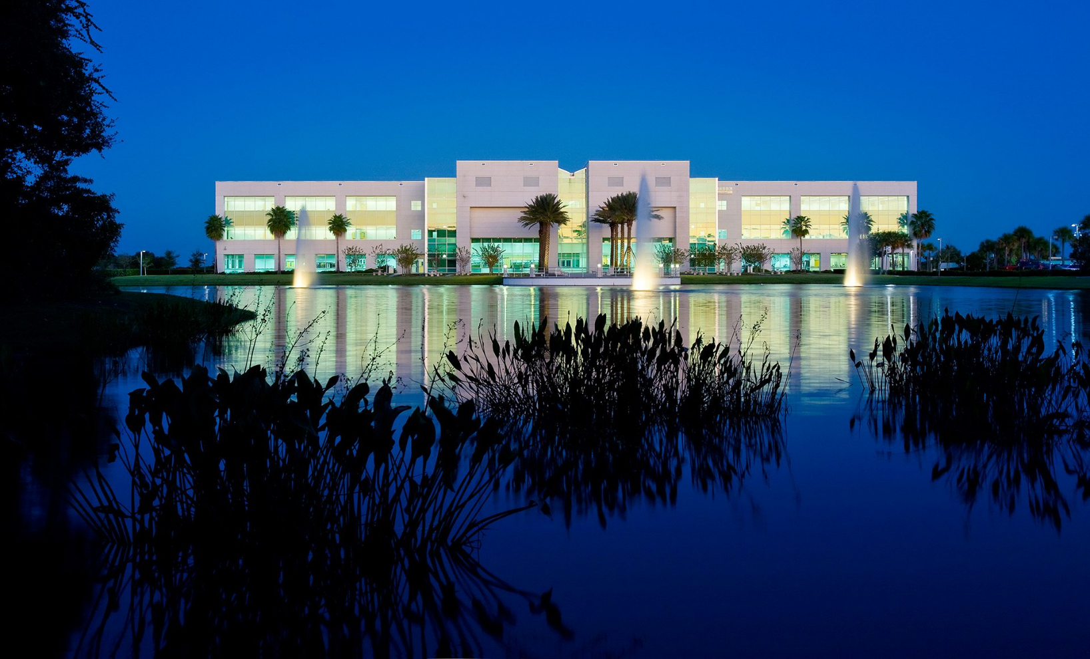
ΣΣΦ
Gamma Gamma Chapter

Slide 2
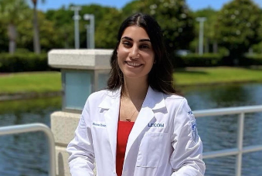
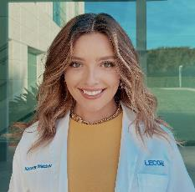
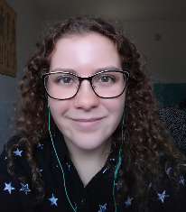
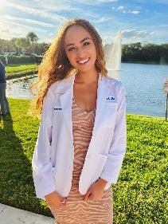
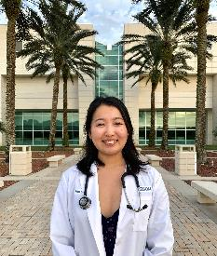
Leadership 2022-2023
President
Reema Tominna
Vice President
Kassidy Webber
Secretary
Maddy Porter
Treasurer
Gabby Hernandez
Service Chair
Min Chae

Slide 3
ΣΣΦ Mission
Leadership
Community Service
Academic Excellence

Slide 4
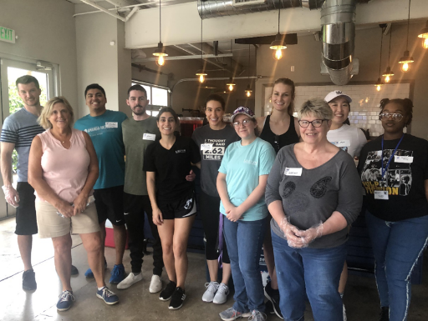
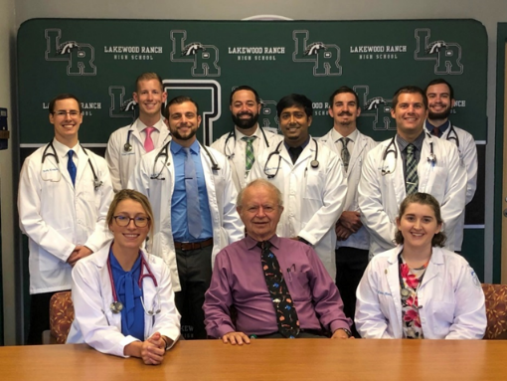
Volunteering Events
Turning Points
Dream Oaks
MMS tutoring
All Faiths Food Bank
Habitat for Humanity
Manatee County Medical Reserve Corps
Lakewood Ranch High School

Slide 5
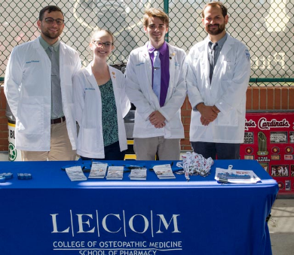
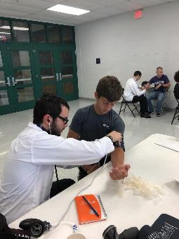
Volunteering Events Cont.
COVID hotline, testing & administering the vaccine
Helping various homeless/underserved outreach organizations
Joshua House – helping foster children
Community Clean Up programs
Sending greeting cards to nursing homes
Helping host virtual community baby showers in partnership with Teen Parent Program
Tutoring/mentoring students of all ages
Food Drives

Slide 6
Hours Completed
SSP class of 2025: Over 800 hours completed collectively so far!

Slide 7
Membership Requirements
GPA of at least a 3.0
Minimum of 15 volunteer hours per semester (including 2 events through SSP)
May only miss one general body meeting per semester
Held as needed to discuss upcoming events/changes
Membership granted to a maximum of 25% of the total class size

