Slide 1
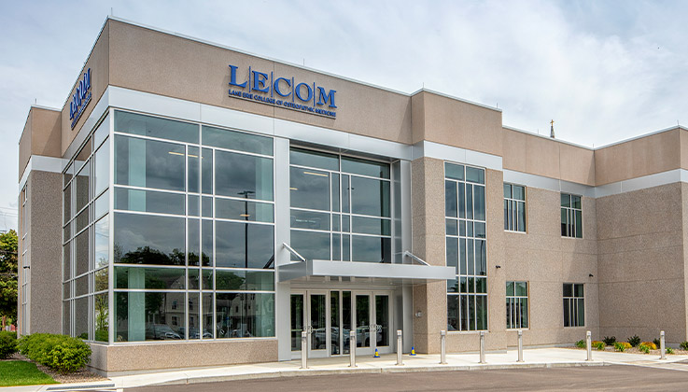
GAMMA CHAPTER OF SIGMA SIGMA PHI

Slide 2
LAKE ERIE COLLEGE OF OSTEOPATHIC MEDICINE
LECOM was established as the 16th college of Osteopathic medicine in December 1992.
The Charter Class Began on August 9, 1993 in Erie, Pennsylvania
LECOM has granted the Doctor of Osteopathic Medicine degree to almost 5,982 graduates as of 2016.

Slide 3
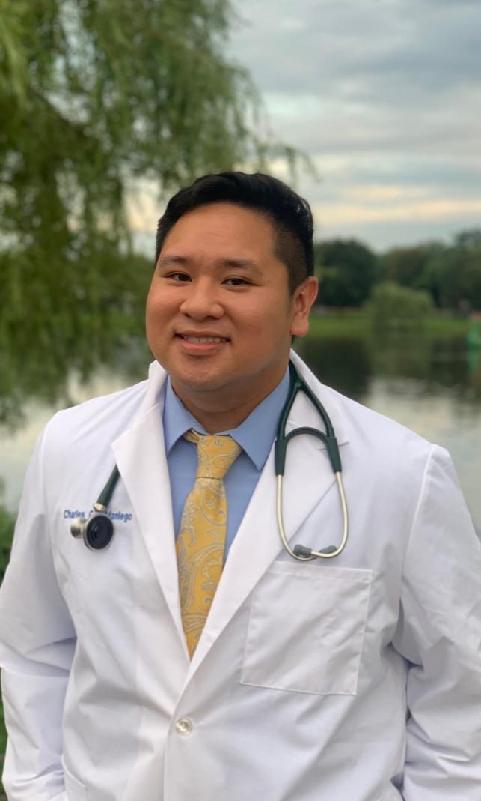
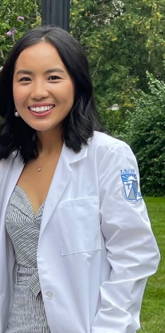
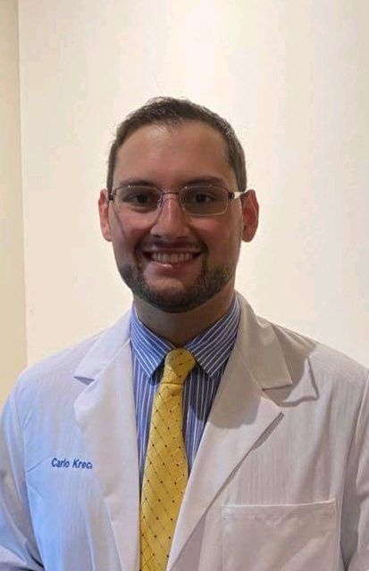
GAMMA CHAPTER EXECUTIVE BOARD
PRESIDENT: Lea Carina Rivera
VICE PRESIDENT: Charles Maniego
TREASURER: Tenzin Khangkar
SECRETARY: Carlo Krecic

Slide 4
GAMMA CHAPTER MISSION STATEMENT
“As an organization founded on scholastic achievement, service, and medicine, we can best serve our community by mentoring the health-underserved populations of Elmira, both academically and socially “

Slide 5
GAMMA CHAPTER GOALS
Positively impact the community at large through health-oriented community service projects and outreach programs
Strengthen the presence and awareness of Osteopathy in the local community
Promote fellowship amongst the student body and to continue the scholastic excellence of its members and its colleagues

Slide 6
GAMMA CHAPTER REQUIREMENTS
In order to apply all prospective members must complete the following requirements must:
Demonstrate involvement in school clubs and community service activities
Complete at least 5 community Service hours in the semester prior to the application cycle
Have at least a 3.0 cumulative GPA
In order to maintain active membership status members must:
Maintain a minimum 3.0 cumulative GPA
Participate in 12 community service hours per semester

Slide 7
CURRENT GAMMA CHAPTER MEMBER STATISTICS
Erie Chapter Total:
110 Total Current Members
Seton Hill Chapter Total:
36 Total Current Members
Elmira Chapter Total:
23 Total Current Members
Membership shall not exceed 25% of the total of the
1st, 2nd, 3rd, & 4th year classes

Slide 8
GAMMA CHAPTER SERVICE ACTIVITIES

Slide 9
WHAT IS AN SSP EVENT?
Anything that is established as an SSP event by the E-board
Must better LECOM and/or the community
If the event is co-sponsored with another club you have the option to record it as either SSP or non-SSP

Slide 10
GIFT OF LIFE BONE MARROW REGISTRY
Gift of Life’s mission is to cure blood cancer through cellular therapy
Conditions that can be treated by transplantation include:
Bone marrow diseases (Amegakaryocytosis thrombocytopenia, Fanconi anemia, PNH
Hemoglobinopathies: Beta-thalassemia major, SCD
Immune system disorders: SCID, Wiskott-Aldrich Syndrome
Leukemias and Lymphomas

Slide 11
INTERVIEW DAY STUDENT PANELIST
Chapter members serve as ambassadors for LECOM by participating in a virtual student panel for prospective students after their interviews.
Members answer questions related to LECOM, the Elmira community and medical school in general
Interview Day Panel – Google Sheets
https://lecom.zoom.us/j/93593685900

Slide 12
MS3 AND 4 STUDENTS MENTORING MS2 STUDENTS FOR BOARD PREPARATION
Coordinating MS3 and MS4 students with current MS2 students to give board prep advice through in-person meetings, zoom, facetime, and email
MS3 and MS4 students maintain a database containing reviews of various rotation sites which are made available to the 2nd year class to aid in their clinical rotation selections

Slide 13
BAMPAS HOUSE - CORNING COMFORT CARE INC.
People nearing end-of-life for whom home care is not an option will have a safe, dignified, peaceful, and comfortable home staffed with volunteers to care for them and their loved ones through end-of-life.
Volunteer responsibilities include:
Adjusting bedding
Getting food and drinks
Helping with feeding
Reading to residents
Offering good company
170 E. First St.,
Corning, NY 14830
bampashouse@gmail.com

Slide 14
HEALTH MEETS HOME (HMH)
In collaboration with the Food Bank of the Southern Tier and Arnot Health
Contacted and interviewed food-insecure families and recruited them in our program
Each week, boxes of groceries were delivered to each family with healthy, balanced recipes to follow
Vitals and participant comments are recorded at each drop-off
Official HMH cookbook
https://drive.google.com/file/d/1JygltdvEgjgnEQZvCc7CzNT_hXfQN6FS/view

Slide 15
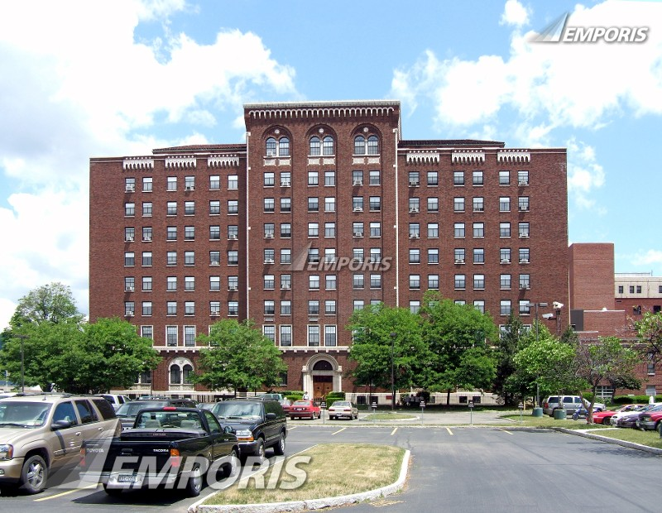
ST. JOSEPH’S HOSPITAL - SKILLED NURSING FACILITY
Arnot Health offers residential care for elderly and chronically ill patients who no longer need acute hospital care or are no longer able to be cared for at home. We offer skilled nursing and rehabilitative therapy in a caring environment at St. Joseph's Hospital
555 St. Joseph's Blvd.,
Elmira, New York 14901
Notes:
Affiliated with Arnot Ogden Medical Center

Slide 16
FAMILY SERVICES OF CHEMUNG COUNTY
Compeer is a community-based mentoring program offered at Family Services of Chemung County to community members struggling with their mental health. Here we recruit and train community volunteers to serve and build meaningful relationships with children and adults
Note: Volunteers are asked to commit one year of volunteer of service, but can work with your schedule should you match with a clinical site elsewhere
1019 E Water St. #3332,
Elmira, NY 14901
Notes:
"Compeer" comes from the blend of the words "companion" and "peer".

Slide 17
OTHER POTENTIAL OPPORTUNITIES
Red Cross Blood Drives
Fundraising Walks – Tanglewood Park
D.O. More – non-profit, fundraising organization composed of osteopathic medical and pre-medical students
Notes:
SPCA: at the moment, they only have volunteer options for spay/neuter clinics which require being available for 12 hours a day

Slide 18
FINAL THOUGHTS
The Gamma Chapter would like to thank the National Grand Chapter for all of its support. We look forward to continuing the fantastic work that our chapter does and to continue our mission of furthering Osteopathic Principles and Values in the communities where we live and serve.

Slide 19
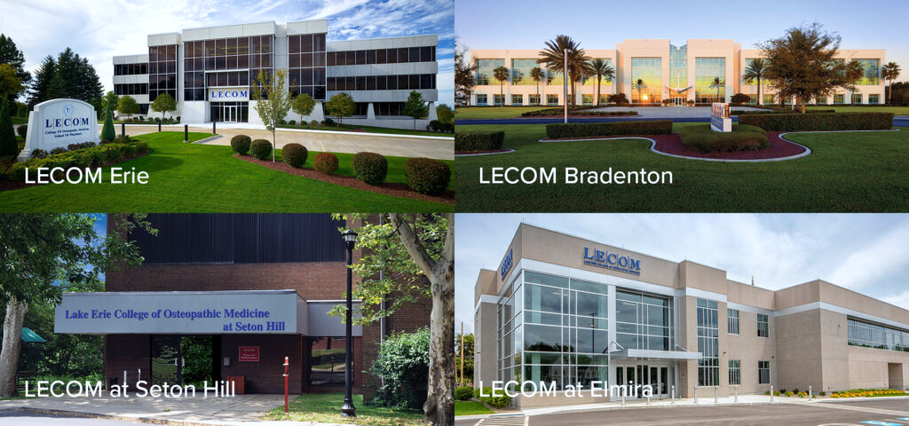
THANK YOU

