Slide 1
Sigma Sigma Phi- Gamma Chapter
NATIONAL HONORARY OSTEOPATHIC SERVICE FRATERNITY
2022

Slide 2
Mission
Further the philosophy, art, and science of osteopathy and its standards of practice
Improve student’s scholastic standing and promote a higher degree of fellowship among its students
To bring about a closer functional relationship and understanding between student bodies and the officials and members of the faculties of our colleges
To further the welfare of the osteopathic profession, its colleges and other institutions
Foster allegiance to the AOA and to perpetuate high professional standards through the maintenance and development of this organization.

Slide 3
Who we are
LECOM at Seton Hill was establish in 2009
57 students from OMS II-OMS IV belong to the LECOM Seton Hill gamma chapter

Slide 4
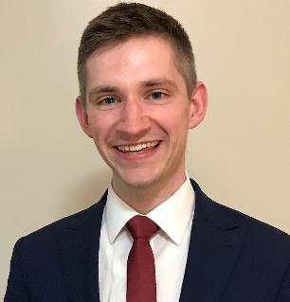
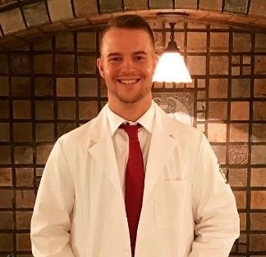
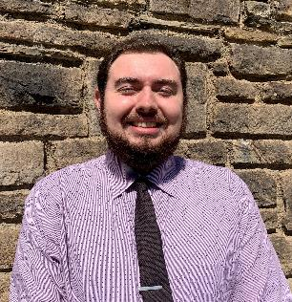
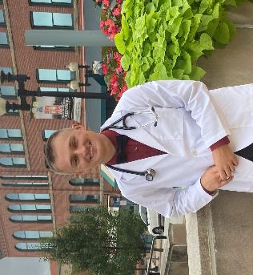
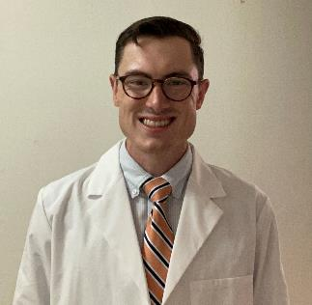
Class of 2025 Eboard
President: Sam Shumway
Vice-President: Cooper Larson
Secretary: Matt Sanchez
Tresurer: Matt Bushik
Historian: Max Spence

Slide 5
Membership Requirements
Limited to 25% of the student body
Must maintain a 3.0 GPA
OMS I & OMS II
Complete 12 hours of community service each semester
5 hours from SSP events and 5 from non-SSP events
2 additional hours from either category
OMSIII & OMSIV Years
12 hours of any community service per year
COVID19 Policy:
In order to promote public health measures and ensure the safety of our members, we did not require mandatory non-SSP event hours for the Spring or Fall semesters of 2020. We did require participation in at least 1 virtual SSP-sponsored serve event per semester.

Slide 6
What is an SSP event?
Anything that is established as an SSP event by the E board
Must better LECOM and/or the community
If the event is co-sponsored with another club you have the option to record it as either SSP or non-SSP

Slide 7
Inductions
Inductions take place each semester
OMSI application invitations are sent out to everyone meeting our requirements in January and induction occurs in March
OMS2 applications are sent out in September

Slide 8
Walk a Mile in Her Shoes
Members of SSP have the opportunity to help the Blackburn Center in Greensburg with the annual “Walk a Mile in Her Shoes” event, which raises awareness of the serious causes, effects, and remediations to men's sexualized violence.

Slide 9
Charity Miles App
SSP members are able to log miles through running, walking, biking, etc. which in turn earns money for various charity groups that the student selects.

Slide 10
Be the Match
SSP members have the opportunity to participate in helping Be the Match to find registry members for its bone marrow registry. The registry is used to help people in need of bone marrow transplants.

Slide 11
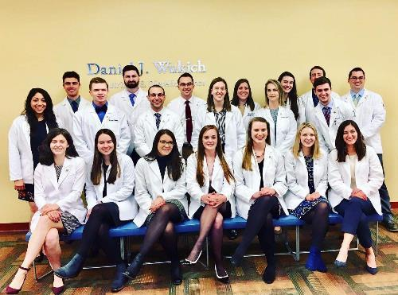
What does membership mean?
ACHEIVEMENT
Taking pride in the hard work you have done to be here, and promote further achievement in ourselves and others
COMMUNITY
Working as a team to promote fellowship within our osteopathic community
SERVICE
Endorsing compassion, empathy, and care for the local community by giving back to those we can!

