Slide 1
SIGMA SIGMA PHI: Lambda Chapter Annual Report Ohio University Heritage College of Osteopathic Medicine Presented by Maya Farhat, OMS II ΣΣΦ President for 2022 - 2023 Cleveland, OH For Academic Year: 2021-2022

Slide 2
Outline
Lambda Chapter Structure
Executive Board
Membership
Activities:
Community Service
Academic Support
OU-HCOM Activities

Slide 3
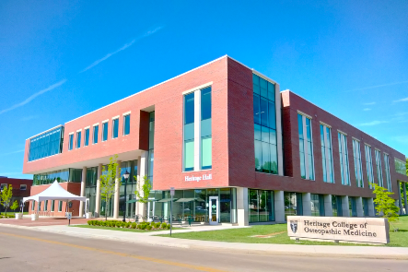
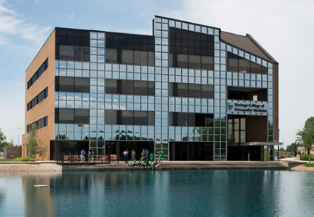
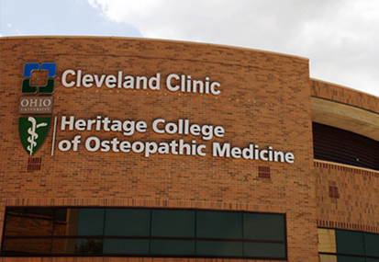
Lambda Chapter
Main Campus
Athens, Ohio
Additional Campuses
Dublin, Ohio
Cleveland, Ohio
Athens
Dublin
Cleveland
Athens

Slide 4
22’-23’ Cleveland Executive Board
President: Maya Farhat , OMS-II
mf489520@ohio.edu
Vice President/Secretary: Sara Gier, OMS-II
sg249716@ohio.edu
Treasurer: Rachel Cuellar, OMS-II
rc762316@ohio.edu
*

Slide 5
Membership
Current Total: (all three campuses)
Class of 2023: 54
Class of 2024: 57
Class of 2025: 29
Recruitment:
End of fall term for Class of 2025 and 2026
Emphasis on:
Community Service
Leadership
Academics
Must be in good academic standing with OU-HCOM
Must pass all courses without reassessment
OMS-I, OMS-II: members must average at least a minimum of 80% between components 1 and 2 of the syllabus each semester.
OMS-III, OMS-IV: must pass all rotation evaluations, COMAT, and rotations.

Slide 6
Community Service
Membership requirement:
1st/2nd years: 12 hours/semester
3rd/4th years: 4 hours/semester
Community Service:
Project Linus
Make blankets for children who are seriously ill, traumatized, or otherwise in need
Athens, Dublin, and Cleveland campuses donated a total of 59 blankets!
Park Cleanup

Slide 7
Project Linus
Non-profit organization providing homemade blankets to children in need
“Providing Security through Blankets”
Blankets are hand made and distributed to children's hospitals, shelters, and social service agencies
Collaborated with multiple clubs (SSP, Pediatrics, Family Medicines, etc) from all three of our campuses!

Slide 8
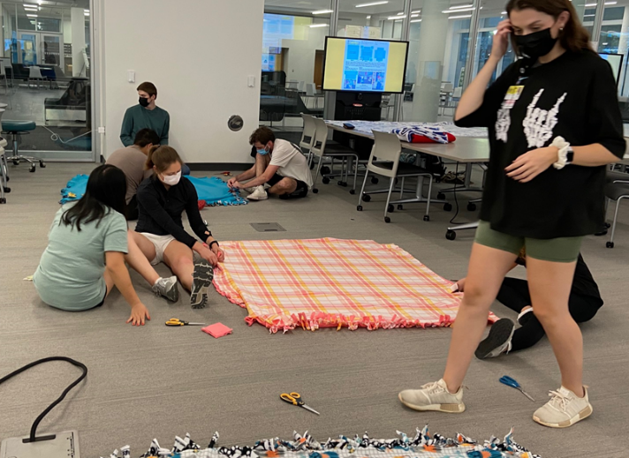
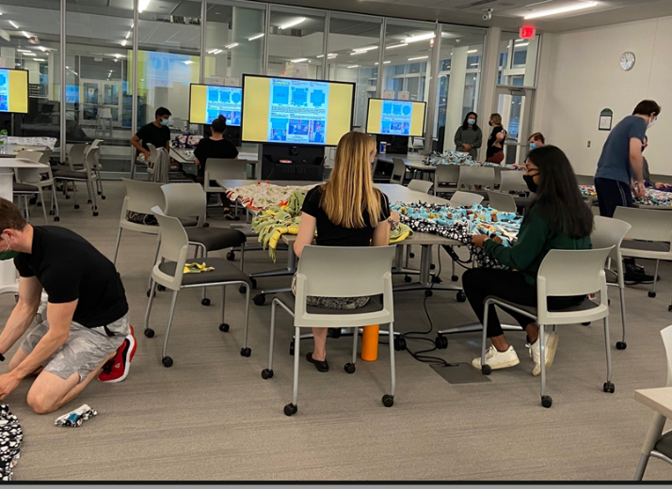
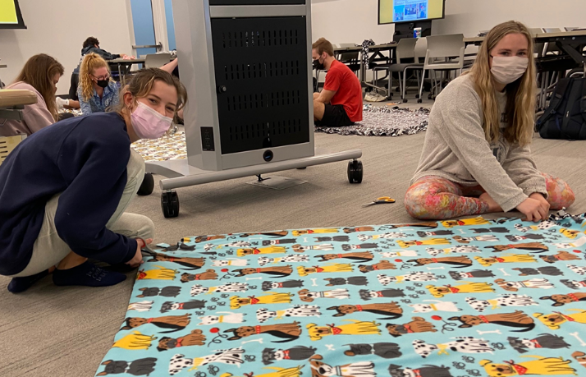
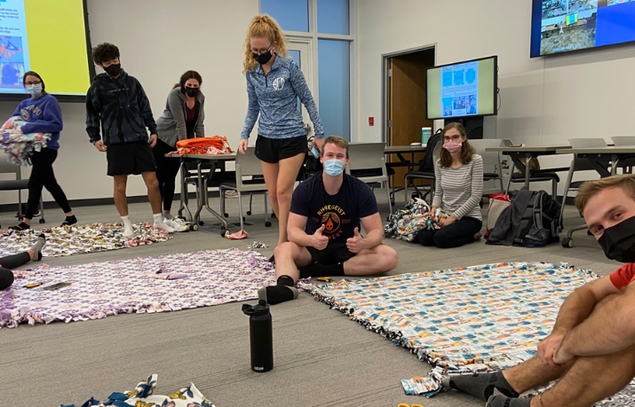

Slide 9
ΣΣΦ Inductions
February 2023
58 new members!

Slide 10
Thank You!
Bhumi Patel, OMS-II
bp324721@ohio.edu

