Slide 1
Mu Chapter Western University
College of Osteopathic Medicine of the Pacific (COMP)
Pomona, CA
SIGMA SIGMA PHI
NATIONAL MEETING
2022

Slide 3
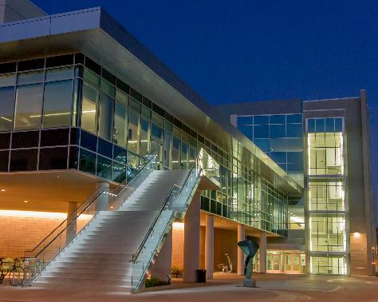

Slide 4
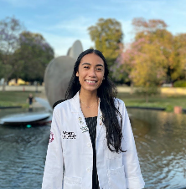
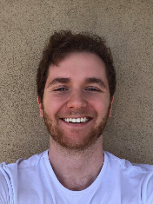
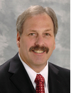
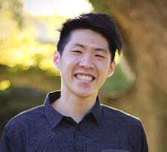
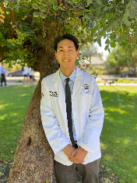
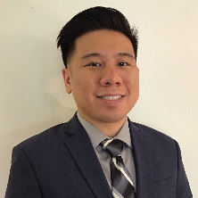
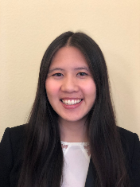
Current Officers & Faculty Advisors
President
Andrew Lian
Vice President
Cheldon Alcantara
Research Coordinator
Ira Glassman
Faculty Advisor:
Dr. David A. Connett, D.O., FACOFP
Administrative Assistant:
Roxanne Gonzalez
Secretary
Kevin Chen
Treasurer
Geoffrey Lo
Service Coordinator
Cathleen Nguyen

Slide 5
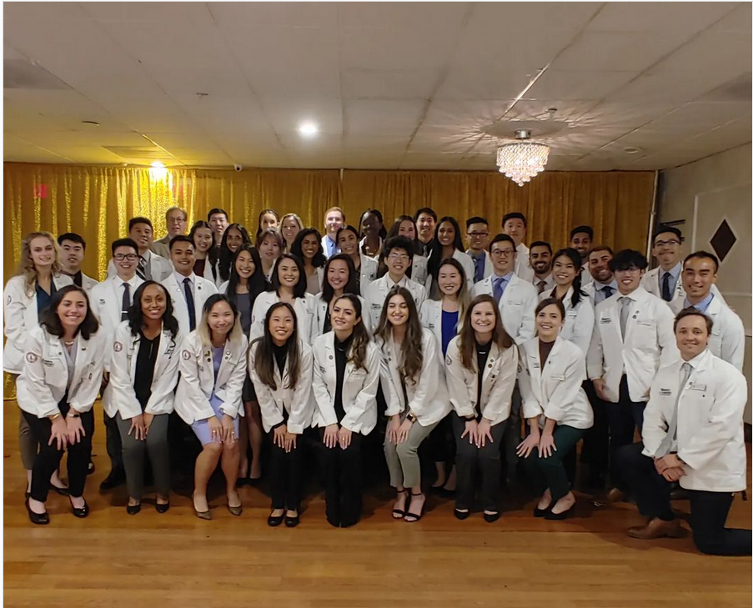
Membership
Class of 2024 and Class of 2025

Slide 6
Chapter Goals
To further the science of osteopathic medicine and its standards of practice
To preserve the meaning of and encourage scholastic excellence and community service
To continue a high degree of fellowship among its students
To cultivate relationships and understanding between the student bodies and officials, such as Faculty members of our Colleges
To foster allegiance to the American Osteopathic Association
To perpetuate Sigma Sigma Phi by preserving the principles and objectives of the organization
To meet the needs of underserved populations in Pomona, California and the Greater Los Angeles area

Slide 7
Membership Requirements
According to the National Sigma Sigma Phi Constitution:
Candidate must have completed at least one semester of school.
Candidate must have a GPA above 3.0 (>88%) to be considered for membership.
Membership is limited to 20% of the class.
OMS-I and OMS-II students are required to participate in at least 20 hours of community service activities per school year.
Members must record at least 15 “obligated” hours per school year for events in which they are obligated to attend (e.g. service learning and community service).
Members must record at least 5 “non-obligated” hours per school year for events hosted by Mu Chapter (e.g. Western University Vaccination Clinic).
Despite COVID restrictions, our members gained direct clinical patient care!
Students granted membership in their second year must participate in a total of 40 hours of service by the end of the year, with no more than 20 hours from the first year and no more than 30 “obligated” hours.
Subject to change as a result of COVID-19
2015: 52
2016: 59
2017: 53
2018: 50
2019: 54
2020: 37
2021: 50
2022: 44
2023: 40
2024: 32
2025: 28

Slide 8
Application Process
Application process takes place only during the FALL semester on the final week before winter break.
SSP admission committee will meet and decisions regarding admission/rejection will be made in no later than 14 days.
Notices of acceptance or rejections will be sent out via email in January.
Applicants who are not accepted by the admission committee based on the primary application have 5 days after receiving the notice to appeal.
Induction will occur during the spring semester
All accepted applicants must pay a $90 membership fee prior to induction.

Slide 9
Expulsion
Active/honorary members may be expelled from SSP and have all rights revoked by the local chapter governing body if any of the following occur:
Failure to comply with rules as laid down by the Constitution & By-laws of the fraternity
Conspiracy against another member
Conduct unbecoming of a physician or member
Violation of Code of Ethics of AOA
Failure (<70%) of ANY required course in the curriculum WITHOUT evidence against personal fault.
(ex. Death in the family, debilitating health crisis)

Slide 10
Major Events
NEW - INSAN Free Clinic - est. 2022
NEW - Research Review Service - est. 2021
NEW - Western University Vaccination Clinic - ONGOING!
Care Harbor LA - Hopefully Re-established 2022
Impacted due to federal decision regarding Unaccompanied Child Migrants
Gods Pantry - On Hold

Slide 11
Research Review Service

Slide 12
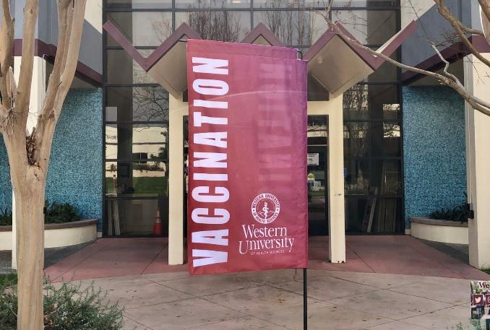
WesternU Health - Vaccination Clinic
Helping both our local community and school, we provide Flu Vaccinations in the fall to help limit the spread!
Hands-on clinical experience
Patient education
Commitment to the community
Increase vaccination rates in underserved communities and LA county!

Slide 13
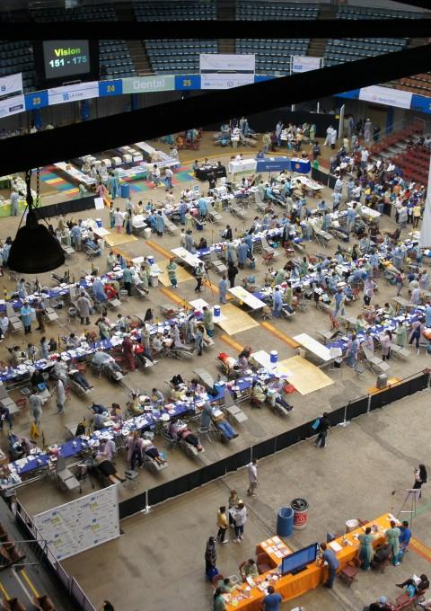
CARE HARBOR LA
Large temporary clinic that converts arenas and other large venues into working clinics to treat thousands of peoples over multiple days.
Provides free medical, dental and vision care prevention resources and follow-up care to thousands of uninsured, underinsured and at risk individuals and families.
Collaboration between WesternU, UCLA, USC medical schools.

Slide 14
God’s Pantry
Local food bank in Pomona Valley
Goal is community outreach and serving the underserved areas around our campus

