Slide 1
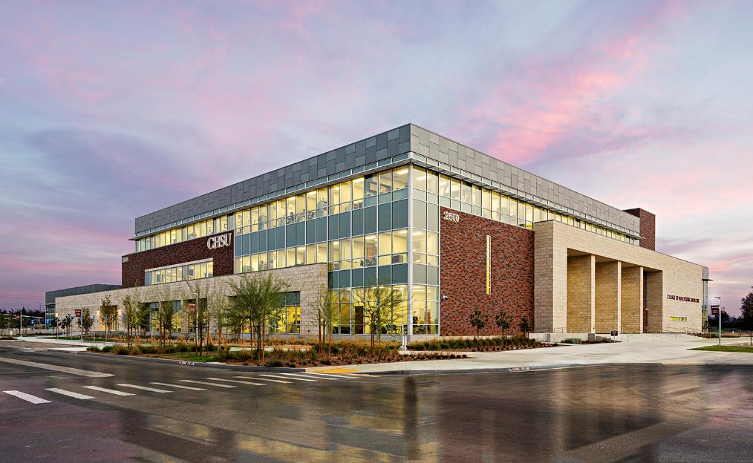
Sigma sigma phi alpha lambda chapter
2023 Report

Slide 2
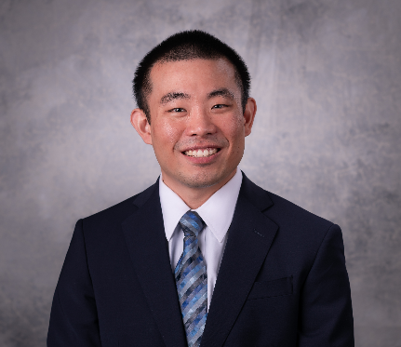
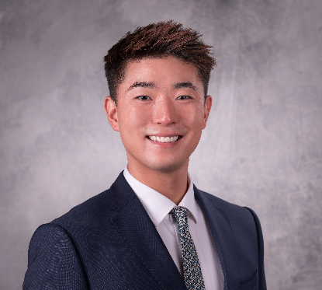
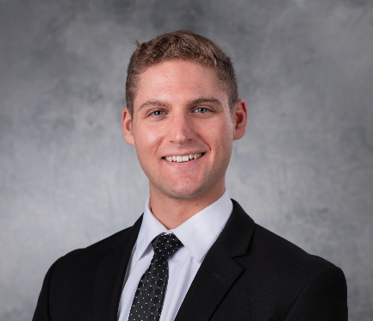
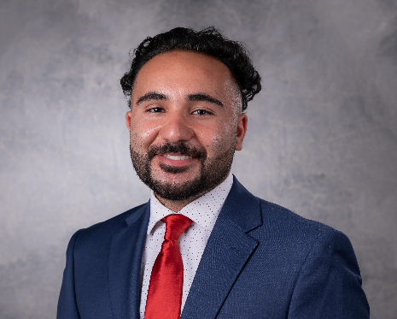
Executive officers
President:
Emmanuel Ho
Vice President:
Ryan Bae
Secretary: Alexander Kosche
Treasurer:
Eiman Azad

Slide 3
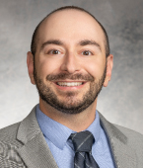
Our advisor
Degrees:
D.O., Kirksville College of Osteopathic Medicine
B.A., Truman State University
Specialty:
Diplomate of the American Board of Psychiatry and Neurology (ABPN)
Diplomate of the National Board of Physicians and Surgeons (NBPAS)
Diplomate of the American Board of Integrative and Holistic Medicine (ABIHM)
Institute For Functional Medicine Certified Practitioner (IFMCP)
National Health Service Corps (NHSC) Ambassador and works primarily with underserved and migrant worker populations, high-acuity inpatient psychiatric patients, and in program and policy­building initiatives.
Most recent teaching experience:
Interim Assistant Dean for Community Clinical Education at CHSU COM
Course Director for Behavioral Medicine at St. Agnes Graduate Medical Education (GME)
Nationally recognized preceptor and educator for OMS I – OMS IV students

Slide 4
Chapter goals
Promote leadership and service at CHSU while furthering the science of osteopathic medicine in California's Central Valley
Emphasize community service and academic excellence
Refine Alpha Lambda’s admission process
Expand fundraising
Continue to develop a more advanced scholarship process
Enhance club organizational systems for detailed tracking and management of service hours

Slide 5
CURRENT Membership
CHSU COM Total Student Body: 500
Active Members: 52
Membership is offered based on multiple evaluations:
GPA
Volunteer Hours
Club Memberships & Involvement/Leadership/Research
2 Essays
Scholarship Opportunities for Need-based students

Slide 6
2023-2024 events
Fresno County Public Cleanup (2023-04)
Anki 101 Education Seminar for OMS-I & OMS-II (2023-08)
Poverello House Meal Preparation and Service (2023-09)
1200 Meals Served to the unsheltered
Central California Food Bank Distribution Event (TBD)
Medical Supply Sorting and Packing (TBD)

Slide 7
Financial status
Currently, our chapter has no debt
We have ample funds to pursue service projects
Future fundraising will expand scholarship opportunities for students with financial need.

Slide 8
Questions?

