Slide 1
SSP ALPHA PSI CHAPTER
2023 Report
Notes:
Call to Order Introductory SSP Alpha Psi Chapter Meeting 2022-2023 Year

Slide 2
What is Sigma Sigma Phi- Alpha Psi Chapter?
Sigma Sigma Phi is an Honorary Osteopathic Service Fraternity
Objectives and purposes:
Further the science of osteopathic medicine and its standards of practice
Improve the scholastic standing and promote a higher degree of fellowship among its students
Bring about a closer relationship and understanding between the student bodies and the officials and members of the faculties of our colleges
Foster allegiance to the American Osteopathic Association
Perpetuate these principles and the teachings through the maintenance and development of this organization

Slide 3
Alpha Psi Chapter
Alpha Psi is a subordinate chapter of Sigma Sigma Phi at University of Incarnate Word School of Osteopathic Medicine
Serve through volunteering at San Antonio Food Bank and Magdalena House
Learn from and participate in scholarly events such as residency panels and board reviews
Conduct fundraising events for the community
Alpha Psi chapter is continuing to develop different ways to contribute academically to both the school and our community.

Slide 4
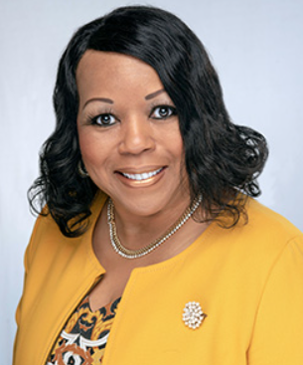
2023-2023
Temporary Faculty Advisor: Dr. Melissa Walker, DO
A Family medicine physician
Owner and founder of Carol Clinic for Family-Centered Healthcare
Graduate of Grambling State University
Bachelor Science in Biology
Master of Public Administration in Health Services
Medical degree from Midwestern University in Illinois
Family Medicine Residency at University of Texas Medical Branch in Galveston

Slide 5
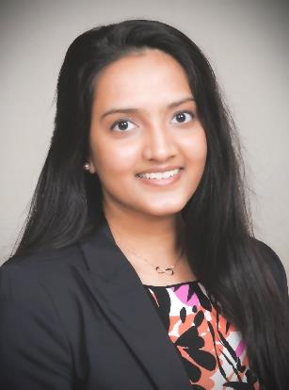
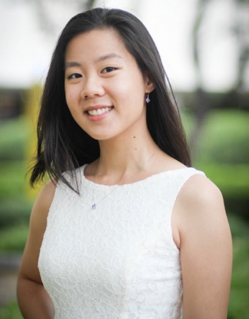
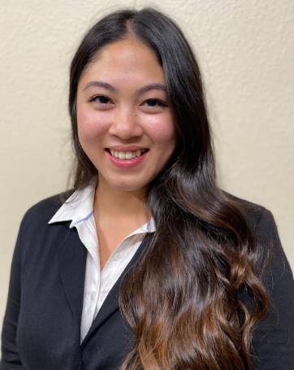
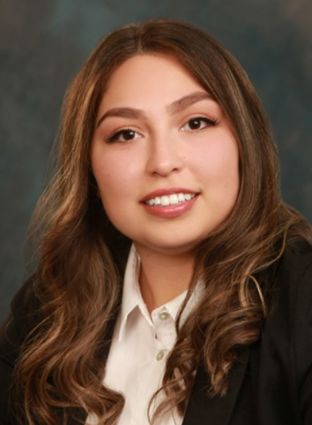
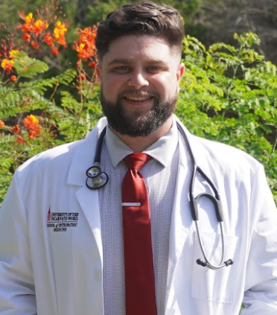
2022-2023 Officers
President: Richa Patel
Vice President: Nancy Kha
Treasurer & Secretary: Rita Tran
Community Service Officer: Michael Shaffer
Finance/ Fundraising Officer:
Celina Salcido

Slide 6
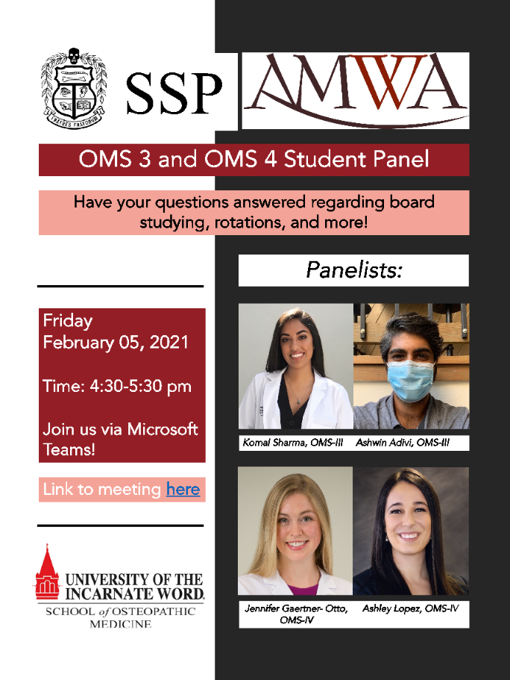
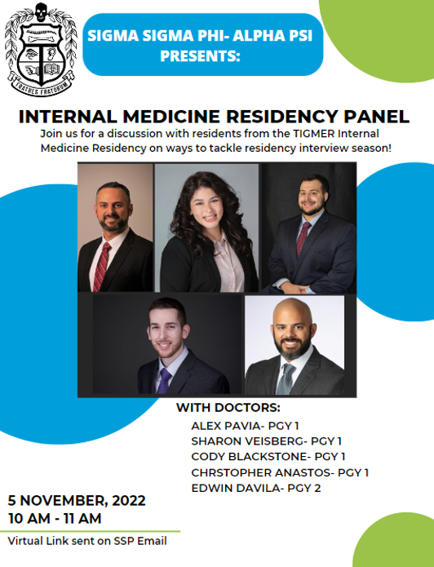
Past Educational Events

Slide 7
Past Fundraising Events

Slide 8
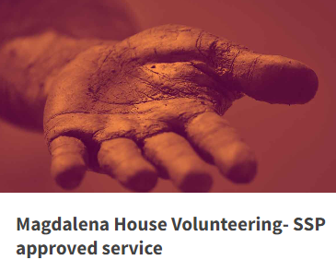
Community Service Events
San Antonio Food Bank
UIWSOM SSP volunteers with SA Food Bank year round
During the pandemic, our members assisted with warehouse sorting and packing along food distribution to the underserved southwest Texas area.
With the onset of the pandemic, most of the assembled meal packages went to families in need, especially to those with children who were not able to obtain school lunches due to school closures.
Magdalena House
Magdalena house is a neighborhood of transitional homes in San Antonio that serves mothers and their children who have fled dangerous and abusive lives.
There are weekly, monthly, and even large yearly volunteer opportunities.
We also set up monthly group volunteer activities with Magdalena House.
This past school year we logged over 300 volunteering hours!

Slide 9
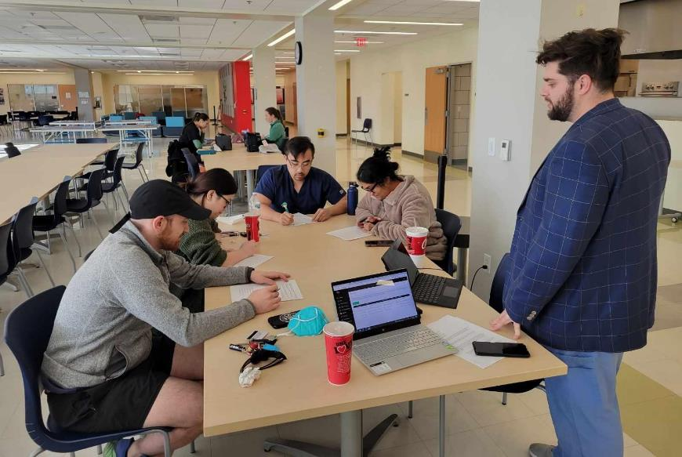
Event Photos
We raised over $100 from our trivia and Raising Cane’s fundraiser for Madalena House!

Slide 10
UIWSOM Awards Ceremony
This year, the Sigma Sigma Phi Alpha Psi Chapter hosted its award ceremony with UIWSOM’s Awards Ceremony
Pictured are:
Richa Patel, 2022-2023 President (left)
Julie Luu, 2021-2022 President (right)

Slide 11
Bylaws Changes Approved by Nationals
STANDING
Standing of members of the Alpha Psi Chapter will be assessed on a yearly basis. Academic requirements of each member will be checked by the Director of Assessment and Program Evaluation for induction into Alpha Psi Chapter and includes good current, academic standing with no history of remediation. Therefore, successful reassessment of a unit or clerkship is permissible but remediation of a year, as defined by the UIWSOM student handbook, is not allowed for continued membership in Alpha Psi Chapter of Sigma Sigma Phi.
Members who are Phase I learners will be required to meet the minimum of 15 volunteer hours per semester and Phase II learners will be required to meet the minimum of 15 volunteer hours per year, through Alpha-Psi Chapter community service opportunities. Volunteer hours should be submitted by the end of each semester and no later than the end of each academic year for total annual volunteer hours. Each member will be required to participate and serve in at least one committee of Alpha Psi Chapter per academic year. Members will also be required to take active participation in at least one fundraising and one scholarly activity including but not limited to submitting unit review, board review, trivia questions, and panelist questions in addition to attending Alpha Psi- Sigma Sigma Phi specific events. Exceptions to these requirements can be made with proper approval for those that are in Laredo and Corpus Christi or those on away rotations during Phase II.
Any member who fails to meet volunteer or academic requirements through the year, will be assessed by the Officers and faculty advisor, and placed on a probation status as deemed appropriate. Probation status will last 6 months; if the member meets requirements during that time frame, they will resume normal Alpha Psi member status.

Slide 12
SSP Alpha Psi National and Chapter Dues
Membership dues for SSP due date pending
Link to submit dues will be submitted early next year
Current/Returning Members: $20 chapter dues/year
Dues as follows:
Newly Inducted Members: $40 National dues/induction
Total for newly inducted members: $60 (Chapter+National fees)

Slide 13
SSP Grand Chapter Annual Meeting
Sunday October 8th, 2023
Time: 10:00a.m.-2:00p.m. EST
Orlando, Florida
Lunch will be provided
Expanses will be covered for a single officer or member who can attend in person and represent Alpha Psi Chapter from UIWSOM
Zoom link will be provided if would like to attend virtually

Slide 14
New 2023-2024 Officers
President: Nancy Kha, OMS III
Vice-President: Yumna Ali, OMS III
Secretary-Treasurer: Sun Young Lee, OMS IV
Community Service Committee Leader: Karen Mina, OMS III
Finance Committee Leader: Selena Cholak, OMS III
Membership Committee Leader: Selena Cholak, OMS II; Karen Mina, OMS III
Unfilled positions: President Elect (reserved for current OMS I), Awards Committee Leader, Pledging Committee Leader, Initiation Committee Leader, Social Committee Leader

Slide 15
More Information on SSP Website
Visit http://www.sigmasigmaphi.org/
Gives details about various other chapters throughout united states osteopathic medical schools
Activities of different chapters
Membership dues
Follow blog
Notes:
Meeting is Adjourned

