Slide 1
Sigma Sigma Phi Beta Chi Chapter Burrell College of Osteopathic Medicine Las Cruces, NM

Slide 2
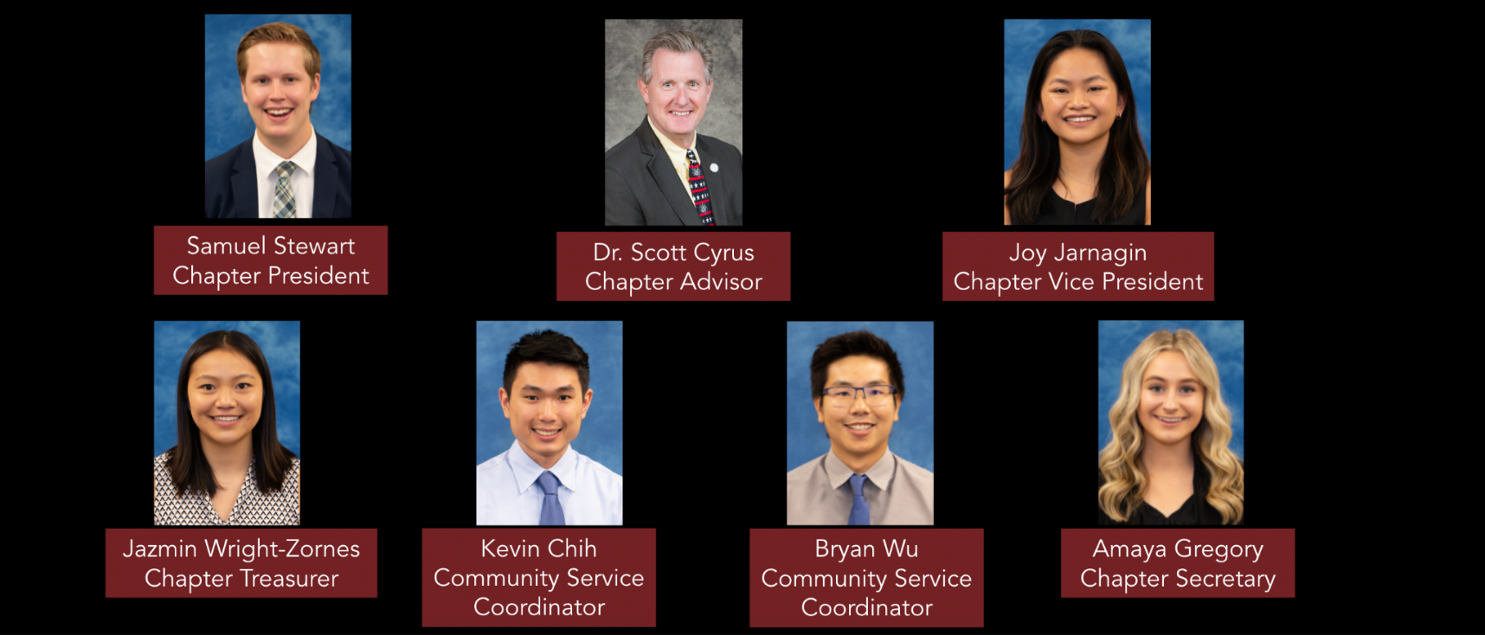
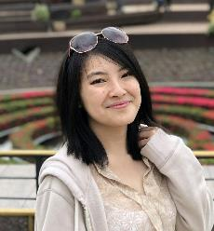
Beta Chi Chapter Executive Board

Slide 3
Membership Requirements
Maintain a Pass score in all courses without remediation.
Community Service
Members in their first and second year of medical school are required to participate in 10 hours of community service and attend one fraternity event per semester
Members in their third and fourth year of medical school are required to participate in 5 hours of community service each academic school year
Lead, organize, and host one community service event before the end of their second year of medical school
Membership cannot exceed 25% of student body
Current Membership
Class of 2024 (33 members)
Class of 2025 (33 members)
Class of 2026 (50 members)

Slide 4
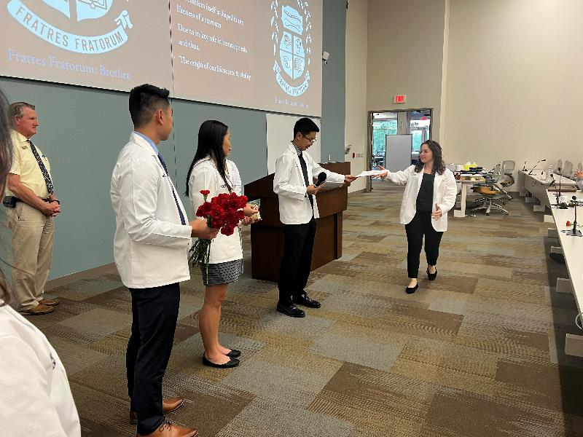
Fall Induction 2023

Slide 5
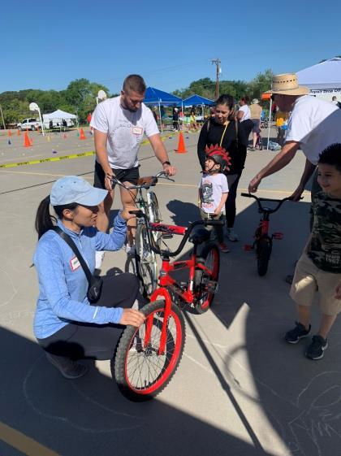
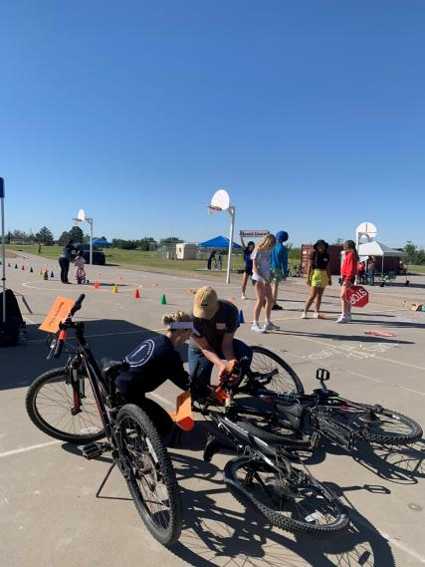
Family Bike Fiesta Public safety and involvement event for children in our community.

Slide 6
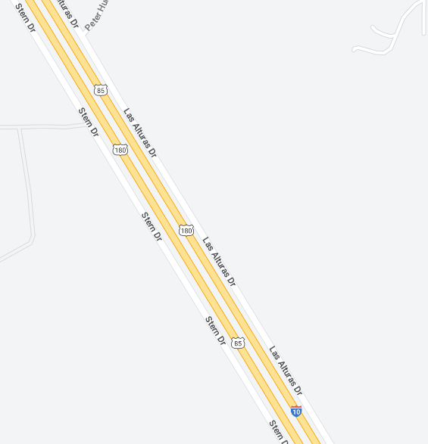
NMDOT Adopt a Highway
Adopted a section of highway under our chapters name for at least twice a year maintenance

Slide 7
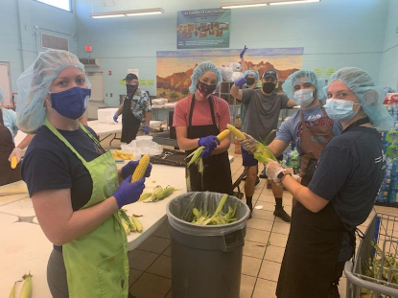
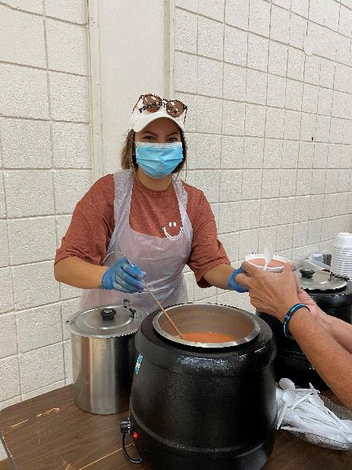
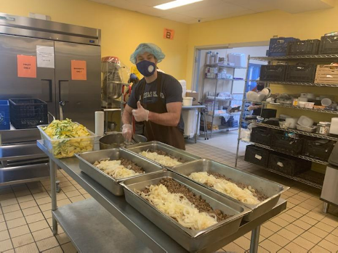
El Caldito Soup Kitchen Prepare and distribute meals to Dona Ana county residents experiencing homelessness and food insecurity

Slide 8
Community Partnerships
Animal Services Center of the Mesilla Valley
Las Cruces Asylum Seeker Shelter
City of Las Cruces
Children’s Reading Alliance of Las Cruces
El Caldito Soup Kitchen
La Casa Inc.
Mesilla Valley Habitat for Humanity
Southern New Mexico Diabetes Outreach
2022-2023 1,330 community service hours from SSP members

Slide 9
Future Goals
Aid SSP chapter members with achieving their service-oriented goals.
Support lead events with promotion and necessary funding.
Induct class of 2027 members in spring semester

