Slide 1
Edward Via College of Osteopathic Medicine
Louisiana Campus
2023 Annual Report

Slide 2
Chi Chapter- Monroe Branch
Mission Statement:
Sigma Sigma Phi is an Honorary Osteopathic Service Fraternity. Its objectives and purposes are to further the science of osteopathic medicine and its standards of practice, to improve the scholastic standing and promote a higher degree of fellowship among its students, to bring about a closer relationship and understanding between the student bodies and the officials and members of the faculties of our colleges, and to foster allegiance to the American Osteopathic Association and to perpetuate these principles and the teachings through the maintenance and development of this organization.
The key symbols (skull, spine, & femur) adorn the fraternity emblem. The emblem itself is shaped in the likeness of a sternum, due to its key role in hematopoiesis, and thus, the origin of our life source & vitality.

Slide 3
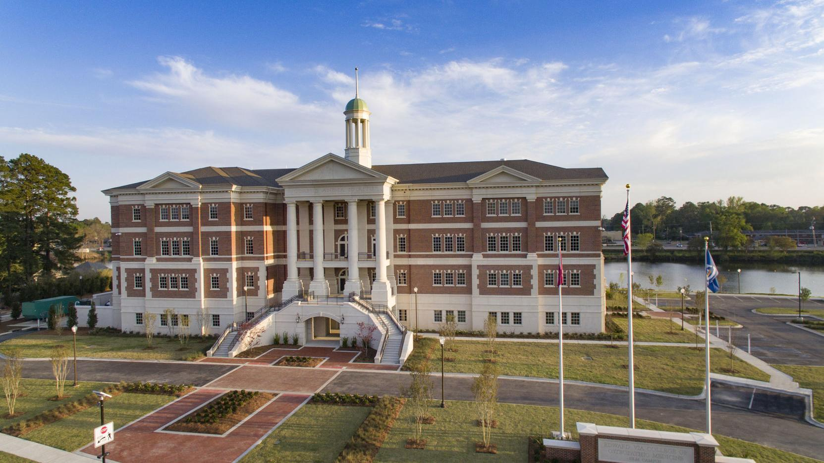
VCOM-Louisiana
Monroe, LA

Slide 4
Officers
Fall 2023-Spring 2024
President: Emilio Cardenal
Vice President: Grace Corrier
Secretary/Treasurer: Madeline Foreman
Community Service Chair: Elizabeth Turnage
Boards Chair: Kiara Pankratz
Social/Merch Chair: Claire Daigrepont and Emily Gioe

Slide 5
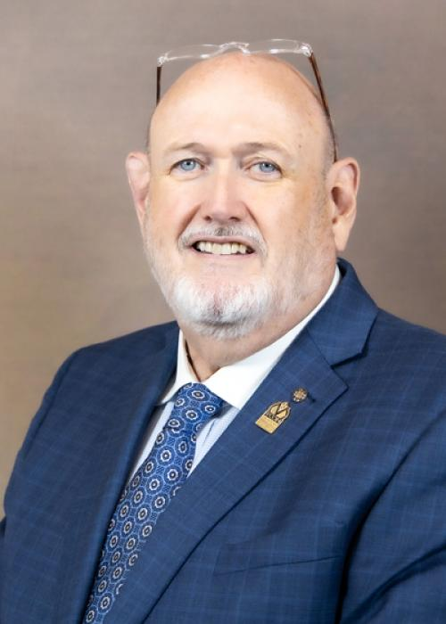
Faculty Advisor
Ray Morrison, DO
Associate Vice President for College Development and Advancement in the Louisiana Region
Dean Emeritus

Slide 6
Membership Criteria:
Our criteria for invitation are currently:
Must have a 3.8 GPA or higher at VCOM at end of the 3rd or 7th blocks
Must have no current or pending academic deficiencies
Must be considered in good standing with VCOM
e.g., no current or pending behavioral infractions, no academic probation, etc.
Must be willing to provide advice or counsel to other medical students or potential medical students on the values and benefits of being an osteopathic physician

Slide 7
Requirements to Maintain Membership:
Maintain GPA – 3.65
Required Service Hours
10 hours/year
Must attend SSP events and member meetings

Slide 8
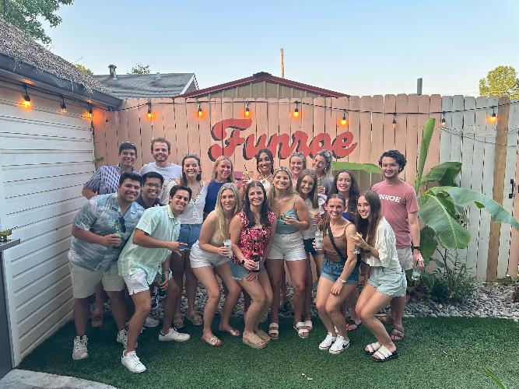
Chapter Involvement
Started out with a social at a local restaurant for any student at VCOM

Slide 9
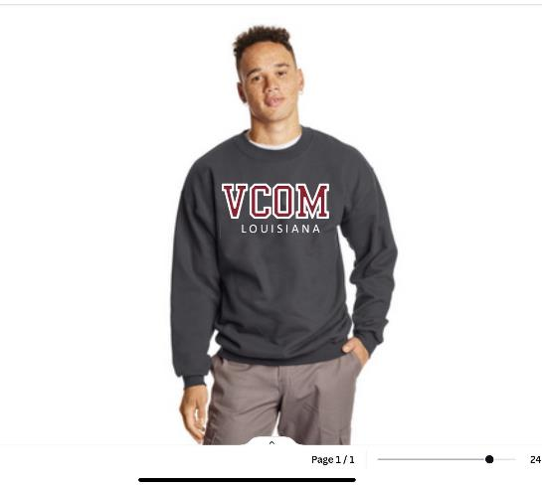
Chapter Involvement
Created two new merch items.
First one has sold fantastically well.
Second one tbd.

Slide 10
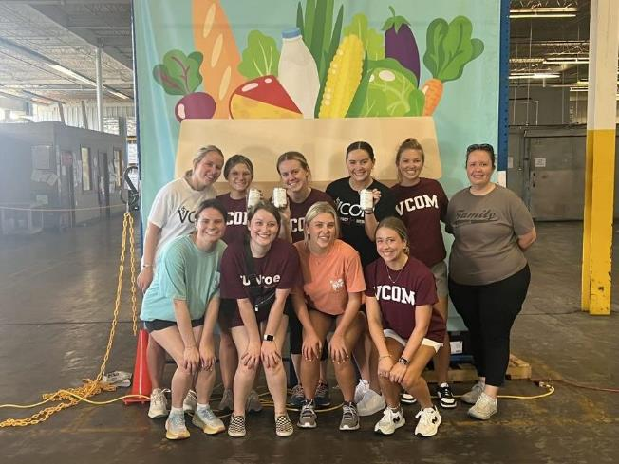
Chapter Involvement
Teamed up with AMWA to provide volunteering opportunities at a local food bank.

Slide 11
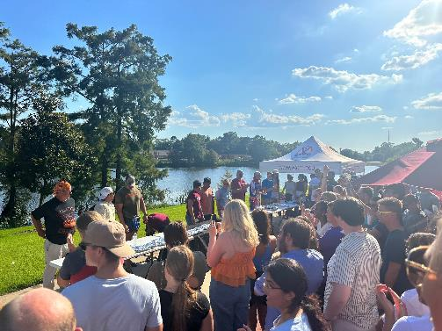
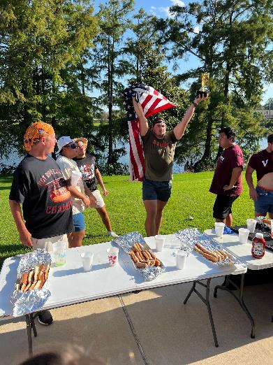
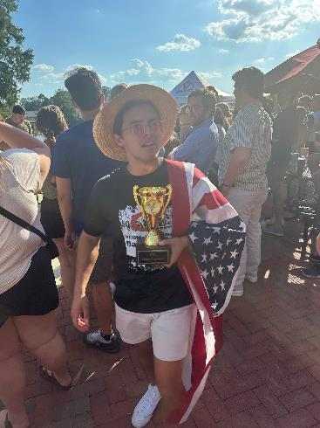
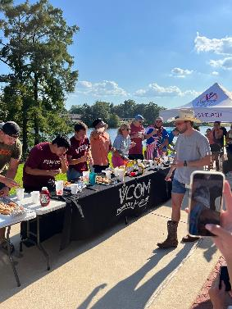
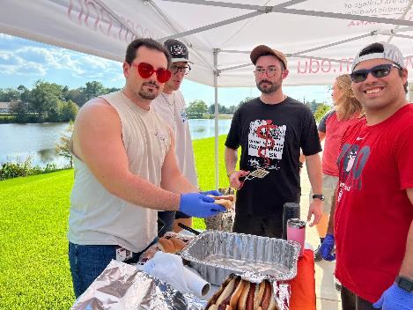
Chapter Involvement
The Bayou Wars Hotdog Contest!
Fundraiser we put together for a 5K this Fall

Slide 12
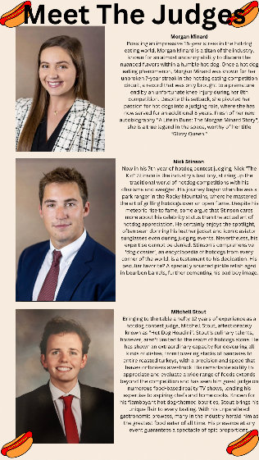
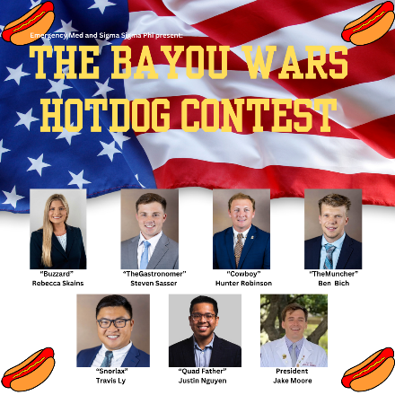
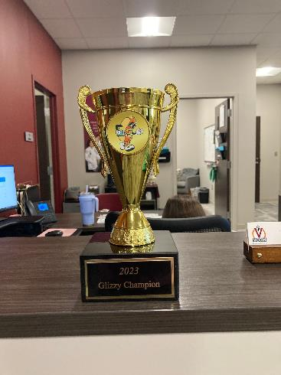

Slide 13
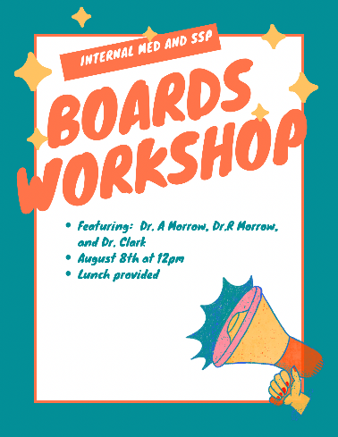
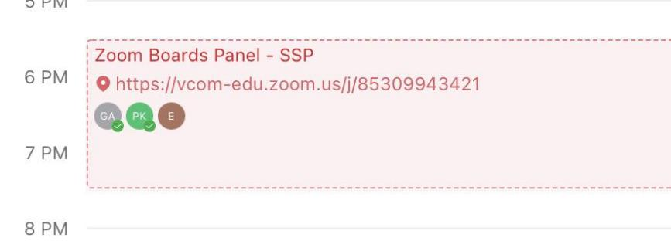
Chapter Involvement
Helped put together two Boards workshops
One with faculty + anking tutorial on campus
Second one with 4 upperclassmen via zoom

Slide 14
What’s next?
Being a new campus our connections with our partner school are still lacking
We have reached out to ULM’s SSC and we are planning to start a tutoring partnership— VCOM students tutoring ULM students
We have also reached out to the Premeds at ULM and we are in the works of having a group come to our building for a student lead tour and panel in the Fall

Slide 15
What’s next?
Our next large event
OMSI v OMSII charity game
Each team will be a sponsor of one local charity

Slide 16
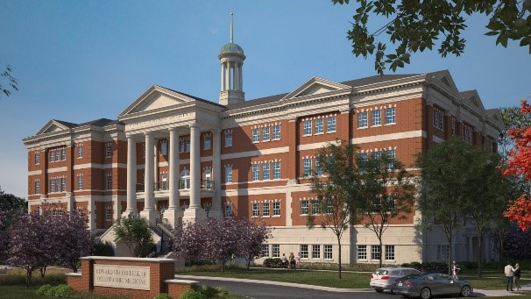
Thank you!

