Slide 1
Sigma Sigma Phi
Delta Chapter - Joplin Report
OCTOBER 5, 2022

Slide 2
Meet Our Executive Board
President: Tate Hanners
Vice President: Mostafa Hamada
Treasurer: Grant Sanders
Secretary: Rajbir Sooch
Community Service Chair: Melissa Bryan
Selection Committee Chairs: Pratyusha Tadepalli & Rebekah Sweyko
Advisor: Dr. Kenneth Stewart, DO, FACEP, FAAEM

Slide 3
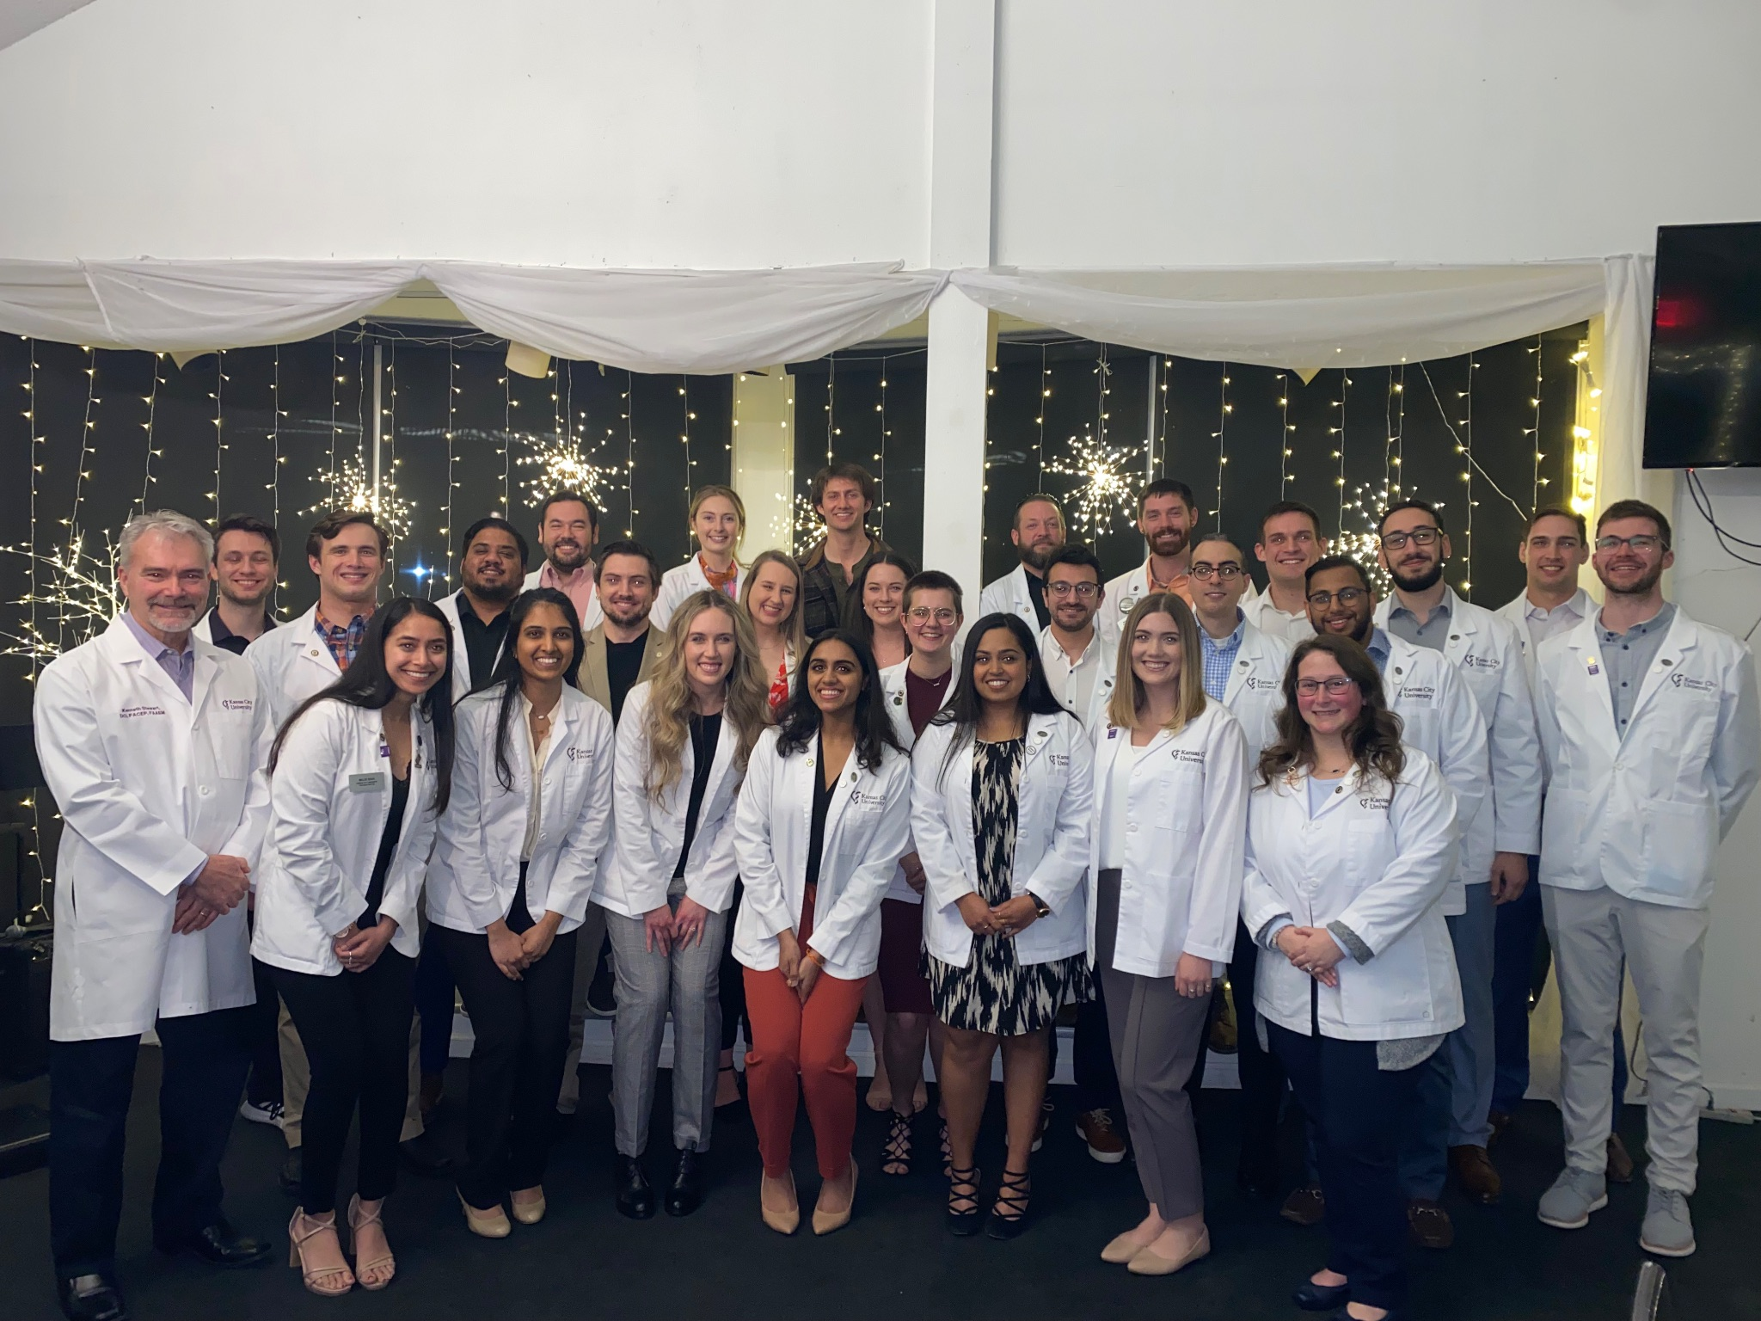
Spring 2022 Induction Ceremony
On March 24, 2023, 29 students were inducted into Delta Chapter - Joplin.
Class of 2025: 10 new members
Class of 2026: 19 new members

Slide 4
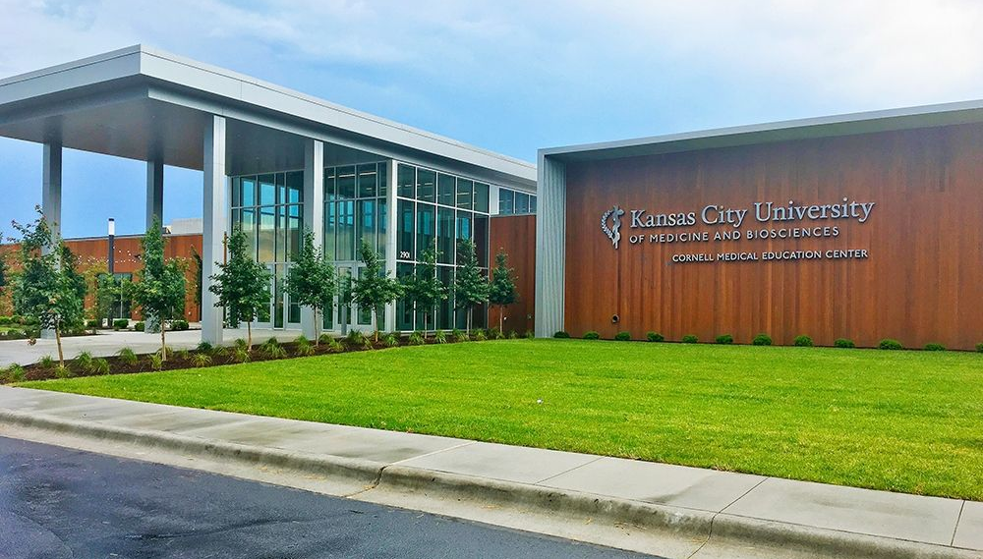
Total Membership
Class of 2023: 22
Class of 2024: 43
Class of 2025: 33
Class of 2026: 19

Slide 5
Requirements for Acceptance
Requirements to Maintain Membership
Must have completed the first semester of OMS-I courses with ≥80% in each course.
Must have submitted an application detailing relevant scholastic accomplishments and community involvement.
Applications are reviewed and potential members are voted on by the Selection Committee.
Delta Chapter - Joplin membership shall not exceed 25% of the total number of students enrolled at the Joplin campus.
Members must remain in the top 45% of their class
Members cannot have a rotation failure during their 3rd or 4th year.
Members must complete at least 4 Sigma Sigma Phi-affiliated hours of community service per academic year.

Slide 6
‘23-’24 Projects
Establish histology review series for the supplementation of OMS-II curriculum.
Establish peer guidance program to inspire high school students to pursue careers in medicine.
Pursue new community service opportunity with Habitat for Humanity.

Slide 7
Questions?
Feel free to reach out!
Email: tate.hanners@kansascity.edu

