Slide 1
Midwestern University Chicago College of Osteopathic Medicine
Grayson Roth
Chapter President, 2023-2024

Slide 2
What is ΣΣΦ?
Honorary Osteopathic Service Fraternity
National Objectives:
Further the science of Osteopathic Medicine and its standards of practice
Improve the scholastic standing and promote a higher degree of fellowship among its students
Foster allegiance to the AOA
Epsilon Corollary:
Demonstrate a sincere commitment to serving communities in Chicago as well as within CCOM

Slide 3
Executive Board 2023-2024
President –Grayson Roth
Treasurer –Brittany Taylor
Plan to open application for VP/Secretary positions

Slide 4
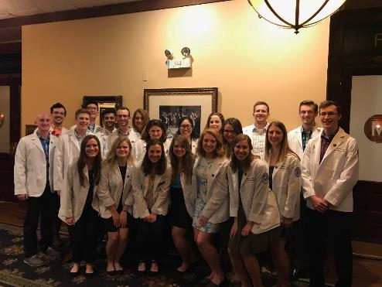
Membership
58 active members
24 OMS-IV
32 OMS-III
2 OMS-II
Faculty Advisor
Dr. Perry Marshall, D.O.

Slide 5
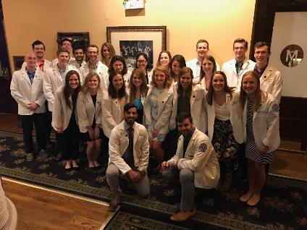
Fall Membership Drive
Executive board met with former president in June to set clear expectations for the year
Written applications closed on August 26th
Grade check for all applicants
Will be randomized before distribution for blind peer review
Conducted by 2-3 current members who are not classmates
Applications reviewed by selection committee
Criteria for admission
Academic (GPA > 3.30)
Community Service
Interest in SSP
Demonstrated leadership

Slide 6
Finances
Current Student Accounts Balance:
$3,141 as of August 29, 2023

Slide 7
Fundraisers
CCOM Apparel Sale
Half Zip Sweatshirts
Sale goes live in Winter Quarter

Slide 8
Projects
Partnership with LearnToBe, an online tutoring service for underprivileged students
Service opportunity spreadsheet for members
Collaboration with local food pantries
West Suburban Community Pantry, monthly visits
People’s Resource Center, self sign-up
Making Strides Against Breast Cancer Walk
”Groovin’ in the Grove” 5K Race

Slide 9
Student Information Panel
Several second-year members answer questions from current first year students
Members offer advice on managing the transition to medical school, course load, and how to make the most out of the M1 summer

Slide 10
Learn to Be

Slide 11
Learn to Be
Supporting the mission that “all kids should have access to a great education- not just those who families can afford one”
Student mentorship proving to be most valuable
SSP members have flexibility to set their own schedule, choose any grade or subject
M3 and M4 members able to actively participate remotely while away on rotations
Outstanding turnout for 2023 informational meeting
Looking forward to expanding involvement

Slide 12
Service Opportunity Spreadsheet
List of service opportunities that chapter members are involved in
Makes search seem less daunting, more approachable
Encourages active participation
Convenient perk for members
List available to all members of Epsilon Chapter

Slide 13
Goals
Create a precedent for academic success that is centered around an encouraging, positive outlook
Coordinate an event with other honor societies on campus to foster interprofessional networking and relationships
Actively search for group service opportunities so members can develop meaningful friendships
Advocate for Sigma Sigma Phi on campus and increase chapter size

Slide 14
Contact
Chapter President, Grayson Roth
grayson.roth@midwestern.edu
Thank you!

