Slide 1
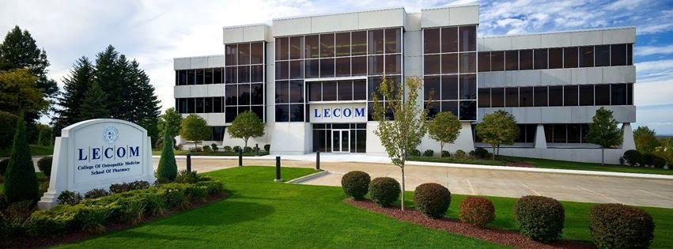
GAMMA CHAPTER OF SIGMA SIGMA PHI

Slide 2
LAKE ERIE COLLEGE OF OSTEOPATHIC MEDICINE
LECOM was established as the 16th college of Osteopathic medicine in December 1992.
The Charter Class Began on August 9, 1993 in Erie, Pennsylvania
LECOM has granted the Doctor of Osteopathic Medicine degree to over 8,000 graduates as of 2021.

Slide 3
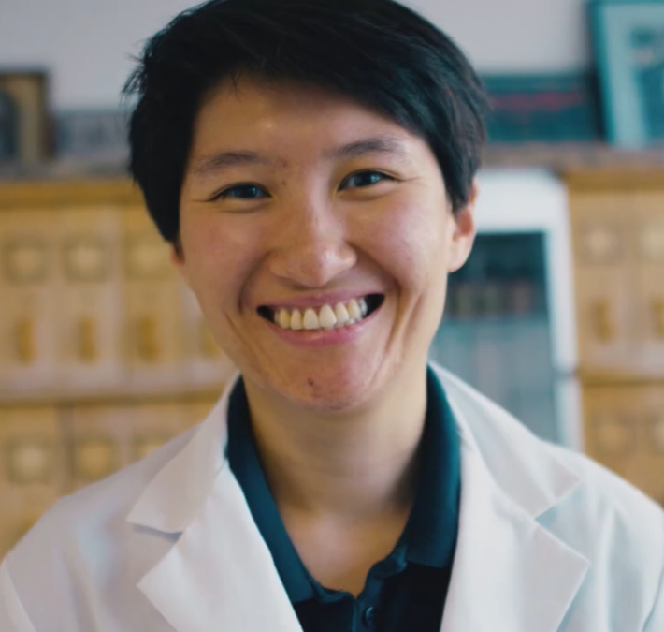
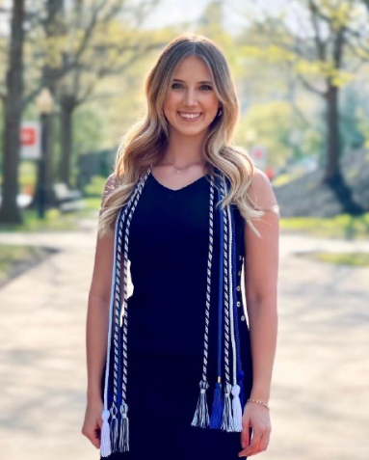
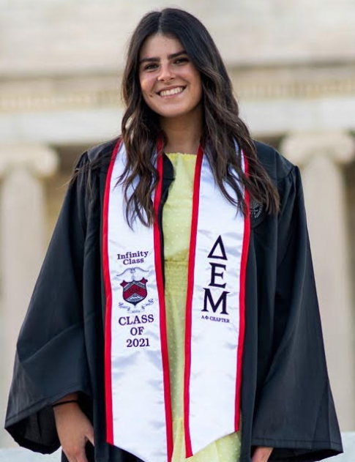
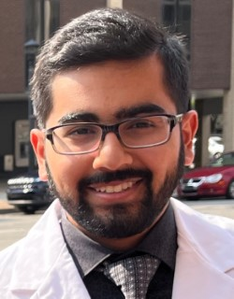
GAMMA CHAPTER EXECUTIVE BOARD
PRESIDENT: Melissa Zhang
VICE PRESIDENT: Grace Hogue
TREASURER: Madison Grossman
SECRETARY: Abdulmuhaimin Khatib

Slide 4
GAMMA CHAPTER MISSION STATEMENT
“As an organization founded on scholastic achievement, service, and medicine, we can best serve our community by mentoring the health-underserved populations of Erie, both academically and socially “

Slide 5
GAMMA CHAPTER GOALS
Positively impact the community at large through health-oriented community service projects and outreach programs
Strengthen the presence and awareness of Osteopathy in the local community
Promote fellowship amongst the student body and to continue the scholastic excellence of its members and its colleagues

Slide 6
GAMMA CHAPTER REQUIREMENTS
In order to apply all prospective members must complete the following requirements must:
Demonstrate involvement in school clubs and community service activities
M1: Complete at least 5 community Service hours in the semester/summer prior to the application cycle
M2: Complete at least 8 community service hours in the semester prior to the application cycle
Have at least a 3.2 cumulative GPA
In order to maintain active membership status members must:
Maintain a minimum 3.2 cumulative GPA
Participate in a minimum # of community service hours per semester

Slide 7
CURRENT GAMMA CHAPTER MEMBER STATISTICS
Class of 2024 → 57 members
Class of 2025 → 57 members
Class of 2026 → 27 members
Gamma Chapter Total:
141 Total Current Members

Slide 8
GAMMA CHAPTER SERVICE ACTIVITIES

Slide 9
Recurring Volunteer Events
LECOM Blood Drives with the Erie Community Blood Bank
Mental Health First Aid Certifications with Erie NAMI
Q&A with LECOM Admissions
Partner with SOMA to tutor current Masters of Medical Science (MMS) students at LECOM
Letters Against Isolation Card Writing: write cards to seniors currently isolating due to COVID-19
Letters Against Depression Card Writing: write letters to those currently suffering from mental health related issues

Slide 10
Admissions Student Panel
Chapter members serve as ambassadors for LECOM by participating in virtual & on-campus student panels to answer questions from prospective students about LECOM, the Erie Community, and Medical School.

Slide 11
MS3 & MS4 Student Mentoring
Our MS3 and MS4 students give board prep & rotation advice to the SSP underclassmen during our monthly SSP meetings.
3rd and 4th year members maintain a database containing reviews of various rotation sites which are made available to the 2nd year class to aid in their rotation selections.

Slide 12
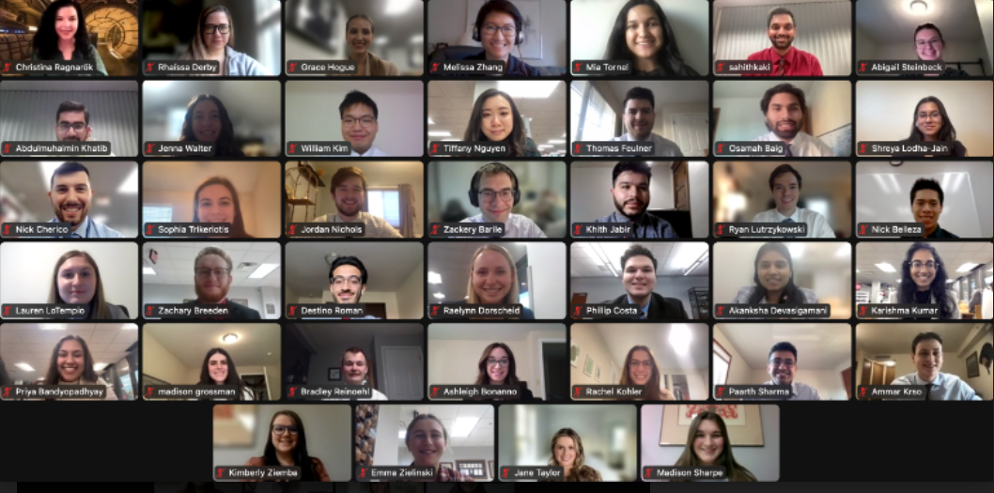
Induction Ceremony Spring 2023

Slide 13
FINAL THOUGHTS
The Gamma Chapter would like to thank the National Grand Chapter for all of its support. We look forward to continuing the fantastic work that our chapter does and to continue our mission of furthering Osteopathic Principles and Values in the communities where we live and serve.

Slide 14
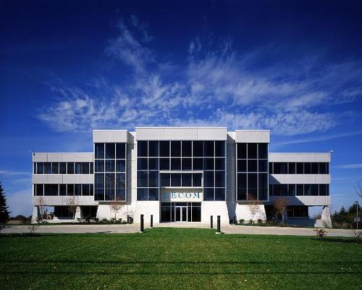
THANK YOU

