Slide 1
Sigma Sigma Phi- Gamma Chapter
NATIONAL HONORARY OSTEOPATHIC SERVICE FRATERNITY
2022

Slide 2
Mission
Further the philosophy, art, and science of osteopathy and its standards of practice
Improve students’ scholastic standing and promote a higher degree of fellowship among the students
To bring about a closer functional relationship and understanding between student bodies and the officials and members of the faculties of our colleges
To further the welfare of the osteopathic profession, its colleges, and other institutions
Foster allegiance to the AOA and to perpetuate high professional standards through the maintenance and development of this organization.

Slide 3
Who we are
LECOM at Seton Hill was established in 2009
44 students from OMS II-OMS IV belong to the LECOM Seton Hill gamma chapter

Slide 4
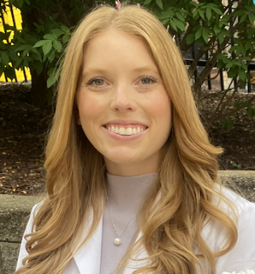
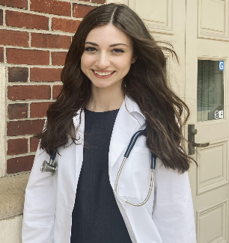
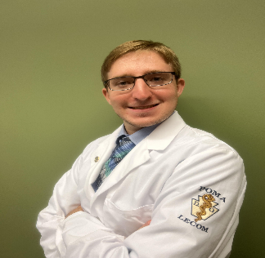
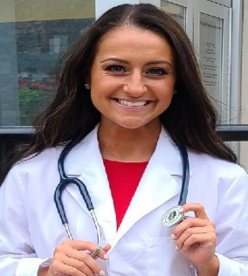
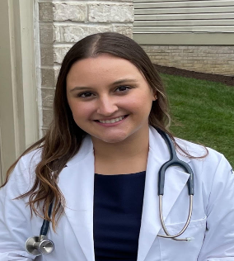
Class of 2026 Eboard
President: Chloe Rough
Vice-President: Yousef Sherif
Secretary: Haley Lucas
Treasurer: Catie Carolla
Historian: Jenna Gruenwald

Slide 5
Membership Requirements
Limited to 25% of the student body
Must maintain a 3.0 GPA
OMS I & OMS II
Complete 12 hours of community service each semester
5 hours from SSP events and 5 from non-SSP events
2 additional hours from either category
OMSIII & OMSIV Years
12 hours of any community service per year

Slide 6
How we track membership requirements
The current members of each class, the volunteer projects they have done, and which members are on probation is tracked and documented on google spreadsheet viewable only to the current Sigma Sigma Phi President and the club’s advisor.

Slide 7
What is an SSP event?
Anything that is established as an SSP event by the E board
Must better LECOM and/or the community
If the event is co-sponsored with another club you have the option to record it as either SSP or non-SSP

Slide 8
Inductions
Inductions take place each semester
OMSI application invitations are sent out to everyone meeting our requirements in January and induction occurs in March
OMS2 applications are sent out in September

Slide 9
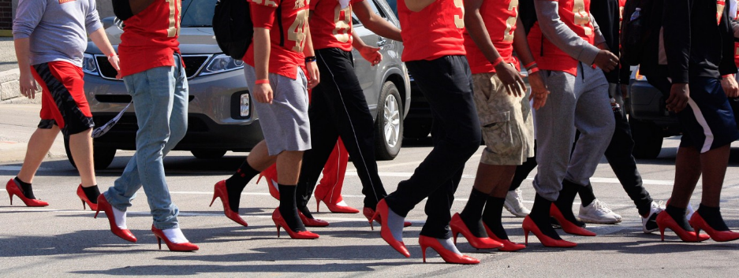
Walk a Mile in Her Shoes
Members of SSP have the opportunity to help the Blackburn Center in Greensburg with the annual “Walk a Mile in Her Shoes” event, which raises awareness of the serious causes of, effects of, and remediations to sexual violence.

Slide 10
Charity Miles App
SSP members are able to log miles through running, walking, biking, etc. which in turn earns money for various charity groups that the student selects.

Slide 11
Be the Match
SSP members have the opportunity to participate in helping Be the Match to find registry members for its bone marrow registry. The registry is used to help people in need of bone marrow transplants.

Slide 12
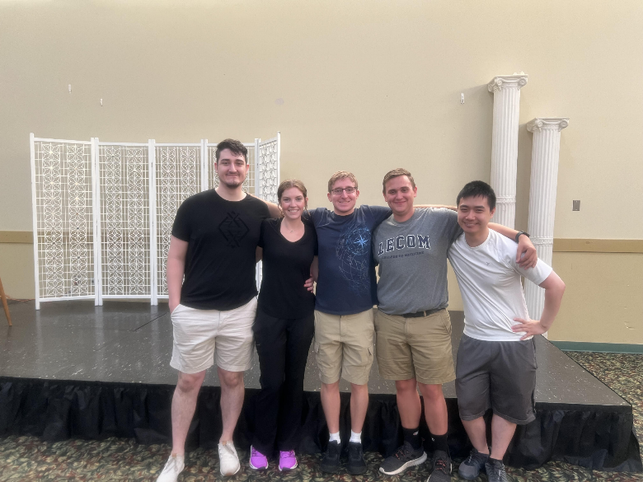
Olympia Banquet Hall Food and Clothing Drive
Every 4th Saturday of each month, Sigma Sigma Phi members and other LECOM Seton Hill Students have the opportunity to volunteer by sorting clothing and preparing meals for those in need in the Pittsburgh area.

Slide 13
Coming up in October… Community Clean-Up Day with The Downtown Greensburg Project
This October, SSP is partnering with the Downtown Greensburg Project for a community clean-up day that is open to anyone!

Slide 14
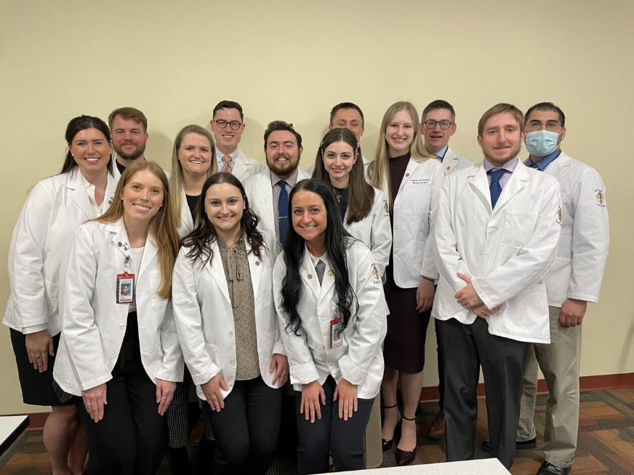
What does membership mean?
ACHIEVEMENT
Taking pride in the hard work one has completed to be here and promoting further excellence for ourselves and others
COMMUNITY
Working as a team to foster fellowship within the osteopathic community of students and our educators
SERVICE
Showing our care and support to the local community by giving back to others whenever we can

