Slide 1
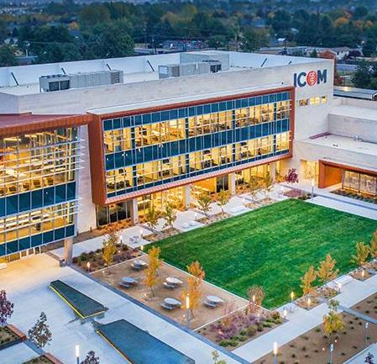
Sigma Sigma Phi Iota Delta Chapter
Idaho College of Osteopathic Medicine
Annual Report 2023

Slide 2
Chapter goals
Iota Delta seeks to:
Improve upon osteopathic standards of practice
Promote fellowship among members
Serve our school and community
Maintain the utmost academic and clinical excellence
Make the greatest change through minimal intervention

Slide 3
Chapter requirements
Members must be in the top 25% of class rank or GPA of 3.40 and above with no remediations for at least two semesters prior to chapter invitation
Members must display a high degree of service to the college and profession
Members must complete 20 hours of service per academic year

Slide 4
Current members
Iota Delta inaugural class inducted on July 25th 2021
Currently Accepting Applications for ICOM class of 2026
ICOM class of 2023: 21 members
ICOM class of 2024: 14 members
ICOM class of 2025: 19 members

Slide 5
Class of 2023
Hailey Barab
Austin Cuttone
Casey DeBeltz
Heidi Dreher
Veronica Graham
Diana Green
Spencer Hassman
Harrison Surratt
Nick Tod
Trey Tosetti
Selena Yakabe
Cody Kohout
Frannie McCarthy
Dayne Moore
Curtis Nelson
Ted Olenick
Kristen Parks
Megan Peterson
Kara Pimentel
Katie Saunders
Shaunton Stubbs

Slide 6
Class of 2024
Jaron Clark
Cameron Davis
Adam Dentinger
Frank Filicetti
Jacob Hathaway
Connor Hoell
Thomas Jay
Kassi Jensen
Quinn Kensey
Ethan McCarty
Josh Outslay
John Riley
Noelle Sobotka
Christopher Thompson

Slide 7
Class of 2025
Cole Adams
Garrett Ball
Matthew Butt
Gordon Calhoun
Thomas Conrad
Hannah Duckson
Katlyn Grootendorst
Scott Kilcoyne
Nahleh Koochak
Jett Murray
Derrick Nguyen
Neil Orton
Olivia Paulson
Tiana Quesenberry
Kori Snider
Cora Stock
Chris Taylor
Jeffery Walsh
Alexandra Zinn

Slide 8
Current Events
Ongoing community service
Monthly case report series
Q&A sessions for board preparation, specialty selection, and residency applications

Slide 9
Iota Delta serves the nation
Iota Delta has instituted community service leads for students located away from the institution core site
Through this initiative Iota Delta will serve communities spanning from Idaho to New York
Region specific community service leads will coordinate local efforts to best help their respective community
Regional Community Service Leads
Aberdeen, SD - John Riley, OMS-IV
Eastern ID - Gordon Calhoun, OMS-III
Gillette, WY - Cole Adams, OMS-III
Great Falls, MT - Matthew Butt, OMS-III
Logan, UT - TBD
Minot, ND - TBD
Rapid City, SD - Cole Adams, OMS-III
Stony Brook, NY - TBD
Treasure Valley, ID - Garrett Ball, OMS-III
Twin Falls, ID - Alexandra Zinn, OMS-III

Slide 10
Case Review Series
Monthly case review lead by chapter members to include:
Pertinent history and physical exam collection
Construction of a differential
Best practice guidelines
Clinical pearls and pitfalls
Board relevant information
Primary goal is the promotion of fellowship among students with emphasis on the discussion of best patient care

Slide 11
Q&A Sessions
Board Preparation Q&A
Virtual meetings will be hosted by SSP members to provide board prep tips and tricks to OMS I-III students
Specialty Selection Q&A
Virtual meetings will be held by senior SSP members to discuss topics of consideration for deciding on a specialty
Residency Application Q&A
Virtual meetings will be hosted by senior SSP members to discuss the timeline of residency applications and personal statements

Slide 12
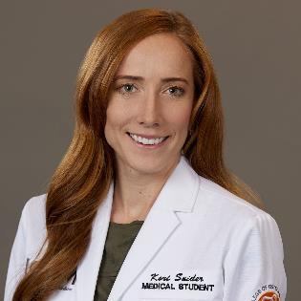
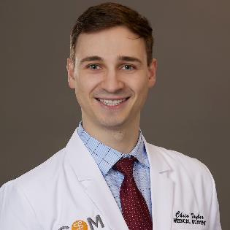
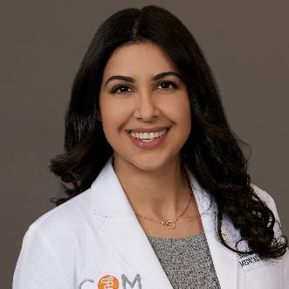
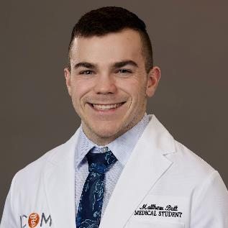
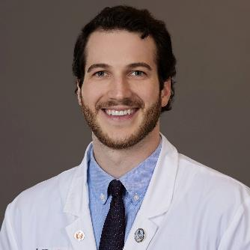
Executive Director-National Liaison:
Nahleh Koochak, OMS-III
Vice President:
Chris Taylor, OMS-III
President: Kori Snider, OMS-III
Secretary/Treasurer: Matthew Butt,
OMS-III
Historian: Thomas Conrad,
OMS-III

Slide 13
References
idahocom.org
https://sites.google.com/icom.edu/sigma-sigma-phi/home

