Slide 1
Kappa Chi Chapter at Kansas COllege of Osteopathic Medicine

Slide 2
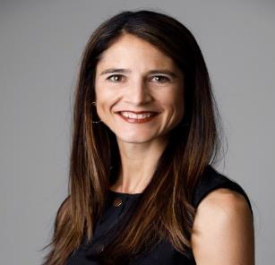
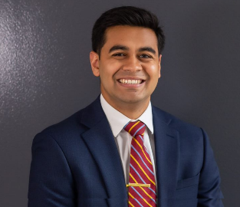
Organization so far
Chapter Advisor: Dr. Angela Carrick, DO, FACOEP, FACEP
Chapter President: Gibran Merchant, OMS-II
Chapter Vice-President: Prarthna Shah, OMS-II

Slide 3
Qualification for Membership – Kappa Chi
Due to the pass/fail nature of grading at the Kappa Chi Chapter, the maintained scholastic standing shall be not less than 80% overall.
Students must have no infractions with Student Progress (either academics or professionalism).
Those eligible will be invited to fill out application for consideration of membership
Application will be evaluated by Chapter Advisor, Dean of Student Affairs, Chapter President and Chapter Vice-President

Slide 4
Application Questions
Please describe a scenario where you have organized or led a service opportunity and/or personally made an impact at a site of service. 250 words or less.
How do you plan to contribute to the maintenance and development of Sigma Sigma Phi to ensure the organization continues to uphold its principles and teachings? 250 words or less.
Explain how you plan to promote scholastic excellence and foster fellowship among your fellow students within the fraternity. 250 words or less.
Describe an instance where you have actively sought to understand and connect with the KansasCOM community (faculty members, staff or students). How do you believe this experience reflects the spirit of Sigma Sigma Phi's mission? 250 words or less.

Slide 5
Example Rubric to assess questions
Score | Keywords
5 | Vivid description, detailed setting, clear purpose/goals, engaged participants, significant personal impact, specific actions/outcomes, exemplary leadership strategies
4 | Clear description, outlined setting, defined purpose/goals, engaged participants, positive personal impact, mentioned actions/outcomes, effective leadership strategies
3 | Basic description, mentioned setting, purpose/goals mentioned, involved participants, general personal impact, some actions/outcomes mentioned, basic leadership strategies
2 | Vague description, limited setting details, unclear purpose/goals, minimal participant involvement, vague personal impact, few actions/outcomes mentioned, limited leadership strategies
1 | Inadequate description, lacking setting details, unclear purpose/goals, minimal participant involvement, no personal impact mentioned, no actions/outcomes mentioned, no evident leadership strategies
0 | Completely missing or irrelevant response

Slide 6
Plan so far
Received 39 applications
First cohort will have a total of 22 students
Plan to complete evaluation of applications by September 5th
Plan to have initiation ceremony 3rd week of October

Slide 7
Kappa Chi Goals
Community outreach and Service: We will plan on engaging with the community around us through individual service projects and as a fraternity
Service Goal: 1 themed service opportunity per trimester (Example: Week-long volunteering at local food bank)
Professional Development: Host speakers and panels to provide networking opportunities for members
Sense of Belonging: Create a sense of camaraderie amongst students with similar goals and interests

Slide 8
THANK YOU
If you have any suggestions on running our new chapter/ideas on implementing goals – please let us know!
Gibran Merchant – gmerchant@mail.kansashsc.org
Prarthna Shah – pshah2@mail.kansashsc.org

