Slide 1
SIGMA SIGMA PHI: Lambda Chapter - Cleveland Ohio University Heritage College of Osteopathic Medicine 2023 Annual Report Cleveland, OH Presented by Kristen Schuch, OMS II ΣΣΦ President for 2023 - 2024

Slide 2
Outline
Lambda Chapter Structure
Leadership
Membership
Community Service
Spring 2023 Inductions
Plans for 2023 - 2024

Slide 3
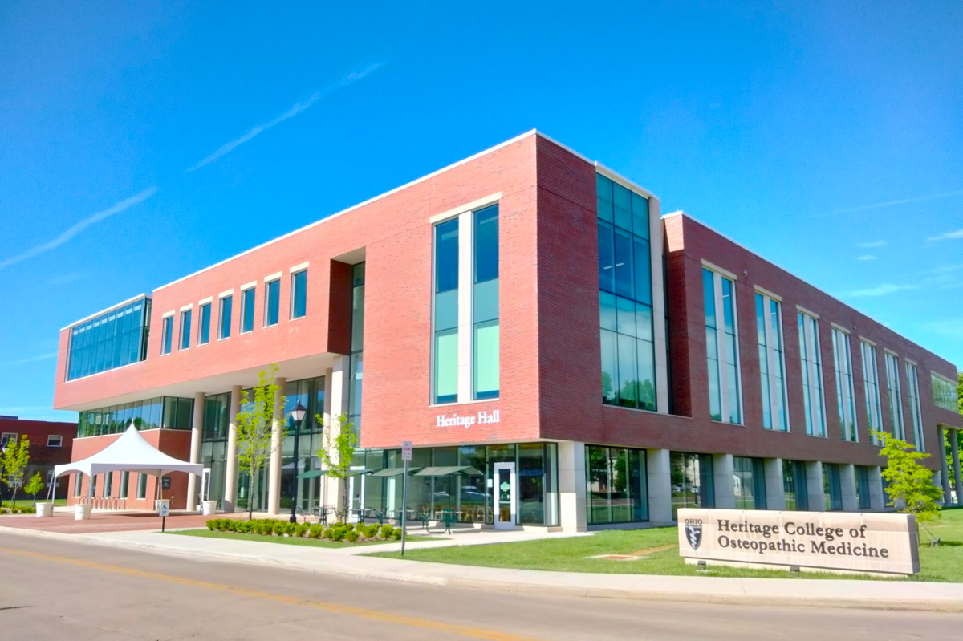
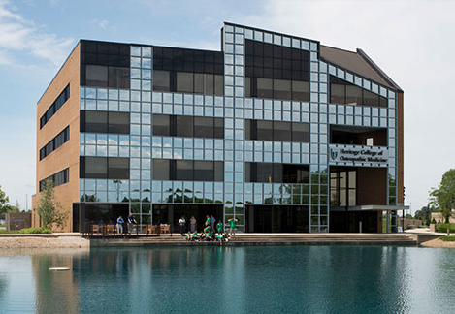
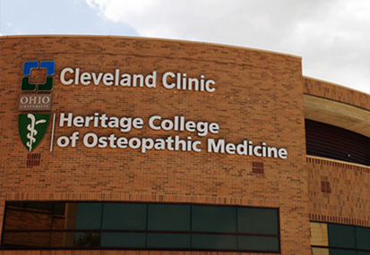
Lambda Chapter
Main Campus
Athens, Ohio
Additional Campuses
Dublin, Ohio
Cleveland, Ohio
Athens
Cleveland
Athens
Dublin

Slide 4
Leadership
2022-2023 Cleveland Executive Board
President: Maya Farhat, OMS-II
mf489520@ohio.edu
Vice President/Secretary: Sara Gier, OMS-II
sg249716@ohio.edu
Treasurer: Rachel Cuellar, OMS-II
rc762316@ohio.edu

Slide 5
Leadership
2023-2024 Cleveland Executive Board
Elected in March 2023
President: Kristen Schuch, OMS-II
ks616617@ohio.edu
Vice President: Xavier Soehnlen, OMS-II
xs278721@ohio.edu
Treasurer: Marisa Tandy, OMS-II
mt619221@ohio.edu
Secretary: Marisa Vislay, OMS-II
mv656021@ohio.edu

Slide 6
Membership
Recruitment
End of fall term (2022) for Class of 2025 and 2026
Emphasis on:
Community Service
Leadership
Academics
Must be in good academic standing with OU-HCOM
Must pass all courses without reassessment
OMS-I, OMS-II: members must average at least a minimum of 80% between components 1 and 2 of the syllabus each semester
OMS-III, OMS-IV: must pass all rotation evaluations, COMAT, and rotations

Slide 7
Membership
As of Spring 2023
Cleveland Campus
Class of 2023: 9
Class of 2024: 11
Class of 2025: 8
Class of 2026: 8
Dublin Campus
Class of 2023: 19
Class of 2024: 18
Class of 2025: 16
Class of 2026: 9
Athens Campus
Class of 2023: 28
Class of 2024: 32
Class of 2025: 25
Class of 2026: 11

Slide 8
Community Service
Service Hours for Membership
OMS-II: 12 hours per semester
OMS-III & OMS-IV: 4 hours per semester
New inductees (OMS-I or OMS-II): 6 hours per first semester
Past Service Projects
Project Linus – Fall 2022
D.O. Day of Service – Spring 2023
Cleveland Metroparks Acacia Reservation Stream Clean-Up in Lyndhurst, OH
Virtual Cards for St. Jude Children’s Research Hospital
Made virtual greeting cards for hospitalized children

Slide 9
Project Linus
Non-profit organization providing homemade blankets to children in need
“Providing Security through Blankets”
Hand-make fleece tie blankets for children who are seriously ill, traumatized, or otherwise in need
Blankets are distributed to children's hospitals, shelters, and social service agencies
Collaborated with multiple clubs (SSP, Pediatrics, Family Medicine, etc.) from all three of our campuses!
Service and recruitment event

Slide 10
ΣΣΦ Inductions
Induction Ceremony in February 2023
10 new members in Cleveland
Class of 2026: 8
Class of 2025: 2
Total Cleveland Campus Members as of Spring 2023
Class of 2023: 9
Class of 2024: 11
Class of 2025: 8
Class of 2026: 8

Slide 11
Plans for 2023 – 2024
Fall 2023
Student Organization Fair
Project Linus Service Project
Information session for potential new members
Applications
Spring 2024
Induction Ceremony
D.O. Day of Service/Service Project
Fundraiser – Dress Down Day
Elections
Additional service opportunities are made available to members as they arise

Slide 12
Thank You!
Kristen Schuch, OMS-II
ks616617@ohio.edu

