Slide 1
Mu Chapter Western University
College of Osteopathic Medicine of the Pacific (COMP)
Pomona, CA
SIGMA SIGMA PHI
NATIONAL MEETING
2023

Slide 3
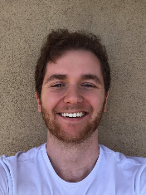
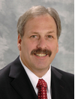
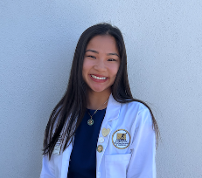
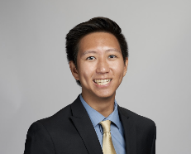
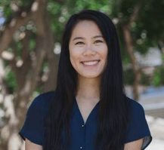
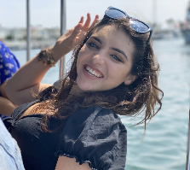
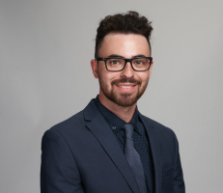
Current Officers & Faculty Advisors
President
Kaylynn Conant
Vice President
Nicholas Oo
Research Coordinator
Ira Glassman
Faculty Advisor:
Dr. David A. Connett, D.O., FACOFP
Administrative Assistant:
Roxanne Gonzalez
Secretary
Jolene Chan
Treasurer
Kelly Delaney
Service Coordinator
David Zitser

Slide 4
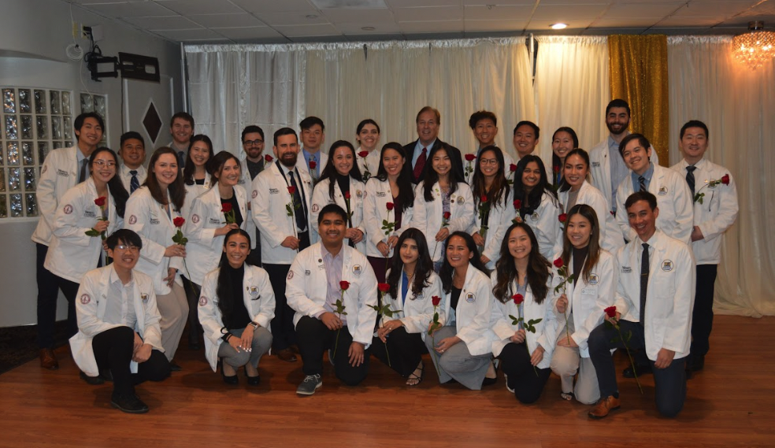
Membership
Class of 2025 and Class of 2026

Slide 5
Chapter Goals
To further the science of osteopathic medicine and its standards of practice
To preserve the meaning of and encourage scholastic excellence and community service
To continue a high degree of fellowship among its students
To cultivate relationships and understanding between the student bodies and officials, such as Faculty members of our Colleges
To foster allegiance to the American Osteopathic Association
To perpetuate Sigma Sigma Phi by preserving the principles and objectives of the organization
To meet the needs of underserved populations in Pomona, California and the Greater Los Angeles area

Slide 6
Membership Requirements
2015: 52
2016: 59
2017: 53
2018: 50
2019: 54
2020: 37
2021: 50
2022: 44
2023: 40
2024: 32
2025: 28
2026: 11
According to the National Sigma Sigma Phi Constitution:
Candidate must have completed at least one semester of school.
Candidate must have a GPA above 3.0 (>88%) to be considered for membership.
Membership is limited to 20% of the class.
OMS-I and OMS-II students are required to participate in at least 20 hours of community service activities per school year.
Members must record at least 15 “obligated” hours per school year for events in which they are obligated to attend (e.g. service learning and community service).
Members must record at least 5 “non-obligated” hours per school year for events hosted by Mu Chapter (e.g. Western University Vaccination Clinic).
Students granted membership in their second year must participate in a total of 40 hours of service by the end of the year, with no more than 20 hours from the first year and no more than 30 “obligated” hours.

Slide 7
Application Process
Application process takes place only during the FALL semester on the final week before winter break.
SSP admission committee will meet and decisions regarding admission/rejection will be made in no later than 14 days.
Notices of acceptance or rejections will be sent out via email in January.
Applicants who are not accepted by the admission committee based on the primary application have 5 days after receiving the notice to appeal.
Induction will occur during the spring semester
All accepted applicants must pay a $90 membership fee prior to induction.

Slide 8
Expulsion
Active/honorary members may be expelled from SSP and have all rights revoked by the local chapter governing body if any of the following occur:
Failure to comply with rules as laid down by the Constitution & By-laws of the fraternity
Conspiracy against another member
Conduct unbecoming of a physician or member
Violation of Code of Ethics of AOA
Failure (<70%) of ANY required course in the curriculum WITHOUT evidence against personal fault.
(ex. Death in the family, debilitating health crisis)

Slide 9
Major Events
NEW - Urban Mission Community Garden - est. 2023
NEW - Pomona Farmers Market - est. 2023
NEW - INSAN Feeding the Homeless - est. 2023
NEW - Pomona Farmers Market - est. 2023
INSAN Free Clinic - est. 2022
Western University Vaccination Clinic - est. 2022
Care Harbor LA - Hopefully Re-established 2023

Slide 10
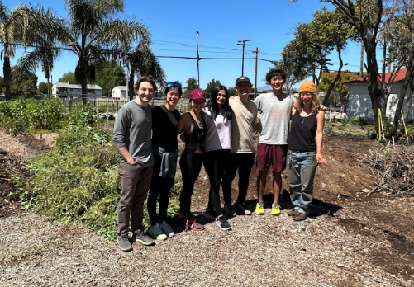
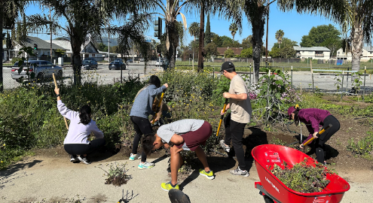
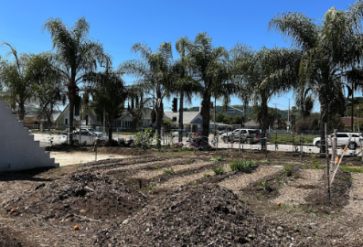
Urban Mission Community Garden
Community garden a few blocks away from campus that provides food, healthy living education, and other enriching services to the local community
Goal is community outreach and with sustained relations

Slide 11
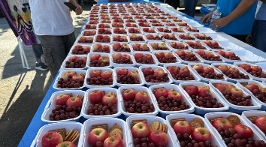
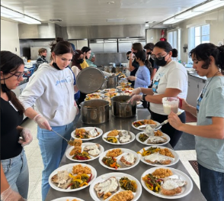
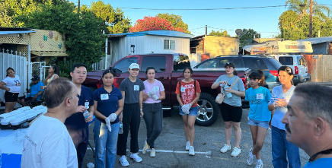
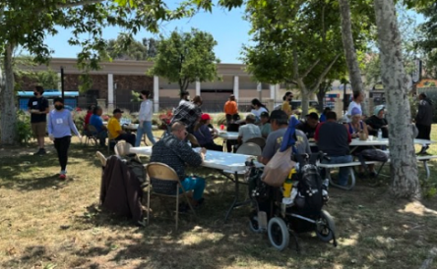
INSAN Feeding the Homeless
INSAN Foundation's INSAN for Humanity is a humanitarian and educational effort to help those around us who are the most vulnerable like children, homeless, and seniors.
Cultivate relationships with local organizations with matching goals of helping the local community

Slide 12
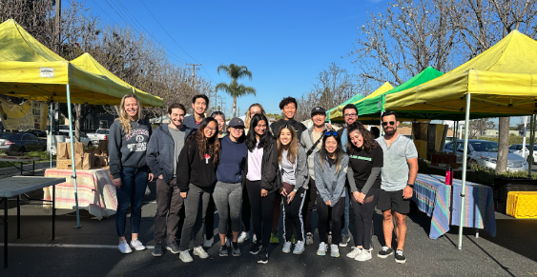
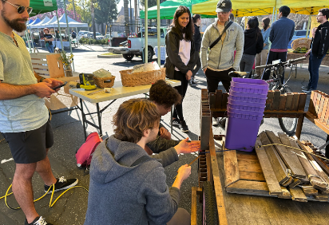
Pomona Farmers Market
Local farmers market a few blocks away from campus
Occurs weekly
Goal is community outreach and serving the underserved areas around our campus

Slide 13
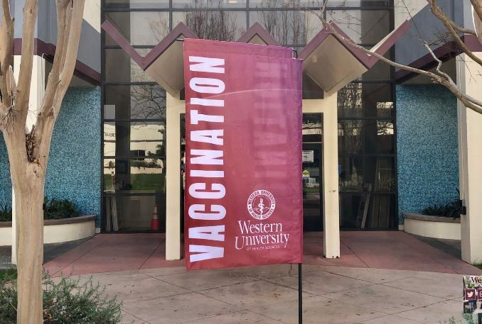
WesternU Health - Vaccination Clinic
Helping both our local community and school, we provide Flu Vaccinations in the fall to help limit the spread!
Hands-on clinical experience
Patient education
Commitment to the community
Increase vaccination rates in underserved communities and LA county!

