Slide 1
Sigma Sigma Phi Psi Chapter
Middletown - Satelite
\
\
Annual Chapter Report - 2023

Slide 2
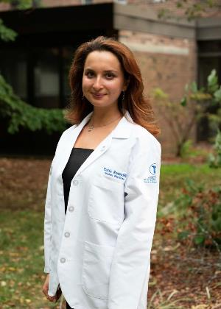
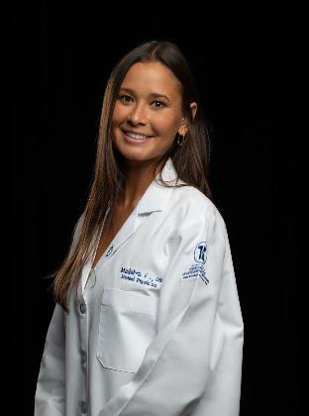
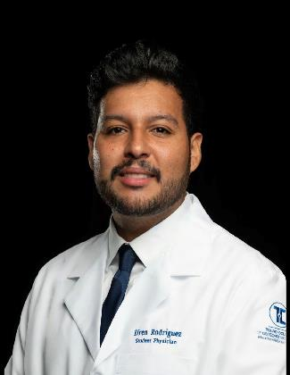
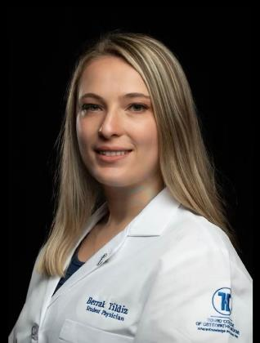
2023-2024 Executive Board
President Yulia Rosenfield
Vice President
Student Name
Secretary Student Name
Treasurer Student Name
Faculty Advisor: Dr. Kenneth Steier, DO

Slide 3
Application Process
Must have at least a 3.2 cumulative GPA to apply.
Apply for membership in spring of 1st year or fall of 2nd year of medical school
Application is reviewed blindly and scored
Points are given for commitment to service, honors, leadership, activities, work experience, academic performance, and essay
Membership is offered to top-scoring applicants, not to exceed more than 25% of the class (60% of seats available given in spring and 40% given in fall)

Slide 4
Membership Requirements
Maintain a minimum 3.2 cumulative and semester GPA
GPA requirements verified each semester by SSP President with Director of Admissions
Not incur any honor code violations and maintain good standing with the school
Attend all general member meetings
Attendance reviewed by SSP Secretary
Complete 10 hours of community service outside of SSP per semester

Slide 5
Membership Requirements
Serve on one SSP service committee and dedicate 10 hours per semester toward event planning
Attend one national conference or three grand rounds meetings per academic year
Members must submit documentation of outside community service hours, event planning, conference, and/or grand round meetings for verification by SSP secretary
If requirements are not met, members are afforded one month of probation before termination. Additionally, if membership requirements are not met by the end of the preclinical years, automatic termination follows

Slide 6
Chapter Membership
Class of 2022: 35
Class of 2023: 34
Class of 2024: 34
Class of 2025: 36
Class of 2026: fall admission→20
Anticipated Spring admission→9

Slide 7
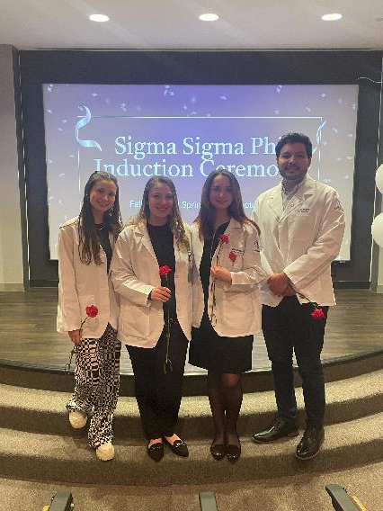
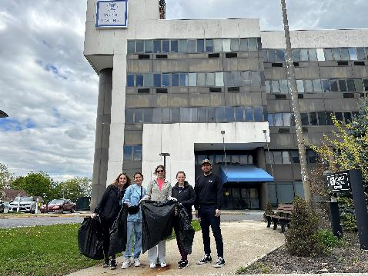
2022-2023 Past Events
Letters to Santa – Make-A-Wish Foundation
Krispy Kreme Fundraiser for Goshen Clinic
Health Fair at the Warming Station
MedAchieve Presentation – “How to Take an H&P”
Earth Day Celebration
Faculty Research Mixer
Local Trail Clean Up

Slide 8
Goals for Psi Chapter – Middletown Satellite
Encourage
Encourage members to volunteer in the community through our chapter-led events or others
Host
Host new service and education events, adding to some of our recurring annual events
Promote
Promote academic excellence
Emphasize
Emphasize importance of professionalism in both academic and work settings
Continue
Continue to foster strong relationships with local organizations
Strengthen
Strengthen the relationship and understanding between student body and faculty and administration

