Slide 1
Oklahoma State college of osteopathic medicine
Sigma Sigma phi – theta chapter

Slide 2
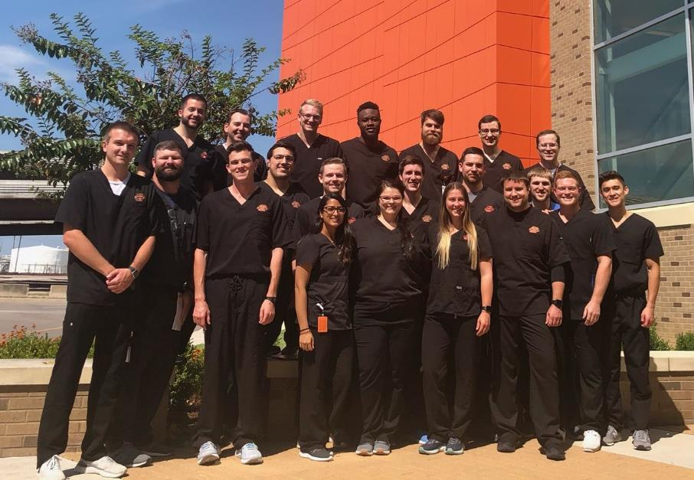
Class of 2022
This year we initiated 22 new candidates out of the class of 2022

Slide 3
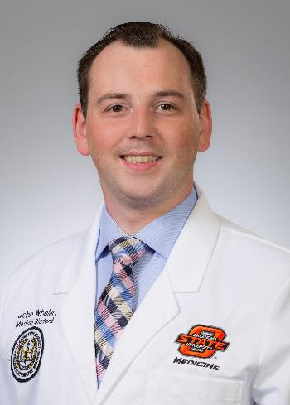
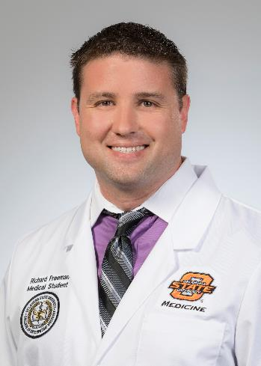
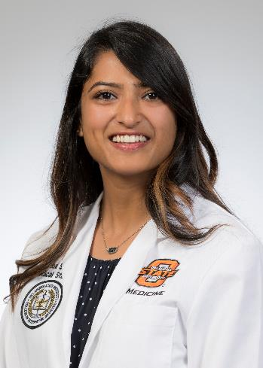
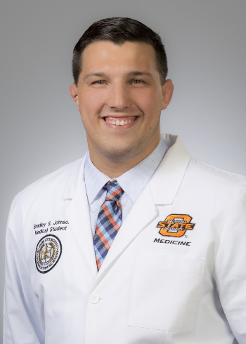
New officers
John Whelan
President
Richard Freeman
Vice President
Sheeba Aga
Secretary
Bradley Johnson
Treasurer

Slide 4
Chapter Advisor
Dr. Harp is our 2019 Chapter Advisor
Dr. Eric Harp is a board certified clinical pathologist
Dr. Harp is also one of our course directors/professors for systems
He is also a members of SSP Theta chapter from his class
Dr. Harp worked vigorously this last year to rewrite our chapter by-laws
We appreciate all the hard work he puts into our chapter

Slide 5
Chapter Goals
Goals:
To raise awareness about our club on campus
SSP has recently been a club that has not been actively involved in school activities. We are sure that the leadership board that has been recently elected will continue to increase the chapter popularity at our campus.
To be actively involved in our community.
Each member served 4 hours of community service at local rural clinic. Additional community service hours were achieved by each member.
To continue the review of biomedical sciences for the first year class. The chapter will also continue providing review of systems for the first and second year medical students starting in the spring.
Last year the reviews were a big success that raised over $600 for the chapter.

Slide 6
Financial status
We are currently not in debt and our chapter has ample funds to complete all cord and pin orders.

