Slide 1
Sigma Sigma Phi
Psi Chapter
Middletown Satellite
Touro College of Osteopathic Medicine
Middletown, NY

Slide 2
Leadership
President: Taylor Sims
Vice President: Jaslyn Maurer
Secretary: Roxana Mehran
Treasurer: Kanza Khalid
Advisor: Dean Kenneth Steier, DO

Slide 3
Admissions
Criteria:
OMS I or II
Minimum GPA of 3.0
History of community service involvement and extracurricular activities
Past leadership experience, research
Process:
Application (Blinded & not blinded)
Each application is read by the executive board members (blinded to the applicant) and needs to be a 75% decision
Top applicants are given to Faculty advisor for review and final decision on applicants.

Slide 4
Membership
Current Members:
Class of 2019: 24
Class of 2020: 20
Class of 2021: 34
Only classes of 2021 and 2022 are eligible for membership.
Anticipated:
Spring 2019: 22 members from Class of 2022

Slide 5
SSP Active Member Requirements
1. Must attend all General Meetings
2. Must serve on at least 1 committee and dedicate at least 10 hours of service/planning hours per semester to their committee
3. Must dedicate at least 10 hours of volunteering outside of SSP activities
4. Must maintain 3.0 GPA or higher
5. Must attend one national conference per year. Ex) DO day, OMED, Specialty conferences, etc.

Slide 6
Committees
Education Committee: School Lectures with other organizations, Science Experiments with Students, School visits
Philanthropy Committee: Fundraisers, Raise money for Make-A-Wish Foundation
Community Outreach Committee: Faculty and student soccer games, Kickball Tournament, Orange County Health Department Events, Health Screenings
Medical Service: Health fairs, Blood pressure screenings, flu shots
Mentor/Mentee Program Coordinators
Teaching Assistant Coordinators

Slide 7
What we have done so far:
Led school tours and panels during open house
Set up mentor-mentee program pairing 1st year students with 2nd year students and master students with previous master students
Mock practical exams for Anatomy, Physical Diagnosis/OSCE, and OMM
Set up TA program where 2nd year students hold reviews and tutor the 1st year students
Started a Medical Spanish organization aimed towards closing the language gap between Spanish-speaking patients and their medical team
Worked with Med Achieve to come up with a program called “Brain Booster” which taught high school students about medical school related subjects

Slide 8
What we have done so far:
Worked with Read4Peds where medical students went to local schools and read to children
Created a school garden to emphasize the importance of healthy choices. Local elementary schools have also visited the garden to help plant and water the vegetables
Partner with Farm to table program through Cornell Extension to provide nutritional education to K-12 students in the Hudson Valley
Partner with the Orange Country Department of Health to teach local high school health classes and promote “Drink Water Week”.

Slide 9
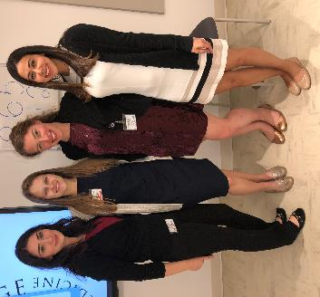
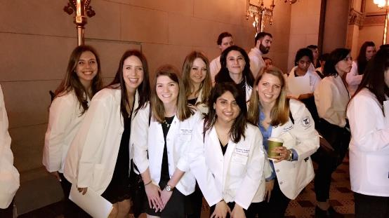

Slide 10
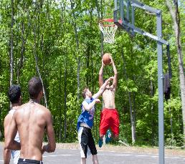
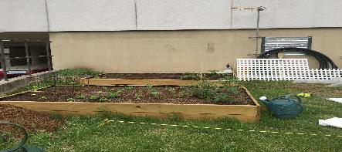
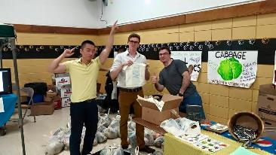
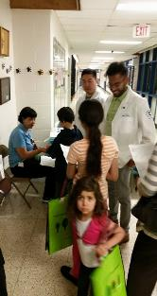
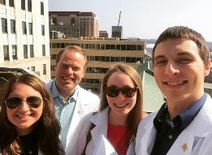
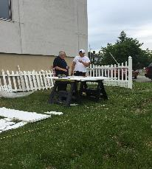
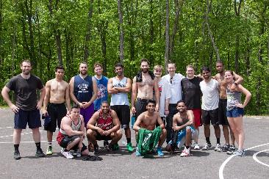

Slide 11
Looking forward to the 2018-2019 school year:
Plan more Medical Spanish Seminars
Plan fundraising opportunities to buy books for Read4Peds
Plan Field Days at local schools to emphasize the importance of healthy choices
Board prep speakers and rotation panels
Continue with TA program and mentor-mentee
Plan to sponsor a child from the Make-A-Wish Foundation
Plan faculty and student soccer tournament

Slide 12
Goals for Psi Chapter-Middletown Satellite:
Help students to achieve academic excellence through our programs and collaborations
Emphasize the importance of professionalism in both the academic and professional settings
Continue building relationships with local organizations that will last for many years to come
Serve as the face of TouroCOM Middletown and make our presence known in the Hudson Valley

